Slide 1
Welcome to Bootstrap:Algebra!
Please fill out the Form at: bit.ly/PreBootstrapPD
Create a tri-fold name plate w/paper and markers.
Notes:
Bootstrap:Algebra Playlist - spoti.fi/BootstrapAlgebra
General PD Playlist of Feel Good Music - spoti.fi/PresoMusic

Slide 2
Bootstrap:Algebra

Slide 3

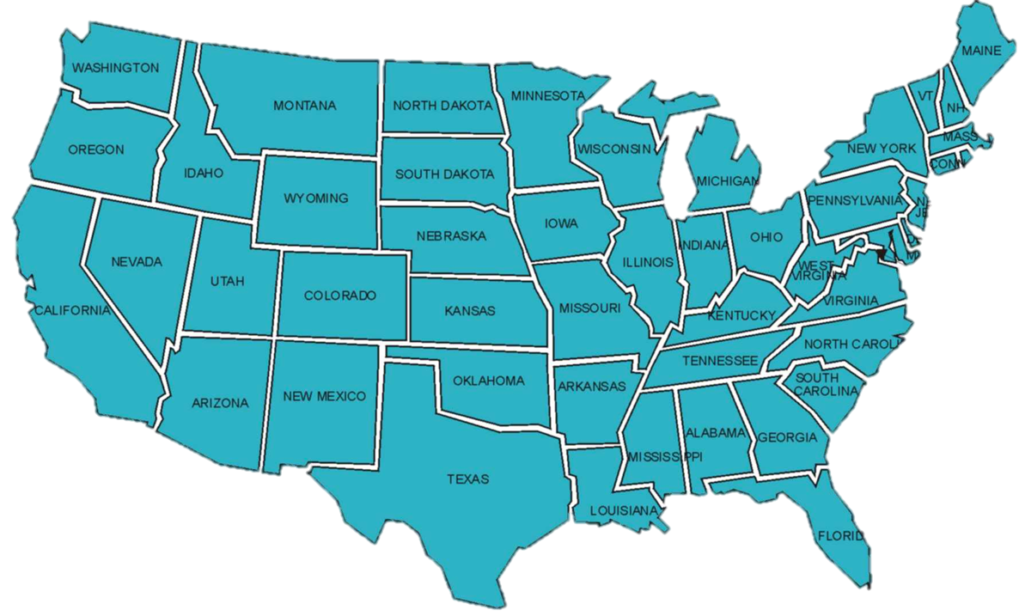
25 Thousand Students Annually
43% Girls and Young Women
46% African-American or Latino
Notes:
KEY POINTS
-Intro should take 20 minutes max!
-Founded in 2005
-many of Emmanuel’s students struggled with basic algebra, and particularly the concept of functions.
-Taught to 20,000+ students
Proud of Equity
MATH CONNECTIONS
POWERFUL QUOTES/PHRASES
When he started teaching, he realized that many of his students struggled with basic algebra, and particularly the concept of functions. He realized he didn’t truly understand functions himself until working as a programmer, and that there must be a way to use programming to teach algebra. Thus, Bootstrap was born.
Bootstrap is now the second largest provider for in-school CS education for girls and young women, and kids who self-report as African American or Latinx
PURPOSEFUL MISTAKE

Slide 4
Goals for this Workshop
Explore the challenge of algebra
Get comfortable with programming
Work through the entire curriculum
Discuss pedagogy
At the end: discuss integration
Notes:
KEY POINTS
-Start with the cognitive challenges of Algebra for our students
-Poll audience: How many of you have done programming before? If not, that’s ok.
-Curriculum requires zero programming experience
-Work through entire curriculum as a student and create a video game
-Focus on Pedagogy throughout
-Wear teacher and student hat throughout
-
MATH CONNECTIONS
POWERFUL QUOTES/PHRASES
-This means that when we’re teaching a lesson and asking you “easy” questions, it’s not because we think you’re stupid or talking down to you, we’re modeling what it would look like to teach the lesson

Slide 5
Agenda
Theory
Overview
Practice
Pedagogy
Notes:
KEY POINTS
MATH CONNECTIONS
POWERFUL QUOTES/PHRASES

Slide 6

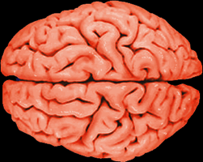


Algebra Matters
Notes:
Equity implications of these point
KEY POINTS
-Brain:Algebra is a child’s first exposure to formal abstraction
-GATE:Algebra is the Gateway to the STEM fields(Science, Technology, Engineering, and Math)
-$$$ - Algebra is strongly correlated to future income
-Tests – Schools and Stakeholders put a lot of weight on Algebra test scores
MATH CONNECTIONS
POWERFUL QUOTES/PHRASES
As teachers, we get asked all the time “when will I ever use this? Algebra isn’t important, right?” I know you as math teachers know why algebra is important, but here’s four quick talking points that we use when talking with parents, or other adults:
Brain: Piaget identifies algebra as a crucial step in the divide between concrete and formal operational thinking.
GATE: Obviously if a student doesn't understand algebra, they're not going to get calculus, but if they haven't mastered functions and variables, they won't be able to study projectile movement in physics, they won't be able to work with chemical equations, or study population trends in biology.
That’s why we say If you care about STEM, you need to care about algebra.
$$$: A 2004 study showed that out of all the classes a student takes in high school, performance in the first year of algebra was most strongly correlated with their future income.
Tests: No matter your opinion of the high-stakes standardized testing that happens today, it's a major focus of parents, teachers, students, and politicians alike. And when we hear politicians talk about standardized testing, which test are they typically focused on? the reading comprehension tests or the math tests? Mostly the math, and particularly the algebra and word problem sections of those tests. If we want to make a difference in education, we need to start with algebra.
So for all these reasons algebra is one of the most important courses taught in schools today. But how do your students, and we as a nation, feel about algebra? [Pause, go to next slide]

Slide 7

A train leaves Chicago at 6pm, traveling East at 70mph…
Notes:
Update Freddy Krueger slide? Maybe new Pennywise from IT movie?
KEY POINTS
-Unfortunately, Algebra scares the hell out of most americans!
-Students and Teachers have math anxiety or Math Trauma(Jo Boaler) research
-
MATH CONNECTIONS
POWERFUL QUOTES/PHRASES
Why do we have a national fear of algebra? To understand, we need to think about how math is taught to young students

Slide 8
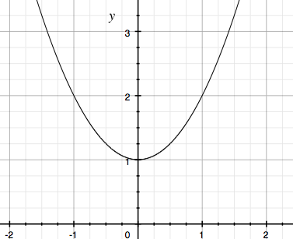
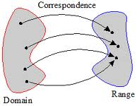
Why is Algebra so Hard?
☐ = 4+2
f(x) = x+2
6 = x+2
6 = ☐+2
process
object
x | f(x)
-1 | 2
0 | 1
-1 | 2
f(x) = x² + 1
Notes:
KEY POINTS
-When you’re 7 or 8 → 4 + 2 “What’s the answer?”
-When you’re a little older → 6 = _ + 2 “What’s the answer?”
Pre-Algebra → 6 = x + 2 “What’s the answer?”
Structure has changed but process remains the same
Then in Algebra, EVERYTHING has changed. f(x) = x + 2 “What’s the Answer?”
Object - Process duality problem
Other problem is seeing/visualizing the representation of functions
MATH CONNECTIONS
POWERFUL QUOTES/PHRASES
-At age 13 or 14, students have done thousands of math problems, and every single one has given them one goal: get the answer. But there is no answer here, there's not even a question. This is the first huge cognitive hurdle for kids: we're no longer talking about math as a process anymore, now we’re talking about functions: objects, with their own properties. When they reach algebra, math hasn't just gotten harder, math completely changed! We’re no longer asking students “what is the answer?” We’re asking questions like “Is this function linear? Is it exponential?” A HUGE change from the way math has been taught before now. Object - Process duality problem.
Which one of these is “the real function”? They all are! These functions as objects have multiple representations, and the second largest challenge in algebra is realizing how they are all connected. Each representation takes a while to learn, and adding that they are connected - involves even more time

Slide 9
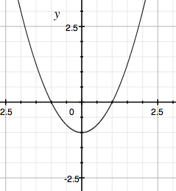
“How many roots does f have?”
x | f(x)
-5 | 24
-3 | 8
-2 | 3
f(x) = x² - 1
Notes:
KEY POINTS
-Demonstrate different representations of functions
-Activity: Raise your hands when you can tell me how many roots the function “f” has?
-Input/Output Table(pause), Symbol Notation(pause) and a Graph
Many students don't think of the graph as the function- the graph is what a function draws. they want the "real" function, usually symbol notation
Struggling Students? They'll typically see this, and pull out some paper and start making an input/output table.
MATH CONNECTIONS
POWERFUL QUOTES/PHRASES
So what's the problem with this, if you're trying to find out how many roots f has? For any finite number of points, there is an infinite number of functions that go through those points. A student can't know how many roots f has with just an input/output table. With this representation, the question isn't just hard, it's impossible. Which is why….

Slide 10
Make representations concrete and connected
Notes:
KEY POINTS
MATH CONNECTIONS
POWERFUL QUOTES/PHRASES
In Bootstrap, our first goal is to make functions and their representations concrete and connected in students’ minds. And this isn't a new idea: The National Council of Teachers of Mathematics has been saying this for years. The common core standards for math is all over this! We know how to help students who are struggling in algebra.

Slide 11


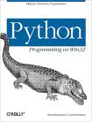

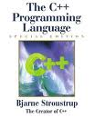
Programming has functions!
Notes:
KEY POINTS
-Programming as a tool to teach math isn’t a new idea
-1960 Seymore Papert published paper on Logo, a programming language developed for children
-Programming has functions
MATH CONNECTIONS
POWERFUL QUOTES/PHRASES
What kind of teacher is usually teaching the C++ or python class in high school? What department are they in? Most likely math.
So, problem solved! We have all these teaching languages, and now every kid is passing algebra with flying colors!(sarcasm)
Which of these is the BEST language?

Slide 12

Programming != Math
But there’s a problem...
1 / 2 = ??
x = 10
x = x+2
foo = 0
function f(x){
return foo++
}
Notes:
Dubinsky 1992, 1995
KEY POINTS
Programming doesn’t always equal math.
Different languages have things called “functions” and “variables”, they behave very differently from functions and variables in algebra.
To teach Algebra, it’s important to choose an Algebraic language
In different languages, there are things that look like numbers but don’t behave like numbers
In different languages, there are things that look like variables but don’t behave like variables
In different languages, there are things that look like functions but don’t behave like functions
IMPORTANT to role play ’foo’
MATH CONNECTIONS
POWERFUL QUOTES/PHRASES
[ (1/x) * x = 1 ]
Here’s a basic expression. Math teachers: is this correct? (Assuming x is not 0.) Of course. But in Python, it doesn’t evaluate to 1, it evaluates to 0! In JavaScript, this evaluates to 0.99999. That’s not mathematical! This is because these languages don’t use numbers. They use floats, or ints, or doubles: things that look like numbers, but behave very differently. Things get even weirder when we add in variables.
[x = x + 2]
Most introductory programming textbook will have a program like this. On the first line I create a value called x, and set it equal to 10. On the second line, I set the value of x to x+2. What is the value of x when the program terminates?
Right, 12! You can write this program in almost any language, and it’s perfectly fine code, but If a student of yours writes this on a math assignment, what's the issue? That kid needs some serious help. That’s because x here isn’t a variable, it’s a place in memory, that can be changed and re-set, unlike variables in math. This issue gets even crazier when we talk about variables!
[foo example]
Here’s some pseudocode: On the first line, I’ve created a value called foo, and set it equal to 0. On the second line I have a function called f, which takes in a variable called x, and totally ignores it. Instead, it just returns foo, incremented by one each time the function runs. In Bootstrap, as a way to make functions concrete and connected for students, we like to have kids act out functions, and that’s what I’d like to do now [take 2 volunteers: foo, and f. foo’s initial value is 0, and evrry time you call f with some number, they’ll point to foo and say “increment”. Foo adds one to his/her current value, and repeats it back to f. Go through f(1), f(2), f(3), then f(3) again, and f(3) again. Thank volunteers.]
So what happened there? Math teachers, are you kind of uncomfortable right now? Is f a function? No! It doesn’t pass the vertical line test! It’s OK for you to feel uncomfortable with this, or even angry: functions, variables: you had these words first!
But what's going on here is that the words functions and variables mean different things for programmers and math teachers. I don’t want you to leave here today thinking that I said “Javascript is bad”, or “Python is bad”: These languages are definitely valuable, depending on what you’re trying to do. However, these languages aren’t mathematical. Just because a language has things called functions, and things called variables, doesn’t mean that they behave like algebra. And if a student is struggling with functions and variables in their algebra class, and you show them functions and variables in programming, things called the same but with very different meanings, it probably won't help, and it might even make the problem worse.
So what is this telling us? if you're using programming to teach math, using a mathematical programming language is crucial. However, as teachers, we know that a great software tool isn't enough. You also need a curriculum, assignments, a final project, exit slips, etc. And that's where Bootstrap comes in.
PURPOSEFUL MISTAKES

Slide 13
Agenda
Theory
Overview
Practice
Pedagogy
Notes:
KEY POINTS
MATH CONNECTIONS
POWERFUL QUOTES/PHRASES

Slide 14
Who is Bootstrap for?
Grades 6-7: First Exposure to Algebra
Grades 8-10: Algebra Enrichment
Grades 11-12: Algebra Remediation
Notes:
KEY POINTS
-Self Explanatory Slide
MATH CONNECTIONS
POWERFUL QUOTES/PHRASES

Slide 15
Bootstrap Materials
Software: In the cloud, or on your machine.
Lesson Plans: Detailed[*] curricula, student handouts, integrated workbooks, and supplemental activities(Open new tab: www.bootstrapworld.org)
Standards: All lessons are aligned to National and State Standards for Mathematics.
Language: Algebraic semantics, simple syntax, rich media and integrated testing
Notes:
KEY POINTS
-Abundance of detailed resources and supplemental materials
- Cloud based
-Algebraic language
MATH CONNECTIONS
POWERFUL QUOTES/PHRASES
Finally, the language that we use is a completely algebraic language, with variables that can’t be reassigned, functions that ARE functions, and a simple syntax that’s easy for students to learn.
We have incredibly detailed lesson plans available online [go to the Bootstrap website, open the algebra notes], and in front of you. [Have them open their workbooks and point out the lesson plans are available in full at the front of the book.] Of course, these are on our website as well, and the links within are clickable. We also offer student hand

Slide 16
10,000 Foot View
Brainstorming, and Circles of Evaluation
Datatypes, Domain & Range
/
9
= f(9, g(2, 3))
*
2
3
Notes:
KEY POINTS
MATH CONNECTIONS
POWERFUL QUOTES/PHRASES

Slide 17

10,000 Foot View
Brainstorming, and Circles of Evaluation
Datatypes, Domain & Range
Defining Functions
Animating your Game
height : Number -> Number
height(1) | 7 * 1
height(2) | 7 * 2
height(3) | 7 * 3
height(t) = 7 * t
Notes:
How do we know the kids are actually getting this?
We do something that most colleges don’t do: code reviews.
KEY POINTS
MATH CONNECTIONS
POWERFUL QUOTES/PHRASES

Slide 18
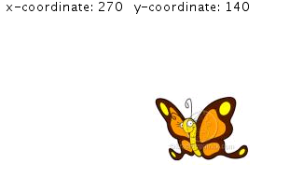
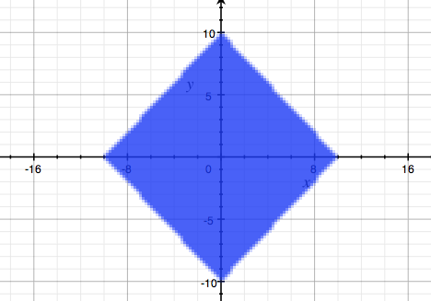
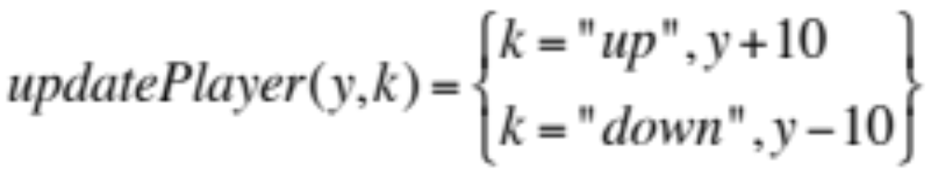

10,000 Foot View
Brainstorming, and Circles of Evaluation
Datatypes, Domain &Range
Defining Functions
Animating your Game
Booleans and Inequalities
Piecewise Functions
0 < f(x) < 640
Notes:
How do we know the kids are actually getting this?
We do something that most colleges don’t do: code reviews.
KEY POINTS
Each unit creates a desire add functionality to their game that creates a NEED to learn more math
Day 1 -Brainstorm video game Give SIMPLE Example(Mouse trying to get the Cheese and avoid the Mousetraps in a Home)
Day 2 -Use that excitement and engagement to intro Circles of Evaluation are a visual and spatial tool for function composition
Day 2 -Use Circles of Evaluation to extend circles of evaluation to cover new data types like strings and images, and introduce the concepts of domain and range.
Day 3 -students start defining their own functions to make basic shapes
Day 4 -by the fourth day, they extend that knowledge to write linear functions and make a rocket fly.
Day 5 – Kids are saying, “What about my game?” And we explain that the same concept of linear functions they just learned can be used in their video game to make their target and danger fly across the screen… and never come back. , “How do I keep my player from going off screen?”
Day 6 – then we introduce Inequalities and Compound Inequalities to help keep Sam The Butterfly safe and on the screen..then they ask “How do I move my player? “
Day 7 – We introduce Piecewise functions to get them to move their characters. Then they ask, “How do I earn points?” “When my player touches the target or danger, nothing happens!”
Day 8 – Need to learn about distance and Pythagorean theorem to get Collision working
Day 9 Code Review/Code Walk is an Industry standard for Computer Science and Engineers
MATH CONNECTIONS
POWERFUL QUOTES/PHRASES
On Day 4, this is when we introduce the most important part of Bootstrap, called the Design Recipe. This is a step-by-step process by which students break down complex word problems into smaller steps to make them easier to solve. First, they declare the name, domain, and range of the function. Software developers call this step “type specification”. Then, they make an input/output table of examples, and show how the function will behave with different inputs. Software devs call this “unit testing”, and math teachers call this “showing your work”. Finally, once they’ve completed these steps, students are ready to define the function. We’re not just filling out worksheets here: because we’re programming computers, we can tie this linear function into an animation, and *actually* see a rocket fly once students have solved this word problem.

Slide 19
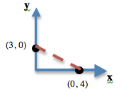
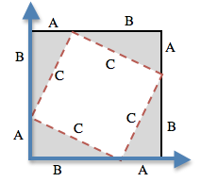
10,000 Foot View
Brainstorming, and Circles of Evaluation
Datatypes, Domain &Range
Defining Functions
Animating your Game
Booleans and Inequalities
Piecewise Functions
Pythagorean Theorem
Game Release Party!
Notes:
How do we know the kids are actually getting this?
We do something that most colleges don’t do: code reviews.
KEY POINTS
Each unit creates a desire add functionality to their game that creates a NEED to learn more math
Day 1 -Brainstorm video game Give SIMPLE Example(Mouse trying to get the Cheese and avoid the Mousetraps in a Home)
Day 2 -Use that excitement and engagement to intro Circles of Evaluation are a visual and spatial tool for function composition
Day 2 -Use Circles of Evaluation to extend circles of evaluation to cover new data types like strings and images, and introduce the concepts of domain and range.
Day 3 -students start defining their own functions to make basic shapes
Day 4 -by the fourth day, they extend that knowledge to write linear functions and make a rocket fly.
Day 5 – Kids are saying, “What about my game?” And we explain that the same concept of linear functions they just learned can be used in their video game to make their target and danger fly across the screen… and never come back. , “How do I keep my player from going off screen?”
Day 6 – then we introduce Inequalities and Compound Inequalities to help keep Sam The Butterfly safe and on the screen..then they ask “How do I move my player? “
Day 7 – We introduce Piecewise functions to get them to move their characters. Then they ask, “How do I earn points?” “When my player touches the target or danger, nothing happens!”
Day 8 – Need to learn about distance and Pythagorean theorem to get Collision working
Day 9 Code Review/Code Walk is an Industry standard for Computer Science and Engineers
MATH CONNECTIONS
POWERFUL QUOTES/PHRASES
On Day 4, this is when we introduce the most important part of Bootstrap, called the Design Recipe. This is a step-by-step process by which students break down complex word problems into smaller steps to make them easier to solve. First, they declare the name, domain, and range of the function. Software developers call this step “type specification”. Then, they make an input/output table of examples, and show how the function will behave with different inputs. Software devs call this “unit testing”, and math teachers call this “showing your work”. Finally, once they’ve completed these steps, students are ready to define the function. We’re not just filling out worksheets here: because we’re programming computers, we can tie this linear function into an animation, and *actually* see a rocket fly once students have solved this word problem.

Slide 20
Agenda
Introduction
Theory
Practice
Pedagogy
Notes:
KEY POINTS
MATH CONNECTIONS
POWERFUL QUOTES/PHRASES

Slide 21
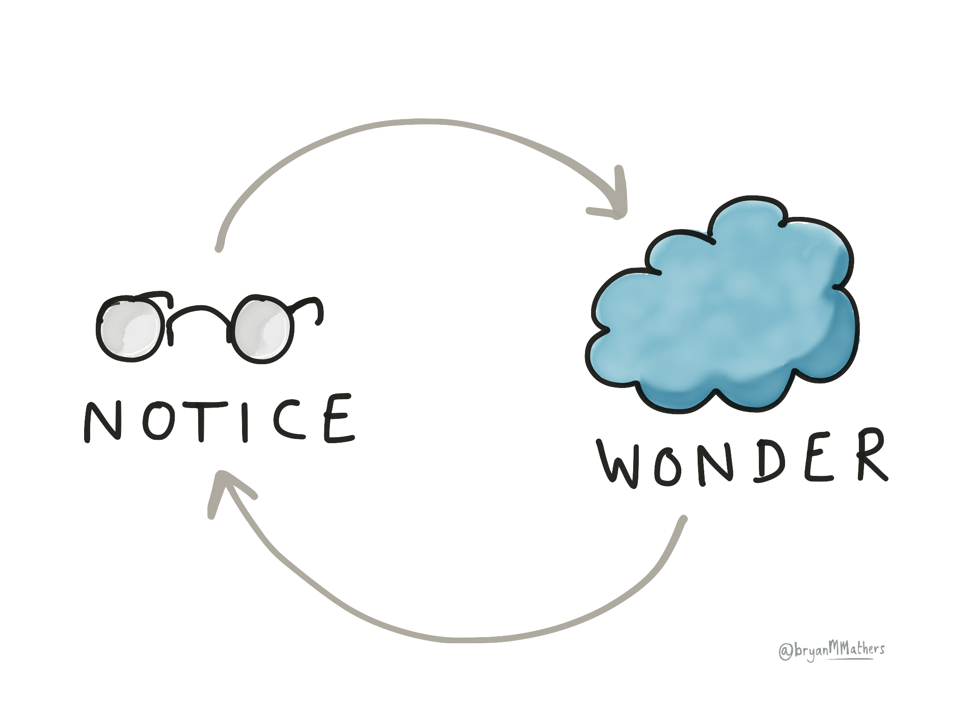
Take a look around the room
Notes:
Notice and Wonder:
Introduce the Notice & Wonder strategy by having teachers look around the room and Notice & Wonder in pairs before sharing out.
-Whiteboards on the wall
Math Practice posters
Jo Boaler Mindset Norm posters

Slide 22
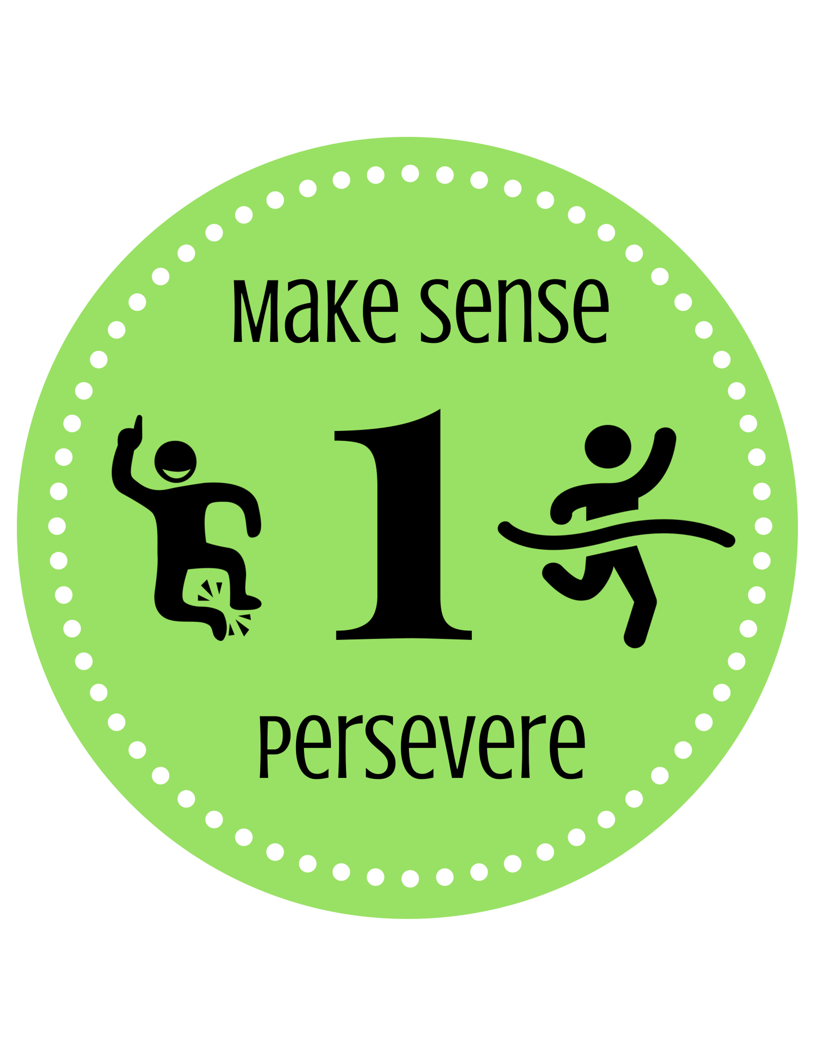

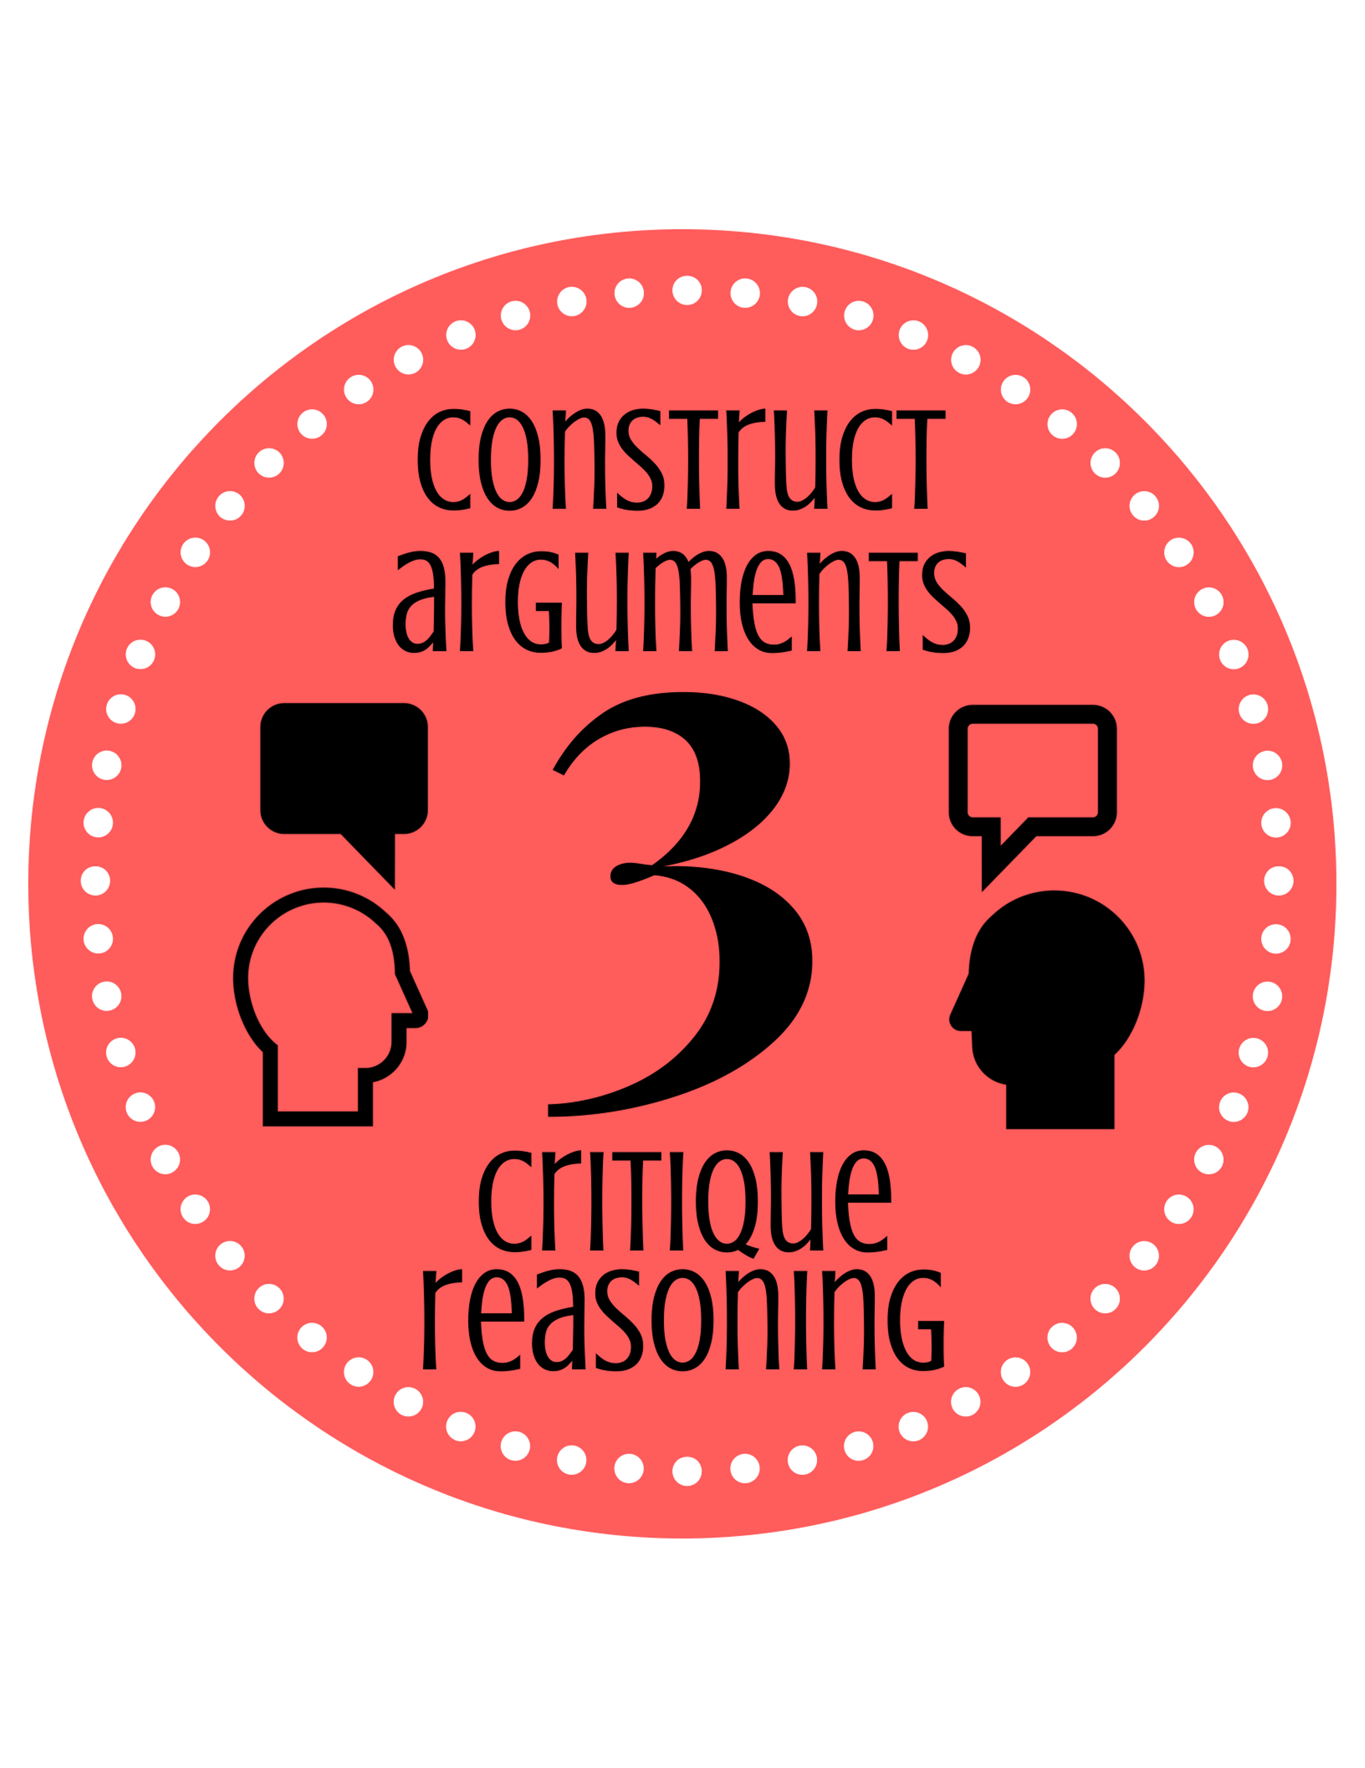
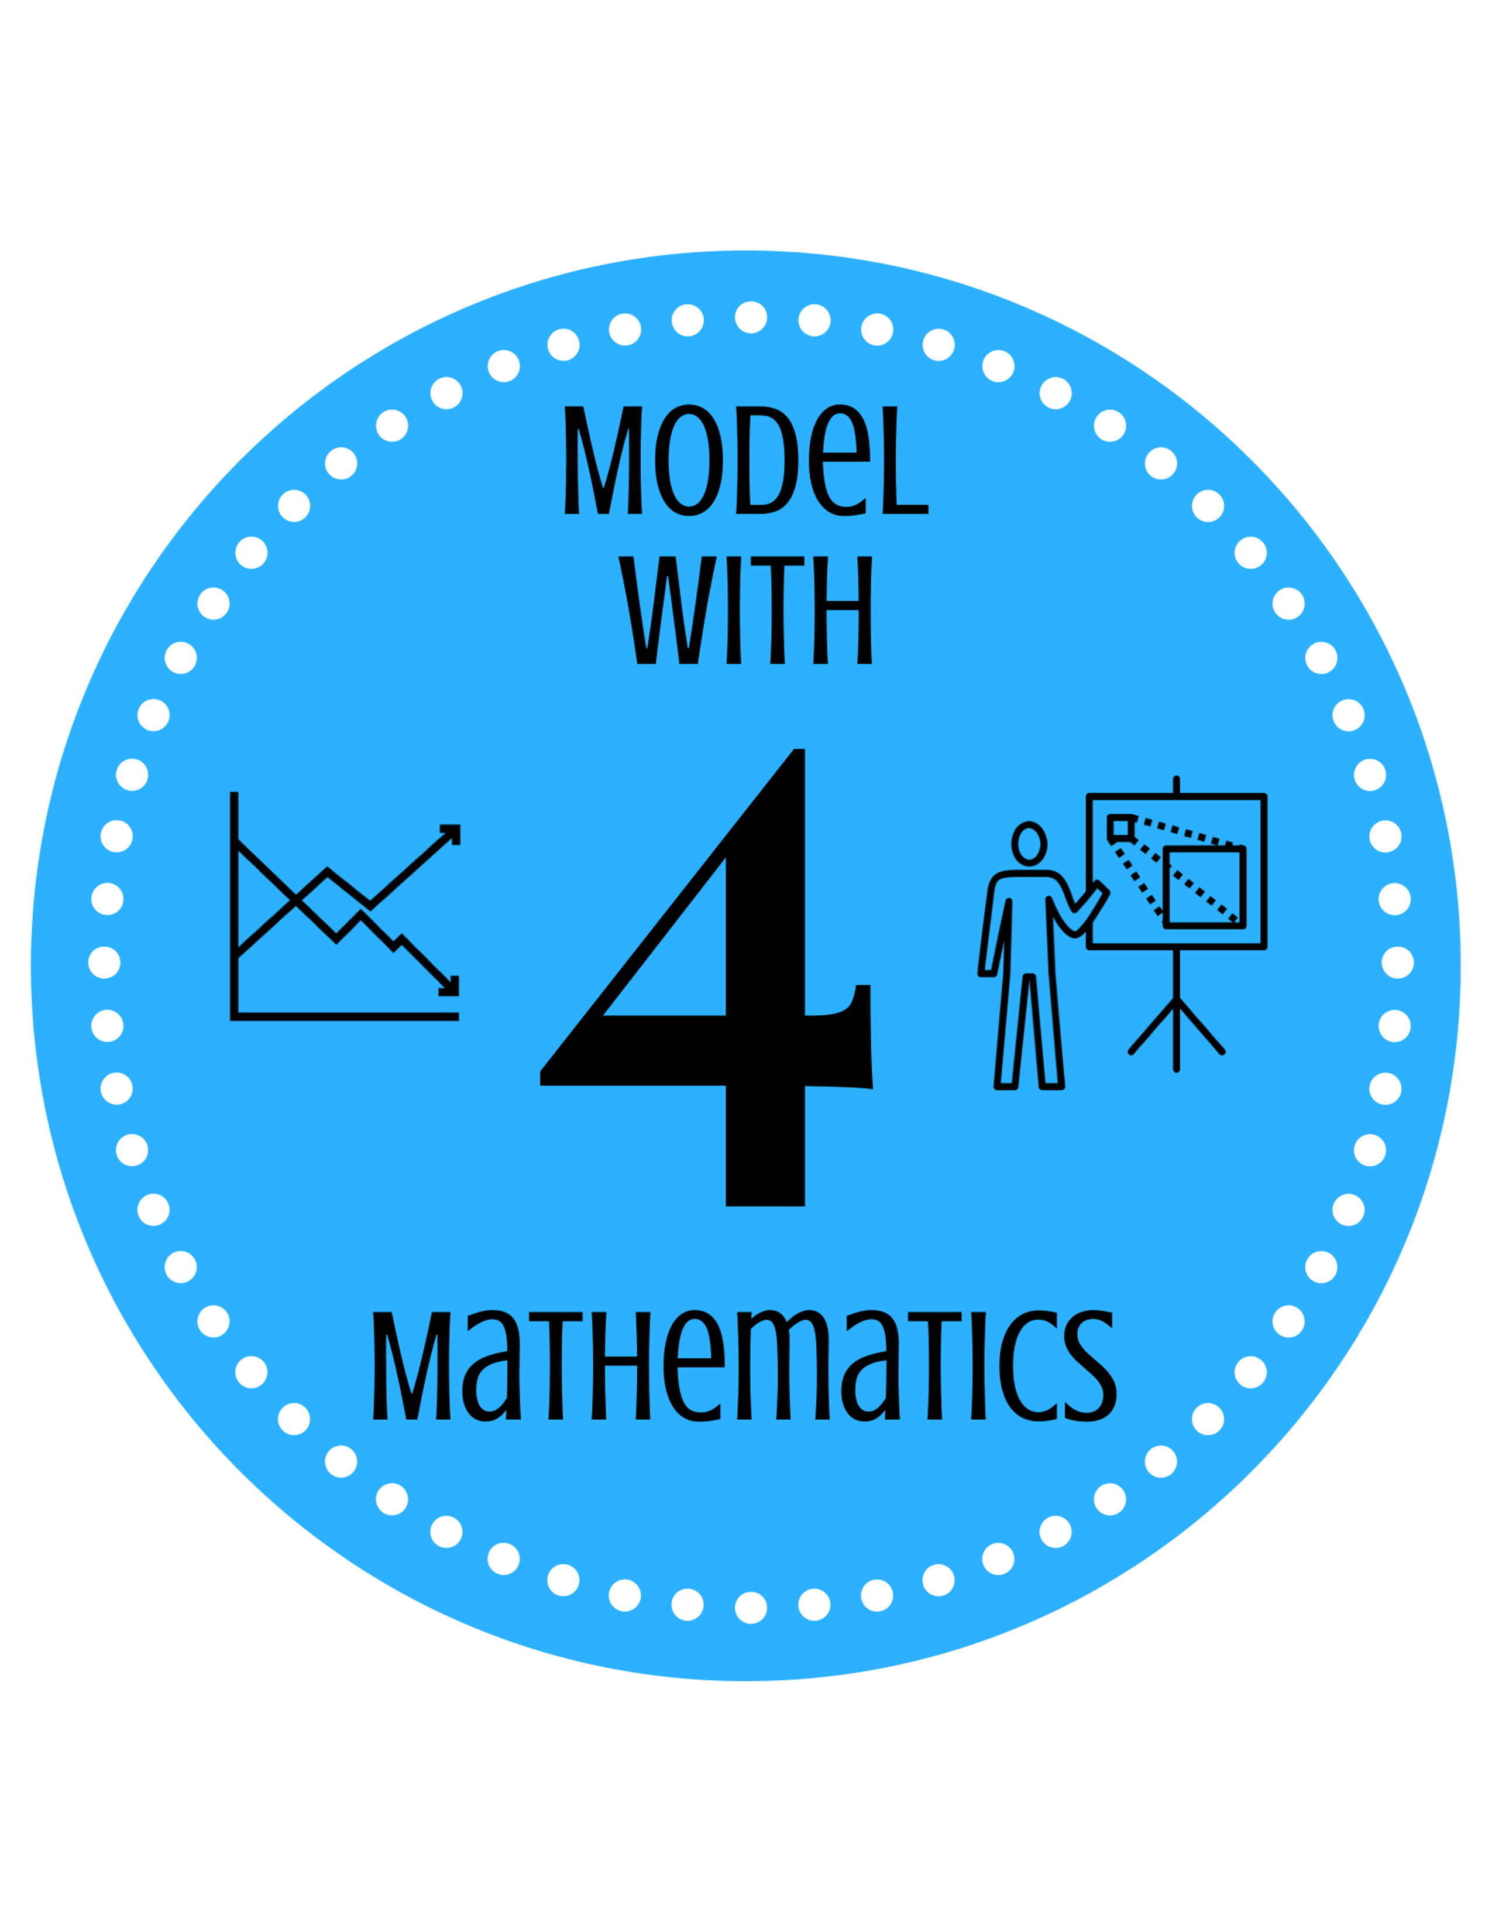
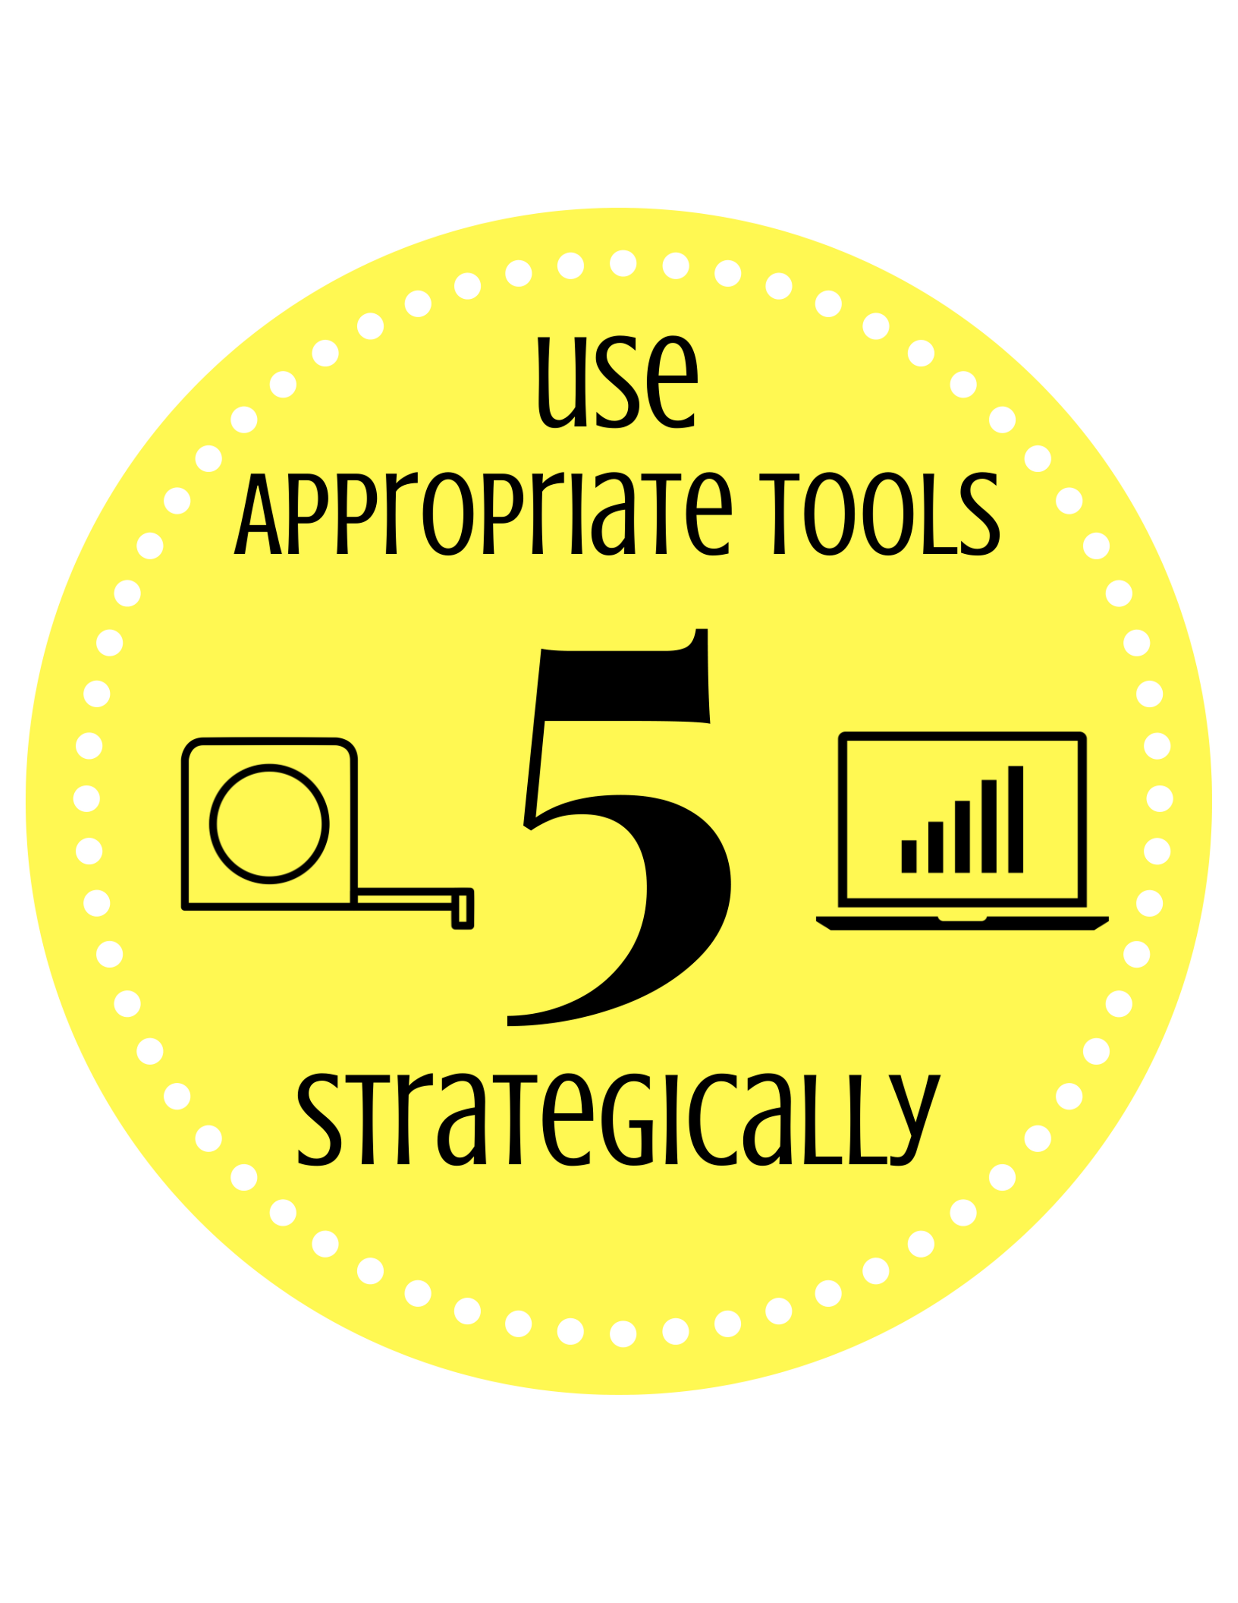

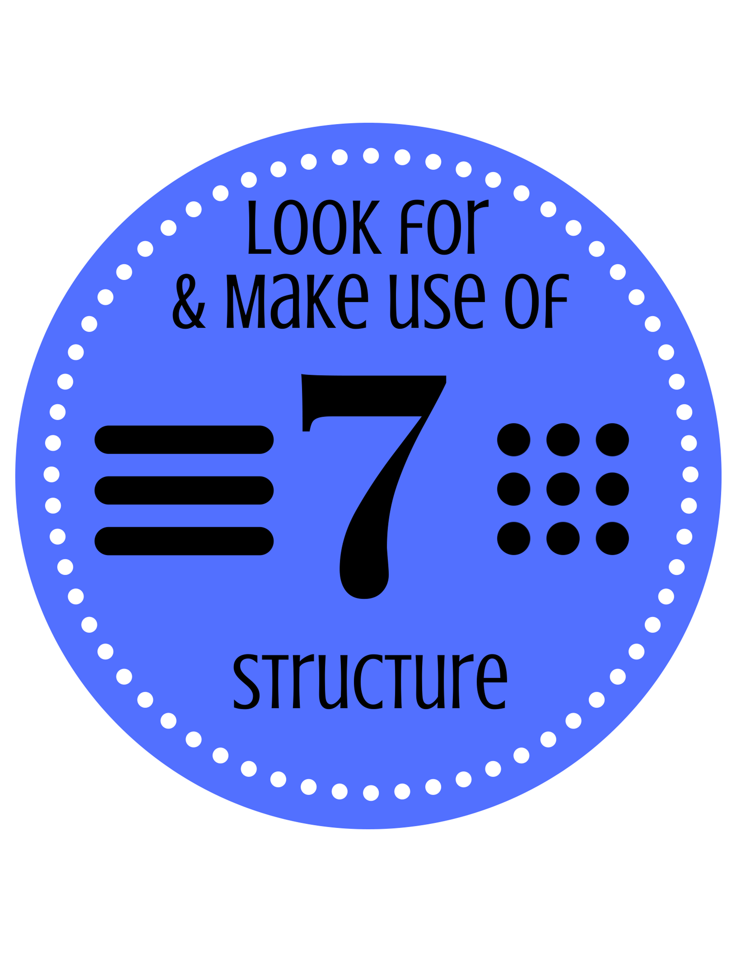
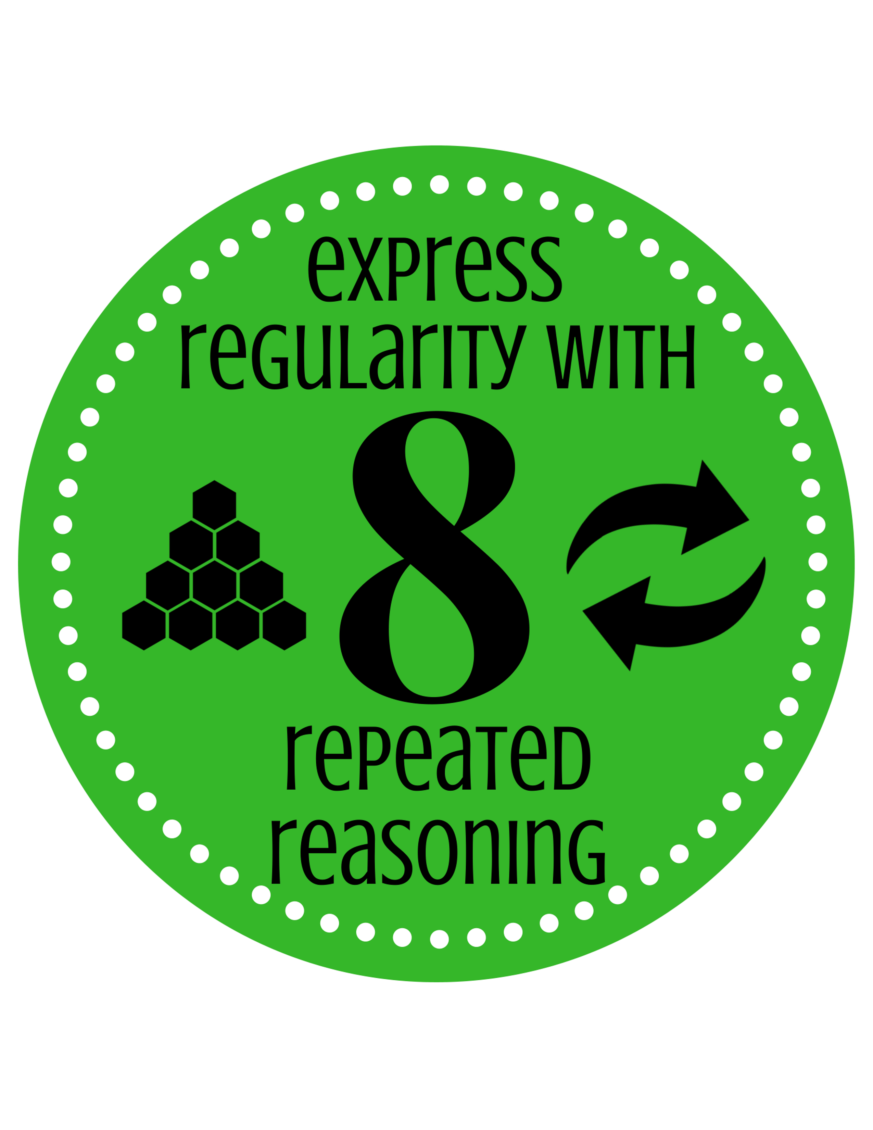
8 Mathematical Practices
Notes:
Options:
Should we intro these 8 MPs and Norms first?
-OR-
Notice & Wonder?
-OR-
Use them the 1st day and then explain during the debrief?

Slide 23
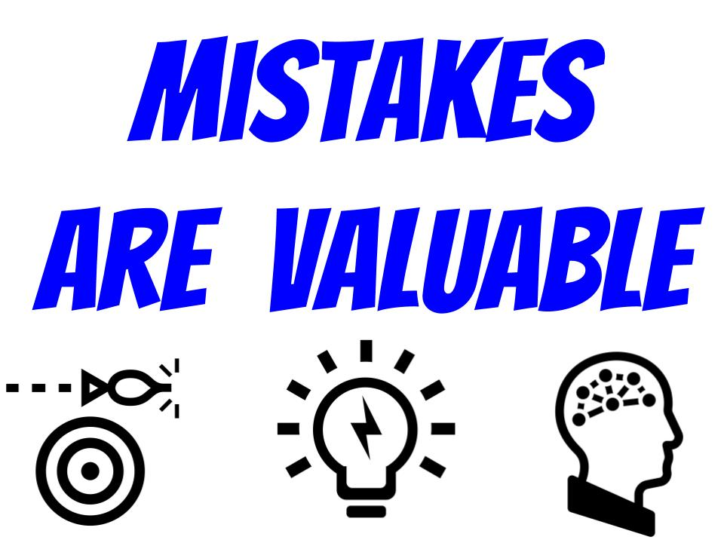
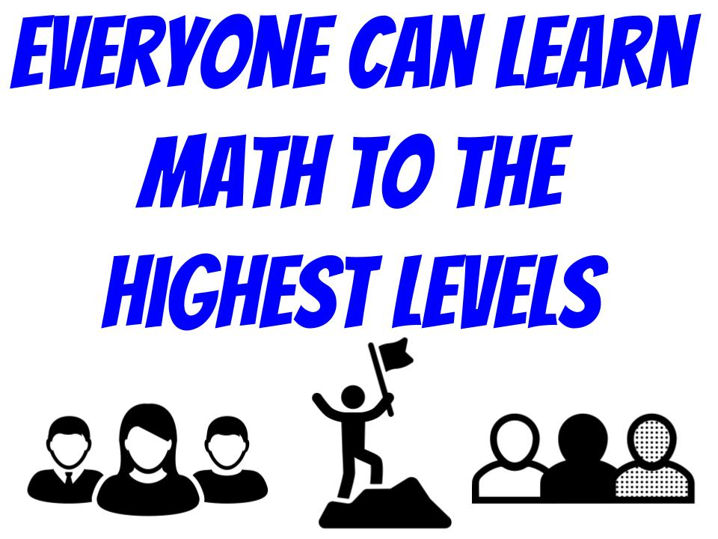

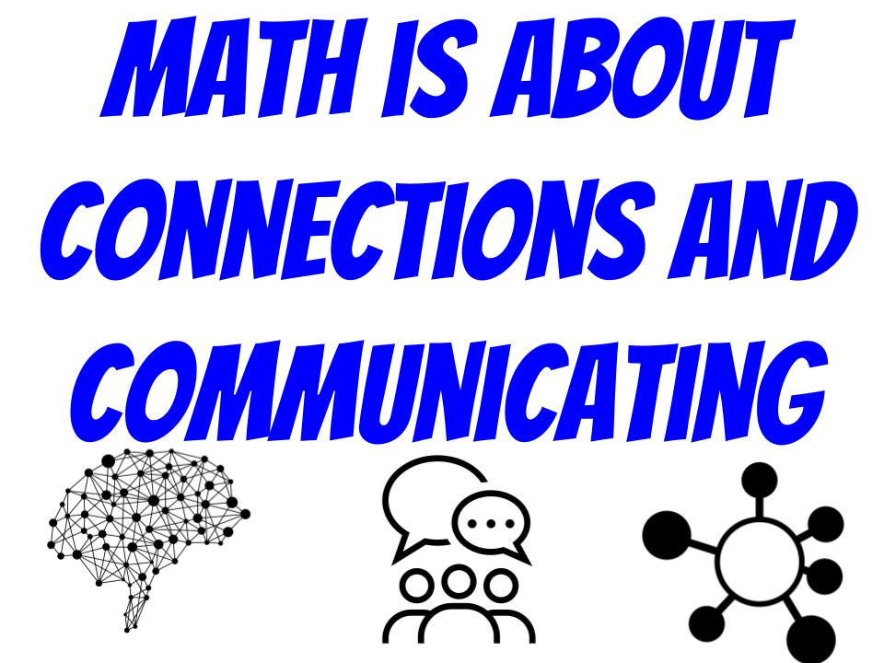
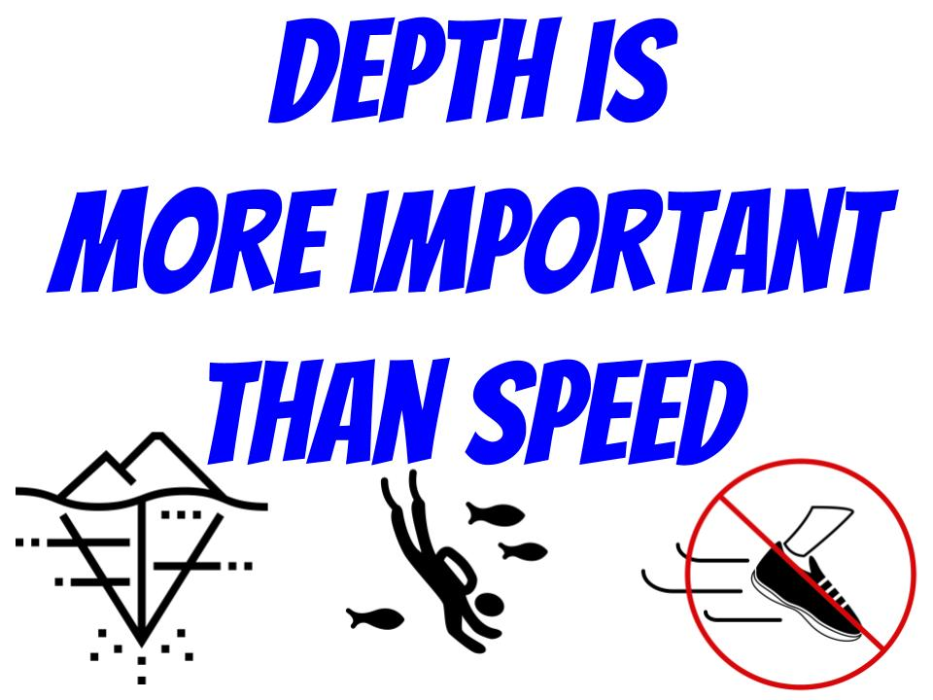
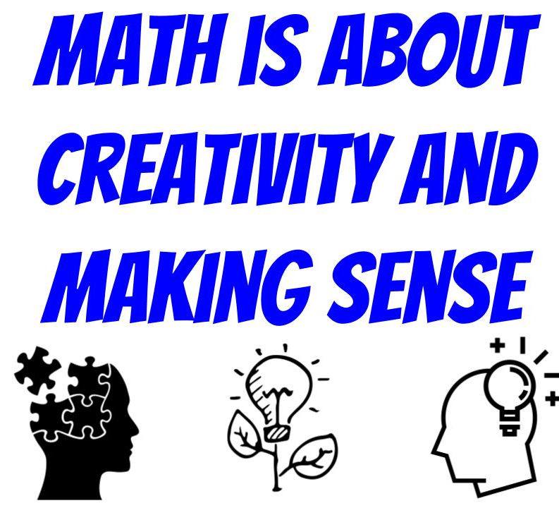
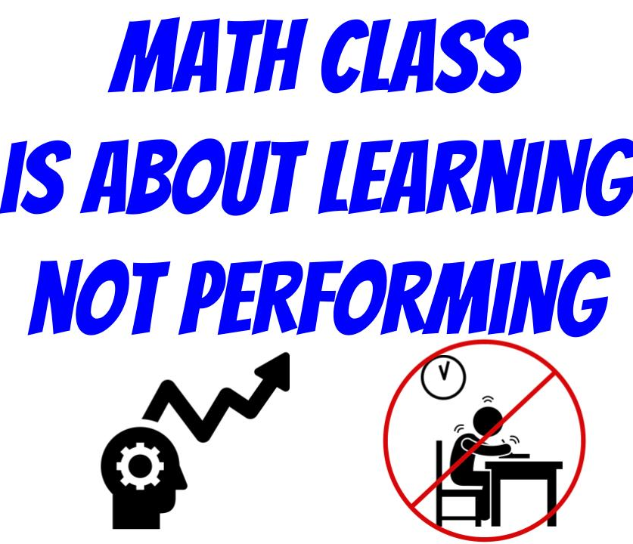
Jo Boaler’s Norms for a Positive Math Mindset Culture

Slide 24


Connections & Communicating
@bootstrapworld
@edcamposjr @youndtsmith
@mrspooleyo @joepolitz
@ShriramKMurthi @KathiFisler
facebook.com/bootstrapworld

Slide 25
Setting up your classroom
Physical Materials (workbooks, pens, etc)
One computer for each pair of students
Gmail Account (per-class? per-pair?)
Log into www.WeScheme.org (IE9+, FF, Chrome)
Go to www.BootstrapWorld.org/materials
Notes:
KEY POINTS
MATH CONNECTIONS
POWERFUL QUOTES/PHRASES

Slide 26
Unit 1
Notes:
KEY POINTS
-Setting expectations (Complexity level of game design)
-See Ninja Cat as example, complete page 2. Alternatively, use a previously made game since Ninja Cat is a little different than what we’ll create.
-Comparison with Block based code, more attending to precision. Connections to Algebra.
MATH CONNECTIONS
POWERFUL QUOTES/PHRASES
Set expectations; “Have you played video games? Yes. Favorite? Tetris. Mindcraft. Clash of Clans. Ms Pac Man.” “How many people it took to make CoC. 5K? 100? 2? How long it took to make it? 100s of hours. Still doing it! 1000s of hours? Years? Money: 1 million USD?”
Why - Hook, connections 2 real world
In this class, limited time, people, money. Our game won’t look like the above. Temper expectations!

Slide 27
Favorite Videogames?
Notes:
KEY POINTS
-Setting expectations (Complexity level of game design)
MATH CONNECTIONS
POWERFUL QUOTES/PHRASES
Set expectations; “Have you played video games? Yes. Favorite? Tetris. Mindcraft. Clash of Clans. Ms Pac Man.”
“How many people it took to make CoC. 5K? 100? 2?
How long it took to make it? 100s of hours. Still doing it! 1000s of hours? Years? Money: 1 million USD?”
Why - Hook, connections 2 real world
In this class, limited time, people, money. Our game won’t look like the above. Temper expectations!

Slide 28
Ninja Cat - Notice & Wonder
Notes:
Notice & Wonder:
Open up Ninjacat and have the teachers notice and wonder about the game(without them opening the file and just the facilitator playing the game).

Slide 29
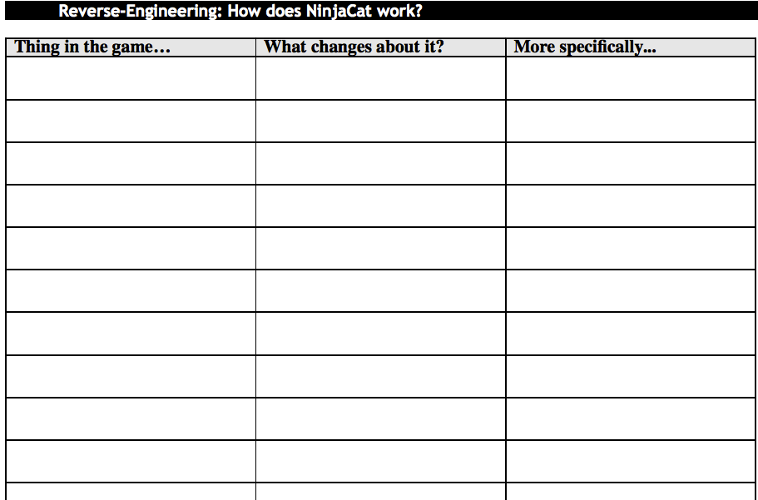
NinjaCat
Dog x-coordinate
moves to the left
position
Notes:
KEY POINTS
-Go to WeScheme and open NinjaCat.
-Coordinate Pair
-Cover 2nd and 3rd columns
-Activity:
1. With partner, list down ‘Things in The Game”(Nouns) Example: dog, cat, cloud, ruby, sun, mountains, sky, background, score ...
2. What changes about each thing? Mention a noun that states what changes about the thing. (e.g., moves to the left -> position or x-coordinate changes).
3. Specifically
-Placement of Images is intentional
-Where is the center or coordinate of your image?
MATH CONNECTIONS
-Number Line
-Coordinate Pairs
-Estimation
POWERFUL QUOTES/PHRASES
How do you explain position (of, say, the dog) over the phone. “Top left”? That’s not very specific. What if I wanted to measure where the dog is? Well by, using a number line (or two). X-axis and Y-axis. That’s the specific description of what’s changing.
PURPOSEFUL MISTAKES

Slide 30
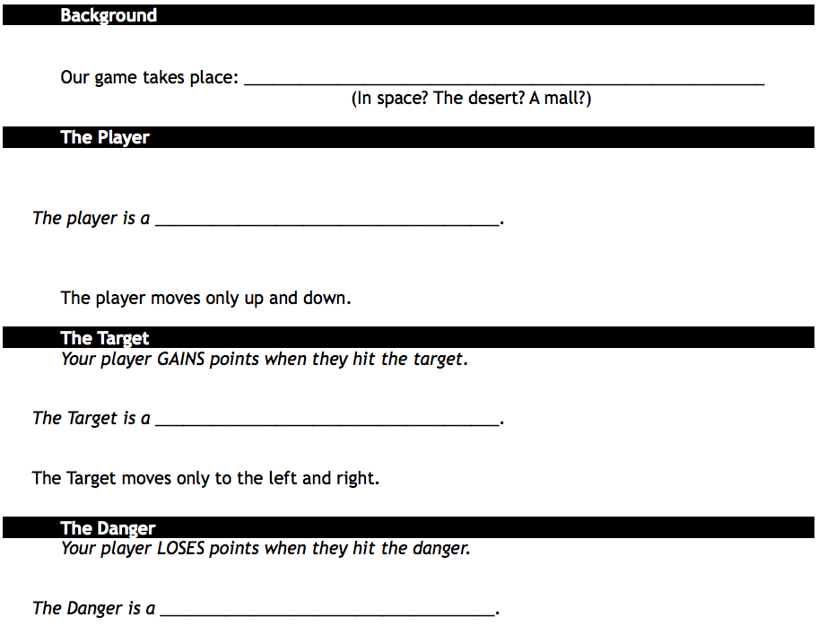
Game Brainstorming
In Space
Astronaut Squirrel
Candy
Alien Shark!
Notes:
KEY POINTS
E-Brainstorm
-Each game has background, player, target, danger.
-Use nouns, not verbs. (E.g., space, astronaut squirrel, candy, alien shark! Or: Serengeti, impala, water, wild dog. *note - Can use game scenarios that empower certain groups of people or activities.)
-Avoid Projectile discussion - Intentionally left out found that games became much more creative and engagement of girls increased
MATH CONNECTIONS
POWERFUL QUOTES/PHRASES
PURPOSEFUL MISTAKES

Slide 31
Starting to Program…
In www.WeScheme.org…
Start a New Program
About the Editor…
Let there be Numbers!
Notes:
KEY POINTS
-Get participants to WeScheme, Login, and Start New Program.
-Thumbs up to Check In with group
-Describe layout (left side Definitions, right side Ineractions)
-Point out they do not need programing skills.
-Key: numbers eval to numbers, but not so in most programming languages.
-Do on left side of screen do 4 + 2 click run and talk about what happens
-Our program has Numbers!! - supports fractions (not many programming languages support fractions)
-Play around with different numbers in the Interactions side
MATH CONNECTIONS
POWERFUL QUOTES/PHRASES
Driver/Navigator - paired programming - a significant structural approach - having 2 people talking to each other while programming
Increases understanding
Decreases bugs
DRIVER: their job is to type and make sure what they are typing makes sense
NAVIGATOR: their eyes on the program - head in the clouds
Time based or task based
PURPOSEFUL MISTAKES

Slide 32

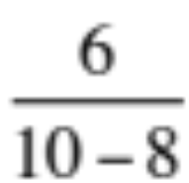

Circles of Evaluation
-
-
10
(- )
8
(- 10 )
10
10
8
8
-
(- 10 8)
/
(/ 6 )
(/ 6 ( ) )
6
2
(/ 6 (- 10 8) )
Notes:
Notice and Wonder with the Arithmetic -> Circles of Evaluation -> Racket Code
KEY POINTS
- Think of +, -, *, / as ‘Functions’ not Operations. Functions with 2 inputs.
-Circles of Evaluation is a Visual and Spatial tool for Order of Operations and Composition of Functions
- Model an Expression with a Circle of Evaluation.
-Convert the Circle of Evaluation into Racket Code
-Importance of spaces: MP6: Attend to Precision
-Model the ‘spider’ crawling through the circle, up to the top, down through the domain, and out through the side of circle.
Do Circle of Eval practice on p. 5 or place CoE’s around the room on whiteboards.
MATH CONNECTIONS
-Order of Operations
-Composition of Functions
-Domain/Range
-Functions
-Math Practice #7: Seeing Structure in Expressions
POWERFUL QUOTES/PHRASES
ORDER OF OPERATIONS IS A LITERACY SKILL- NOT A COMPUTATIONAL SKILL
Q: How many of you spend hours teaching (or reteaching!) the order of operations? We have: circles of evaluation!
Circles of Evaluation are Sentence Diagramming
Q: How do spaces work in Racket code?
A: Must have at least one space (but more are allowed) where not having space would change the expression. No space needed to separate parenthesis from other expressions. (*Note - If the adding/omitting the space changes an argument, (i.e. (-4 3) vs. (- 4 3)), it matters)
Do you start drawing from inside-out or outside-in?
A: Each is OK, sometimes one is easier than the other. Gender bias: girls outside-in, neat, make small to fit. Boys: inside-out, willing to take up space.
Q: How could you help a struggling student convert a multi-step math expression to CoE?
A: If there are three operations (better: “functions”), you’ll need three circles. Try circling in the math expression what should be solved first, second, etc. You’ll begin modelling the CoE.
Think about our assessments of order of operations: Traditionally uses computation (which can give false positives and false negatives; maybe the student doesn’t know how to calculate the operation but does know what the order is). But CoE is not a computational skill, it’s a literacy skill.
PURPOSEFUL MISTAKES
Change order of Inputs in Circle?
Typing Code as “ 8 -10”

Slide 33
Unit 2
Notes:
KEY POINTS
MATH CONNECTIONS
POWERFUL QUOTES/PHRASES

Slide 34
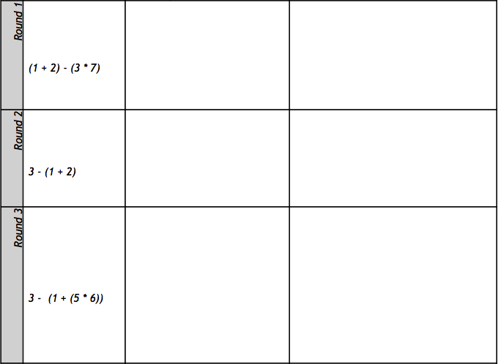
Circles Triathlon
-
(- )
(* 3 7)
(+ 1 2)
*
+
(3 * 7) – (1 + 2)
*
+
3
7
1
2
3
7
1
2
-
(- 3 (+ 1 2) )
3
+
1
2
-
+
(- 3 (+ 1 (* 5 6) ) )
3
1
*
5
6
Notes:
KEY POINTS
-How can you assess whether kids understand evaluating expressions?
-Review Circles of Evaluation w/ Circles Triathalon – 30 second rounds
-Do Circles First(Cover Racket Code)
-Ask Teachers to switch from inside out to outside in and vice versa
-comment on structure of math rather than the answer
“Order of Operations is a literacy skill, not a computational skill”
-Point out difference between R1 and R2: Purposely ordered this way because symmetry made R1 easier.
MATH CONNECTIONS
-Order of Operations
- Composition of Functions
POWERFUL QUOTES/PHRASES
what if I’m a student that is struggling to get started on creating this circle.
How could you help me to get started with a simpler task? [Take answers from teachers]
We can start out by drawing the simplest circles we see (* 3 7) and (+ 1 2).
Now, what function connects those two circles? Subtraction!
We need one larger circle with a subtraction function to complete the entire expression.
Can anyone tell me why the 3 is not in its own circle? [3 is not a function].
Do you guys think the order matters for a circle or Racket code for the expression 1 + 2 or 3 * 7? [Take answers]
If I was a stickler, I wouldn’t accept (+ 2 1) or (* 7 3). Even if the answers are the same, we want to focus on the process, not the answer. This exercise allows us to test if students understand the structure of the math, not just if they’re able to get the right answer. By stressing vocabulary like “function” instead of “operation” we are getting students to think about arithmetic operations as functions and order of operations as function composition - exactly what they are!
PURPOSEFUL MISTAKES
Change order of Inputs in Circle?
Typing Code as “ 8 -10”

Slide 35
Contracts
<name> : <domain> → <range>
; MrCoffee : Beans Water → Coffee
; + : Number Number → Number
; - : Number Number → Number
; sqrt : Number → Number
; sqr : Number → Number
Can you fill out the contracts for +, -, *, and / ?
Notes:
KEY POINTS
-How many of you use Function machine to teach Functions?
-Contracts are what programmers use to keep track of what’s coming in and out of functions?
3 parts of a contract: Name: Domain -> Range
-The domain is the type of thing that the function consumes and the range is the type of thing that the function produces.
-Explain the difference between types and examples
Coffee is a type, Folgers is an example, Starbucks is an example. Water is a type, Tap is an example, Filtered is an example, Evian is an example.
-Introduce teachers to the Contracts page on the back page of the workbook.
-Every contract we learn is written in the contracts page.
-Write contracts for +, -, *, /, sqr, and sqrt
MATH CONNECTIONS
-Domain/Range
-Functions
POWERFUL QUOTES/PHRASES
Great, you guys are building up a huge cheatsheet to use for the rest of the workshop. But all of the functions that we’ve talked about so far only take in numbers - that’s kind of boring. Let’s learn about a new data type. (next slide)
PURPOSEFUL MISTAKES

Slide 36
Strings and Images
One of these things is not like the other…
        12 -53 “hello” 4.9
A String is anything with quotes around it: “hello!”, “Houston” and “42” are all strings.
How would you convert this to code?
star
(star 50 “solid” “red”)
50 “solid” “red”
Notes:
KEY POINTS
-Introduce new data types: String, Image
-Anything in quotes is a string: “hello” “434”
-
MATH CONNECTIONS
Doman/Range
Functions
POWERFUL QUOTES/PHRASES
Show the Circle of Evalution for ”star”
What is the name of the function? [Answers]
How did you know? [Answers]
What is the domain of the function?
How do you know? [Answers]
What do you think the range of this function is? [Answers]
Let them type that code into WeScheme to find out.
PURPOSEFUL MISTAKES
”3006” is a number

Slide 37
More Image Functions
; circle : Number String String → Image
; ellipse: Number Number String String → Image
; triangle: Number String String → Image
; rectangle: Number Number String String → Image
; text: String Number String → Image
; rotate : Number Image → Image
; scale: Number Image → Image
…and dozens more!
Notes:
KEY POINTS
More Image Functions
MATH CONNECTIONS
-Domain/Range
-Functions
-Transformational Geometry
POWERFUL QUOTES/PHRASES

Slide 38
Error Messages
How we react is key: are we scared or excited?
“The computer is giving you a clue…”
“What do you think it’s trying to tell us…?”
Notes:
KEY POINTS
Importance of detailed Error messages
Model making errors and troubleshooting
Have volunteers read error messages outloud.
Challenge: Remember the star?
Make the same star but rotate it by 45 degrees
MATH CONNECTIONS
POWERFUL QUOTES/PHRASES
What happens if we use a function incorrectly.
What if I type in “(circle 50 “blue” “solid”)?
PURPOSEFUL MISTAKES
Good opportunity to highlight a really good error

Slide 39
Driver / Navigator
Pair programming needs structure!
The “Driver” has their eyes on the computer
The “Navigator” has their eyes on the workbook
Switch roles regularly
Notes:
KEY POINTS
MATH CONNECTIONS
POWERFUL QUOTES/PHRASES

Slide 40
10min Break!
Notes:
KEY POINTS
-introduce bitmap/url: String -> Image
-model how to find a transparent image
MATH CONNECTIONS
POWERFUL QUOTES/PHRASES
You want to make sure your URL is just of the image, not of the entire web page.

Slide 41
Unit 3
Notes:
KEY POINTS
MATH CONNECTIONS
POWERFUL QUOTES/PHRASES

Slide 42
Defining Values
Open the “Defining Values” link from the teachers-only page, and Run
What do you think the code on line 3 does? Line 4?
What will happen if I evaluate TITLE in the Interactions window?
How could we change the title of our game?
Click “Remix”, and name your file
What other definitions do you see?
Playing with SCREENSHOT…
Make your images!!!
Notes:
KEY POINTS
MATH CONNECTIONS
POWERFUL QUOTES/PHRASES

Slide 43
More Review
Data Types
Defining Values program
How can I move my game images?
Notes:
List Data Types on Board
Number
String
Image

Slide 44
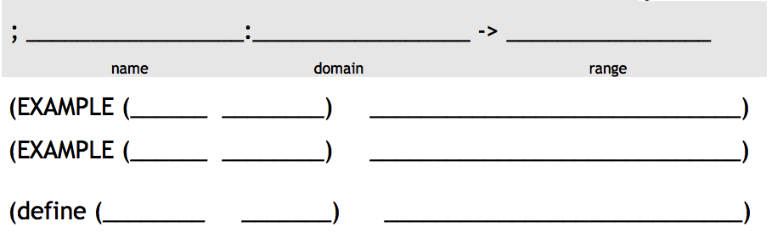
Defining Functions(p.9)
I just loooove green triangles….
Write a function ‘gt’, which takes in a number and gives back a solid, green triangle of the given size.
gt
Number
Image
radius
size
size
size
gt
10
(triangle 10 “solid” “green”)
gt
gt
11
(triangle “solid” “green”)
(triangle 11 “solid” “green”)
Notes:
KEY POINTS:
-how do I make a green triangle?
-Introduce word problem
-role play & trial run.. ”gt 50 ->
-role play AFTER “I love green triangles” and BEFORE word problem
MATH CONNECTIONS:
-find the pattern of word problem?
POWERFUL QUOTES/PHRASES
“What was his(gt’s) contract?”
“When do you just accept JUST the answer in math class?”
For definition -“Copy what stays the same & label everything else”
“So The Computer Can Check It For You”
“Many think that the define is the HARDEST part..it’s not.

Slide 45
Defining Functions(p. 9)
Confession: I lied. I actually prefer blue circles!
Write a function ‘bc’, which takes in a number and gives back a solid, blue circle of the given radius.
bc
Number
Image
radius
radius
radius
radius
bc
16
(circle 16 “solid” “blue”)
bc
99
bc
(circle “solid” “blue”)
(circle 99 “solid” “blue”)
Notes:
KEY POINTS
MATH CONNECTIONS
Examples ->Show Your Work!
gt by itself is just f(x) = 3x-2
POWERFUL QUOTES/PHRASES
“What was his(bc’s) contract?”
“When do you just accept JUST the answer in math class?”
For definition -“Copy what stays the same & label everything else”
“So The Computer Can Check It For You”
“Many think that the define is the HARDEST part..it’s not.

Slide 46
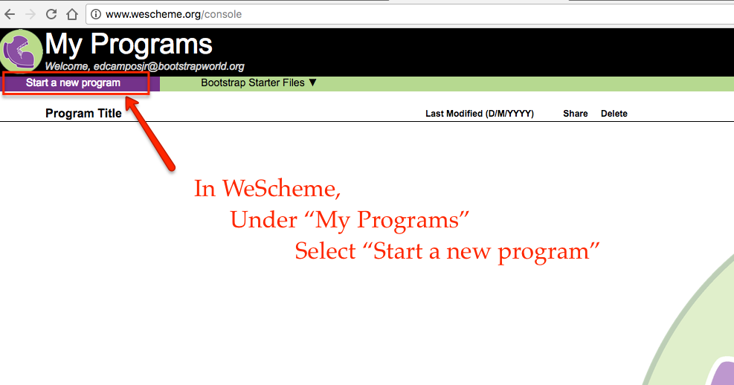
Type bc into a new program
Notes:
KEY POINTS
-Ask teachers to tell you what to copy into the ‘Definitions’ pane
Be literal.. Make them be precise.
Showing examples is key
MATH CONNECTIONS:
Examples ->Show Your Work!
-gt by itself is just f(x) = 3x-2
-need f(3) = 3(3)-2
POWERFUL QUOTES/PHRASES
“When do you just accept the answer in math class?”
For definition -“Copy what stays the same & label everything else”

Slide 47

Day 1 Review
Notes:
Circles on the walls
-Review Data Types – Numbers, Strings, Images
-Open “Defining Values” – What’s name of file?, (define

Slide 48
Unit 4

Slide 49
Rocket-Height - Notice & Wonder
Notes:
Notice & Wonder:
Open up rocket-height and have teachers notice & wonder about the program.

Slide 50
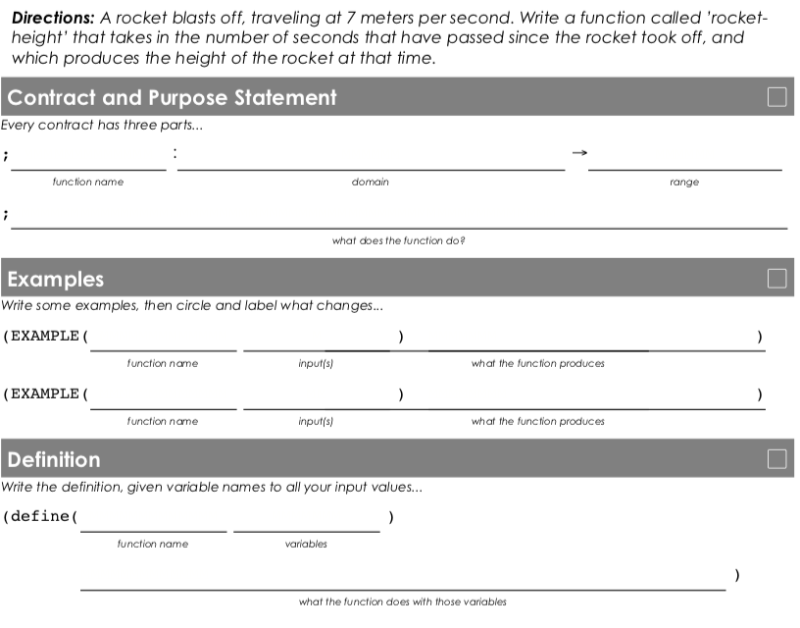
Word Problem: rocket-height
rocket-height
Number
Number
Given the number of seconds, how high is a rocket, traveling at 7m/s?
seconds
rocket-height
15
(* 7 15)
105
rocket-height 289
(* 7 289)
rocket-height
seconds
seconds
( * 7 )
Notes:
KEY POINTS
Graduation to Coding
Stress the students are at the point of doing “real coding.” They have graduated to being able to do higher level tasks and solve real problems.
Full Design Recipe
Contracts are not the whole story. Purpose statements add important details that contextualizes the contract.
When modeling the design recipe, be sure to stress the each section only uses the information from the preceding section (cover up). Every step can come directly from the step before it.
Purpose statement language: consume, produce, how?
Canned Problems to Word Problems
Authentic Mathematics Problem; has the feel of a real world mathematics problem.
Jerk Sibling/”Other”
The Rocket Height starter code is the “jerk sibling”’s work. Use this code to facilitate this discussion.
Definition is correct based upon the example.
EXAMPLES should show the computation and not just the output… This will translate to the definition.
Used to motivate students without shaming any one of them.
Kids hate criticizing themselves, but love to criticize others.
Battling is a way to check your answer by starting at the answer and going up. You can only look at the step above.
Introducing the Purpose Statement - a chance to write all of the important information in the problem in your own words
Cover Pieces with your hand as you move Step by Step through the design recipe.
MATH CONNECTIONS
Word Problems can be solved using the Design Recipe
Show Your Work
Linear Function
Direct Variation
POWERFUL QUOTES/PHRASES
Why do we have students say things in their own words?
When do we have students write examples before defining functions? Do you do this in your classroom?
Rocket-height was taken directly from a 2009 MCAS exam - a standardized test in Massachusetts.

Slide 51
Challenges
Can you make the rocket fly faster? Slower?
Can you make it fly backwards?
Can you make it fly faster over time?
Notes:
KEY POINTS
-If time allows and depending on grade level, give time to explore these questions
-
MATH CONNECTIONS
-Linear growth
-Can extend to quadratic and exponential growth
POWERFUL QUOTES/PHRASES

Slide 52
Practice
red-square
yard-area
New technique: Battling
Notes:
KEY POINTS
-more practice with Design Recipe
-If done early, practice Battling
MATH CONNECTIONS
-Word Problems can be solved using the Design Recipe
-
POWERFUL QUOTES/PHRASES

Slide 53
Unit 5
Notes:
KEY POINTS
-Open the “blank game” template
-Copy your definitions over from “game images” file
-Explain event-loop (teachpack) and the difference between SCREENSHOT vs. your game
-Complete “update-danger” and “update-target” (pg. 16-17)
-Rely on the Design Recipe and practice what you know. There’s nothing new this time.
-Add “update-danger” and “update-target” to your game file.
MATH CONNECTIONS
POWERFUL QUOTES/PHRASES

Slide 54
Animating your Characters
Open the ”Game Template” link
Copy & Paste your Images from your copy of the “Defining Values” program & Add your game images!
Complete update-target(p. 16) and update-danger(p. 17)
Notes:
KEY POINTS
-SCREENSHOT is NOT YOUR GAME!
-Model Copy paste from line 2-25 from Defining Values
-Explain Event Loop & Difference between screenshot & the game
-Complete Update Danger & Update Target(P. 16-17)
:30, 1:00, :30 for Design Recipe
MATH CONNECTIONS
POWERFUL QUOTES/PHRASES
Is it ok that we used “x” label for both functions? Yes.
Questions? Do I show ‘update-dander’ in Game template before workbook & give scapegoat?

Slide 55
For Practice…on Page 10
Sally sells lemonade for $1.75/glass. Describe her revenue as a function of the number of glasses sold.
It costs Sally $0.30 to buy the sugar and lemons for each glass of lemonade she sells. Describe her cost as a function of the number of glasses sold.
Profit = revenue - cost. Describe Sally’s profit as a function of the number of glasses sold.
Notes:
WHITEBOARD:
Recommended: Do Profit, Revenue, Cost on Whiteboards
KEY POINTS
-different ways to show profit
-different ways to show mastery
Why should I use 3 functions when I can just use 1? Isn’t 1 easier?
How does my profit function know other functions?
Isn’t the one-piece function faster, because calling other function is more work for the computer?
MATH CONNECTIONS
-3rd solution is the most efficient(?) because it deals with abstraction.
POWERFUL QUOTES/PHRASES
-work smarter not harder
-someone else maybe using your code
-cost and revenue could change based on market forces..what would I have to change then?

Slide 56

Activity: Design Recipe
Tri-fold a blank piece of paper

Slide 57

Activity: Design Recipe
Contract & Purpose Statement
Examples
Label each section
Definition

Slide 58
Unit 6
Notes:
KEY POINTS
MATH CONNECTIONS
POWERFUL QUOTES/PHRASES

Slide 59
True and False…
A game of True or False…
Evaluate the following 3 pieces of code:
  (+ 1 4) (* 7 5) (< 3 4)
Try using other Boolean functions
  There’s also string=?
Open ‘Sam the Butterfly’ in Bootstrap Starter File
  Complete page 19
Notes:
KEY POINTS
Introduction of a new Data Type: boolean
Importance of the Game: Stand up activity
Play the True/False game and use statements with “I am holding a black marker…” ”I am wearing a blue shirt.”
True and false - intro to boolean functions
Walk through contracts for boolean functions:
>, <, = , string=?
Open “Sam The Butterfly” in Bootstrap Starter File
Go over the boundaries for Sam together
Introduce Sam the Butterfly, complete page 19
Identify 3 functions
Ask students to provide a TRUE example AND a FALSE example
“False doesn’t mean wrong!” problem for some students
MATH CONNECTIONS
POWERFUL QUOTES/PHRASES
What happens now that you finished safe-left? and safe-right? Does Sam stay onscreen? No! Does the mean something was wrong with the code I wrote? No! I know that the code that I wrote works because I tested it! I wrote my examples and they passed, so I know my code is correct. That means the problem must be somewhere else.

Slide 60
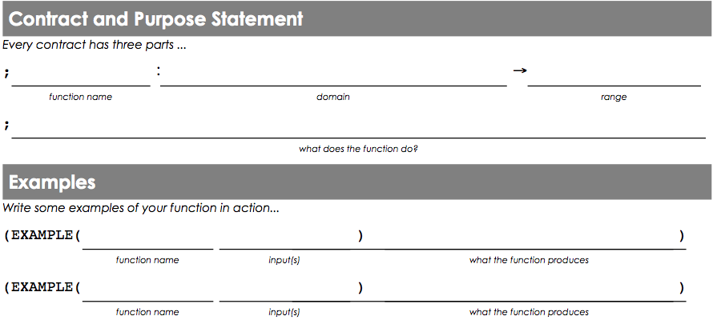
safe-left?
Let’s have a volunteer…
safe-left?
Number
Boolean
Given an x-coordinate, check if it is greater than -50
x
x
x
x
safe-left?
-100
(> -100 -50)
safe-left?
320
(> 320 -50)
Notes:
KEY POINTS
Write safe-left? together (page 20)
MATH CONNECTIONS
POWERFUL QUOTES/PHRASES

Slide 61
Finishing onscreen?
Complete safe-right? and change onscreen? so it uses safe-right? instead
How can onscreen? use both functions?
Challenge: change the boundaries so that no part of Sam can leave the screen.
Copy the safe-left?, safe-right? and onscreen code into the game template!
Notes:
KEY POINTS
Write safe-right? as partners (page 21)
Let them struggle! They will think they did safe-right? wrong.
Role Play: Act out safe-left? Safe-right? & on-screen?
Play true and false with and/or statements
mention the importance of two separate statements for and/or
Use phrases like “I am holding a black marker AND I am holding a green marker” NOT “I am holding a black marker AND a green marker”
complete page 22
Let teachers work through onscreen?
Go over solutions for onscreen? Prompt two teachers: one who used abstraction and one who didn’t. Give them 30 seconds to discuss the “better” solution
Abstraction discussion
Enter AND/OR in contracts page
MATH CONNECTIONS
Inequailities
Compound Inequalities
POWERFUL QUOTES/PHRASES
Why doesn’t Sam stay on the screen? Act out safe-left?, safe-right?, and onscreen?
Which solution is the ‘better’ solution?

Slide 62
10min Break!
Notes:
KEY POINTS
MATH CONNECTIONS
POWERFUL QUOTES/PHRASES

Slide 63
Day 2 Review – The Design Recipe
Notes:
Circles on the walls
-Review Data Types – Numbers, Strings, Images
-Open “Defining Values” – What’s name of file?, (define

Slide 64
Unit 7
Notes:
KEY POINTS
New Material: will show something we haven’t done yet.
So far, every function we’ve written so far follow one rule - this limits us as there are problems that can’t be solved that
MATH CONNECTIONS
POWERFUL QUOTES/PHRASES

Slide 65
Luigi’s Pizza
What does (cost “cheese”) evaluate to?
What will happen for (cost “onion”)?
Add “mushroom” to the menu, for $11.99.
Change the code to add your favorite topping!
Change the code to charge customers $1000.00 for anything not on the menu.
Challenge: Write a detailed description of how you think cond works.
Notes:
KEY POINTS
-Open luigi’s pizza file
-Self-guided inquiry
-New Code, New Questions: We don’t expect you to understand this code. We are throwing something at you that we want you to explore
-When changing else from “That’s not on the menu!” to 1000.00 this is a key moment and misunderstanding sometimes.
-Function composition inherits the limitations of the functions domain.
MATH CONNECTIONS
Piecewise functions
Absolute Value function
Function composition inherits the limitations of the functions domain.
POWERFUL QUOTES/PHRASES

Slide 66
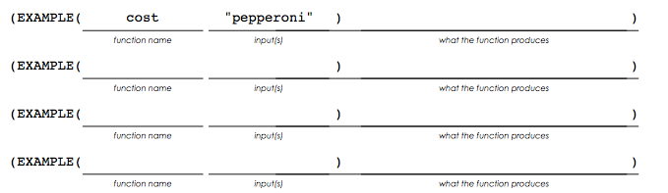


Extending the Design Recipe
cost
String
Number
topping
cost “cheese”
9.00
price
cost “pepperoni”
10.50
cost “chicken”
11.25
cost “broccoli”
10.25
cost
topping
cond
 | 9.00
 | 10.50
 | 11.25
 | 10.25
(string=? topping “cheese”)
(string=? topping “pepperoni”)
(string=? topping “chicken”)
(string=? topping “broccoli”)
Notes:
NOTICE & WONDER:
Have teachers notice and wonder after you’ve circled and labeled the things that have changes.
KEY POINTS
-Using the DR with cond
-More power, more responsible - needs to have more planning and which means the DR needs to be updated
-Using the DR with contract, purpose statement, and examples are all the same.
-The moment of change is when we circle and label (draw attention to this!!)
-We’ve circled and labeled more things than what’s in the domain.
-We now have functions with multiple personalities
MATH CONNECTIONS
-piecewise functions
-The order to which you give arguments to a function has no bearing on how the function - what does y represent(Example f(x, y) = 2y + x^2
POWERFUL QUOTES/PHRASES
How do you know this is a cond?: A We’ve circled and labeled more things than what’s in the domain.
-Note: When realizing it’s cond & writing the definition start on the right side w/10.50, 9.00, 11.25 and ask “When is the function going to produce this?”
-What data type is pepperoni?
-Do we have a function to compare a string to another string?
-Won’t we need quotes around range?
-The function cost uses another function string=?

Slide 67
update-player
update-player
Number String
Number
update-player 320 “up”
(+ 320 20)
key
update-player 100 “up”
(+ 100 20)
function
update-player 320 “down”
(- 320 20)
y
y
update-player 100 “down”
(- 100 20)
update-player
y key
cond
(string=? key “up”)
(string=? key “down”)
else
(+ y 20)
(- y 20)
y
Notes:
KEY POINTS
-Using the DR with cond
-More power, more responsible - needs to have more planning and which means the DR needs to be updated
-Using the DR with contract, purpose statement, and examples are all the same.
-The moment of change is when we circle and label (draw attention to this!!)
-We’ve circled and labeled more things than what’s in the domain.
-We now have functions with multiple personalities
MATH CONNECTIONS
-piecewise functions
-The order to which you give arguments to a function has no bearing on how the function - what does y represent(Example f(x, y) = 2y + x^2
POWERFUL QUOTES/PHRASES
How do you know this is a cond?: A We’ve circled and labeled more things than what’s in the domain.
-Note: When realizing it’s cond & writing the definition start on the right side w/(+ y 20) , (- y 20) and ask “When is the function going to produce this?”
-What data type is pepperoni?
-Do we have a function to compare a string to another string?
-Won’t we need quotes around range?
-The function cost uses another function string=?

Slide 68
Challenges
GoFast: Make a set of “secret keys” that move the player faster than the up and down arrow.
Warping: “b” jumps to the bottom, “t” to the top, etc.
Wrapping: moving the player to the top of screen makes it re-appear at the bottom.
Blocking: prevent the player from leaving the screen
Hiding: Press a key to hide. Press the same key to re-appear at the same place.
Notes:
KEY POINTS
If time permits, have teachers explore the challenges
-GoFast
-Warping
-Blocking
-Hiding
-When am I adding 20?
-When does y increase by 20?
MATH CONNECTIONS
POWERFUL QUOTES/PHRASES

Slide 69
The last lessons…
Notes:
Unit 8:
KEY POINTS
-Act out 1 dimensional collision, asking “How far are we?”, “Did we collide?”
-They are not only touching when they are one certain distance from each other. It’s an inequality when they are less than a certain distance from the centerpoint.
-Walk them through line-length
MATH CONNECTIONS
Inequaliities
POWERFUL QUOTES/PHRASES
How many of you teach absolute value?
How many of you teach Pythagorean Theorem?
How many of you teach Distance Formula?

Slide 70
At the End..
Share your programs!
Practice submitting as a HW Assignment
Use the “tilt” teachpack to support phones/tablets
Add data structures to support 2d motion and graphing
Building on what you know…all the way to college
Notes:
KEY POINTS
-Model how to share programs by copying link and submitting via Google Form
-Model how to create a QR code, highlight email and social media
-For ’tilt’ teachpack, have teachers save a different copy with the ‘tilt’ teachpack as best practice.
-show teachers where ‘data structures’ resources are to get player moving in 2D
Highlight ”How to Design Programs” textbook taught at Universities like Brown, WPI, and Northeastern
MATH CONNECTIONS
POWERFUL QUOTES/PHRASES

Slide 71
Implementation
Notes:
KEY POINTS
MATH CONNECTIONS
POWERFUL QUOTES/PHRASES

Slide 72
Integration
Transferable Skills
Circles of Evaluation
Design Recipe
Rocket-Height
Target/Danger Motion
Sam the Butterfly
Luigi’s Pizza
Player Motion
Collision Detection
Notes:
What’s different for pre-algebra and earlier?
KEY POINTS
MATH CONNECTIONS
POWERFUL QUOTES/PHRASES

Slide 73
Integration
Transferable Skills
Circles of Evaluation
Design Recipe
Rocket-Height
Target/Danger Motion
Sam the Butterfly
Luigi’s Pizza
Player Motion
Collision Detection
Notes:
100 Days devoted to material that Bootstrap Covers
KEY POINTS
MATH CONNECTIONS
POWERFUL QUOTES/PHRASES

Slide 74
Next Steps
You’ll need access to a computer lab
You’ll need Google accounts
Join our Google Group for questions and answers
Figure out your integration plan
Notes:
KEY POINTS
MATH CONNECTIONS
POWERFUL QUOTES/PHRASES

Slide 75
Sample Questions for Breakout
What elements are usable without a computer?
What elements would you like to integrate?
What will be the challenges for using Bootstrap?
Create a rough calendar for when you might use each section of Bootstrap.
Report back after the breakout!
Notes:
KEY POINTS
MATH CONNECTIONS
POWERFUL QUOTES/PHRASES

Slide 76

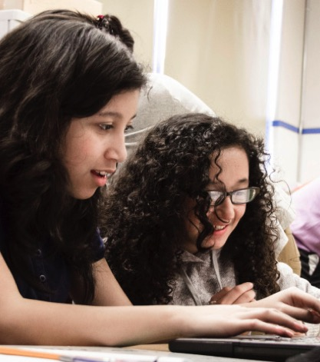
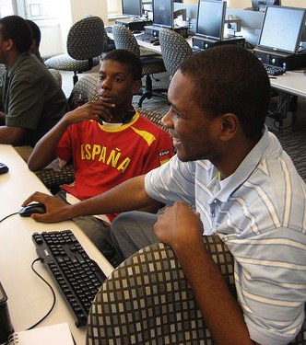


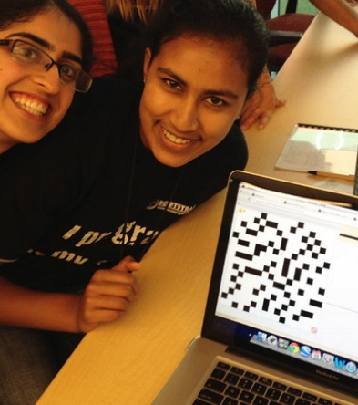
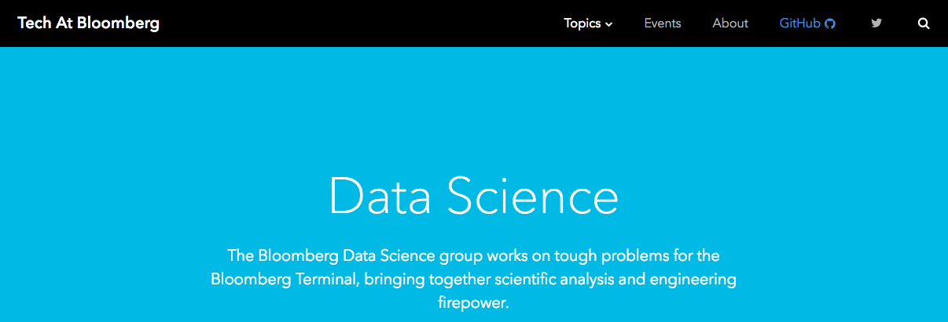
Algebra
Bootstrap:Algebra applies algebraic
concepts and rigorous programming
principles to creating a simple
videogame. Students use order of
operations, function composition, the
distance formula, coordinates and inequalities in the plane to detect collisions, handle keystrokes, and determine how they move and interact – with each challenge framed as a standard word-problem. The module is aligned to National & State Standards for Mathematics, the CSTA standards and K12CS frameworks, and has been shown to improve students’ performance on standards algebraic tasks*.
DataScience
Which artist do you listen to most? Do
schools in richer areas of your town do
better than those in poorer ones? What’s
the healthiest cuisine? Our Data Science
module teaches students to view
programs as questions we ask of data. Students form their own questions about the world around them, and learn to analyze data critically and carefully to find answers. Business, science, and history teachers can utilize this module to help students make inferences from data. Math teachers can use this module to introduce statistics in an accessible way. It also works great as a module for AP CS Principles’ unit on data!
Physics
This module is developed in partnership
with the American Association of Physics
Teachers & American Modeling Teachers
Association. It helps students understand
dynamics concepts by using
programming to build models of the
physical world. The module is targeted at ninth grade, a year in which every student is expected to take science. The module is aligned to the Physics First movement, allowing teachers to present computational modeling as a basic tool to students preparing to study science more broadly.
Reactive
Bootstrap:Reactive goes deeper into
programming, building events and data
structures on top of the foundation laid by
our intro courses and allowing students to
build far more sophisticated programs.
Students learn how the event loop that drives their Bootstrap:Algebra game works, and use it to create animations using simple datatypes. They then learn about data structures, and design a structure for a sophisticated game of their own design. Bootstrap:Reactive is aligned to the CSTA standards and K12CS frameworks.
Notes:
This is just one part of a multi-facet pathway that we at Bootstrap have created. Bootstrap:Physics allows your physics teacher to integrate computing into a standard HS Physics class, and Bootstrap:Reactive allows your students to go deeper into CS by building on – rather than throwing away – what they’ve learned. But there’s also a new trend in CS, which is taking over universities and the corporate world: Data Science. Here are just a few screenshots of major institutions that are pushing for Data Science. And now…Bootstrap is offering an introductory Data Science module for middle or high school, which requires no computing background!
KEY POINTS
MATH CONNECTIONS
POWERFUL QUOTES/PHRASES

Slide 77


Connect with Us!
/ BootstrapWorld
@BootstrapWorld
Questions:
bit.ly/BootstrapHelp
Group photo!
Notes:
KEY POINTS
MATH CONNECTIONS
POWERFUL QUOTES/PHRASES

Slide 78

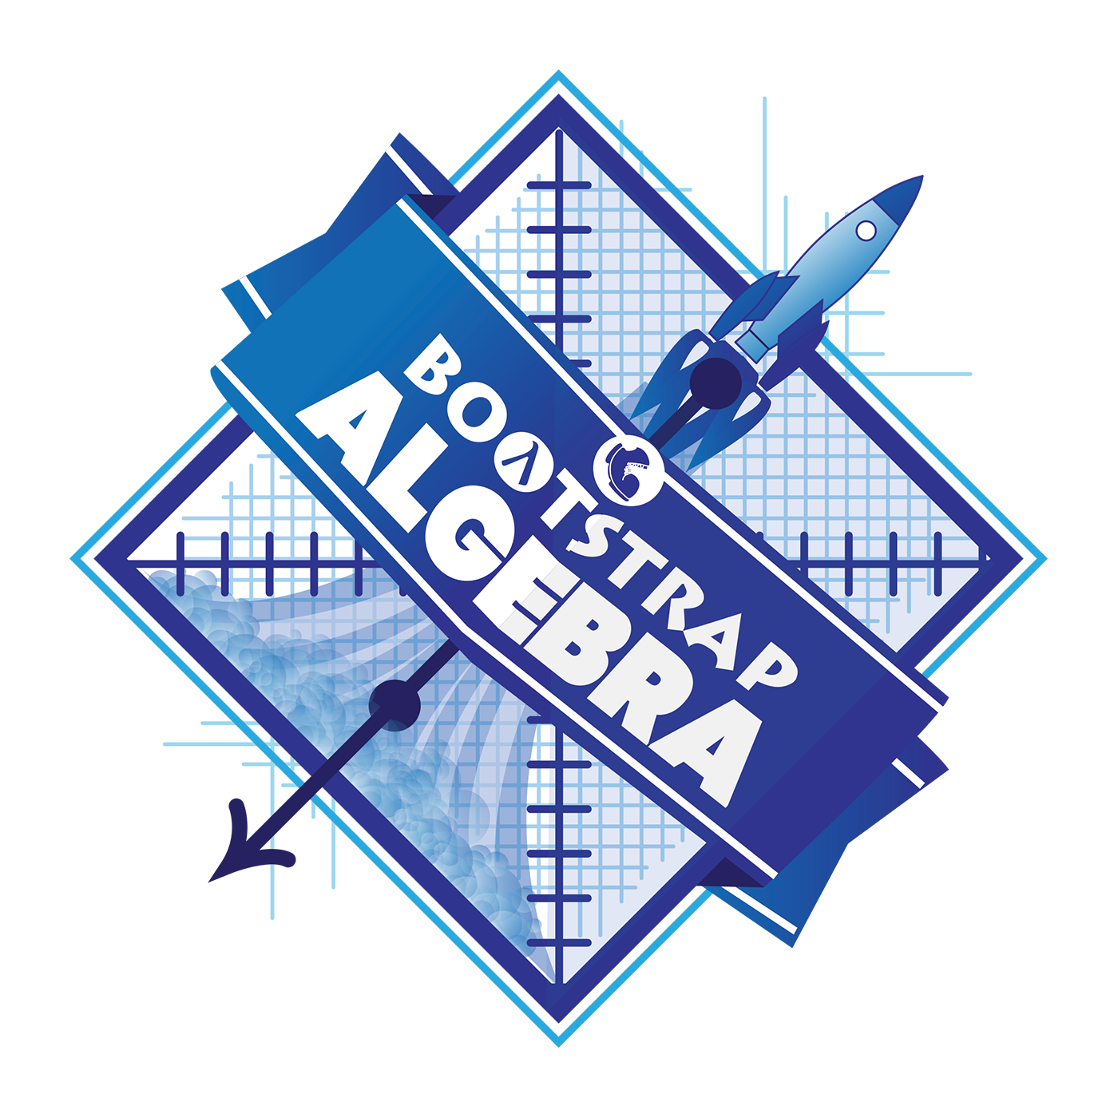
Notes:
Use this slide as background for the Group Photo

Slide 79
We’d like your feedback!
Notes:
KEY POINTS
MATH CONNECTIONS
POWERFUL QUOTES/PHRASES

Slide 80
Workshop Evaluation

Slide 81
Workshop Certificate

