Slide 1
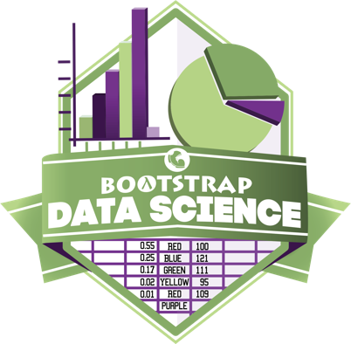
Notes:
Introduce Trainers, and have Participants introduce themselves

Slide 2

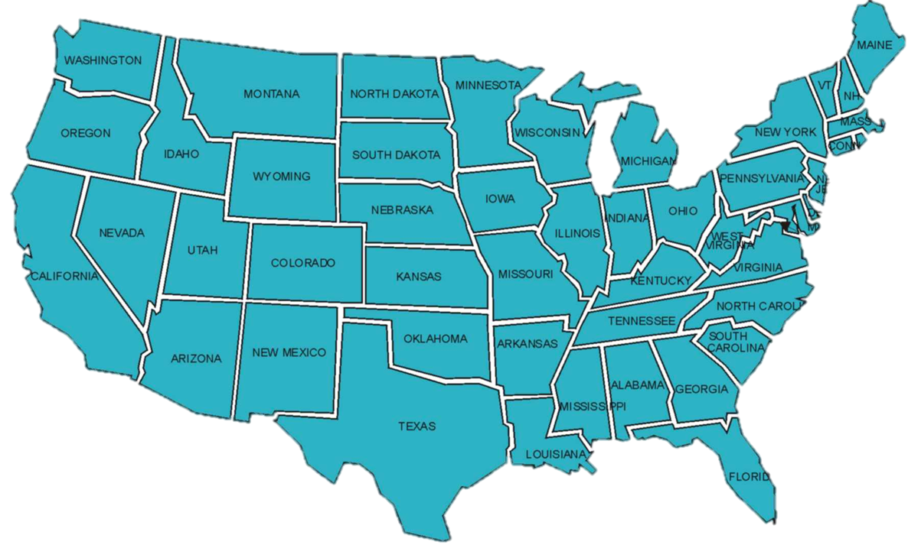
25 Thousand Students Annually
43% Girls and Young Women
46% African-American or Latino

Slide 3
Design Principles
Data Science is the New Hotness™
Principle 1: It should be authentic
  Use real, messy data
  Separate analysis from data
  Dynamic tables - not interconnected spreadsheets
Principle 2: It should be accessible
  R?
  Looping through 2D Arrays?
  Python + PANDAS?
Link: https://www.jessesadler.com/post/excel-vs-r/
Notes:
Equity implications of these points

Slide 4
The Austerity Problem

Slide 5
The Austerity Problem
Austerity was based on recommendations from economists
Those economists created a giant Excel spreadsheet to analyze historical data
“Backed by millions of data points” sounds a lot more convincing than “backed by hundreds of data points”.
There was just one problem…
Notes:
Equity implications of these points

Slide 6
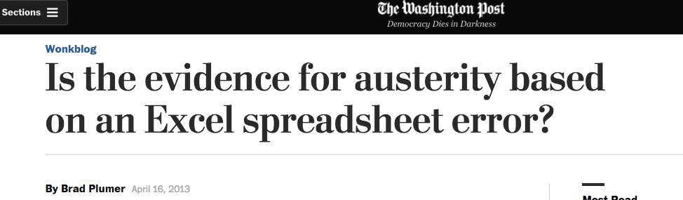
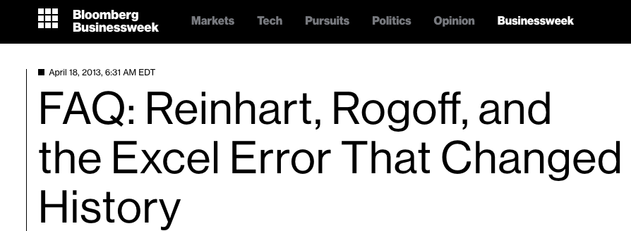
The Austerity Problem
Notes:
Equity implications of these points

Slide 7
The Austerity Problem
Data Science is not about writing for-loops, queries or Excel formulas…
…any more than programming is about “writing code”
Data Science is about analysis, and making sense of data. If all we do is teach kids Excel, R, etc…we fail.
Principle 3: Address the Austerity Problem
Notes:
If it’s more about programming than it is about thinking and writing, we fail

Slide 8
Goals for this Workshop
Understand what “Data Science” is, why it matters
Get comfortable with programming in Pyret
Work through the entire curriculum
Discuss pedagogy

Slide 9
Bootstrap Materials
Software: In the cloud, or on your machine.
Lesson Plans: Detailed[*] curricula, student handouts, integrated workbooks, and supplemental activities.
Language: Algebraic semantics, integrated tables, integrated graphing and plotting

Slide 10
Where Does Data Science Fit?
Data Science Classes
Math & Statistics Classes
Business Classes
AP CS Principles Classes
Social Studies / Civics Classes

Slide 11
Setting up your classroom
Physical Materials (workbooks, pens, etc)
One computer for each pair of students
Gmail Account (per-class? per-pair?)
Log into http://code.pyret.org/
Go to www.BootstrapWorld.org/

Slide 12
Unit 1

Slide 13
Do Now
Choose a question
How would you find an answer to that question?
What do you Notice?
What do you Wonder?

Slide 14
Introducing Pyret
Open the Shapes Starter File
About the Editor
Save a copy and click “Run”
Type shapes into the Interactions Area

Slide 15
Tables
Header v. Data rows
Add rows for circle, ellipse and rectangle
Columns: Categorical v. Quantitative
  Quantitative values can be compared (Numbers)

Slide 16
Numbers and Strings
Complete Page 3
Numbers and Strings evaluate to themselves
Anything in matching quotes is a string
Operators need spaces around them
More than one operator? Use parens!
Error messages are helpful!

Slide 17
Error Messages
How we react is key: are we scared or excited?
“The computer is giving you a clue…”
“What do you think it’s trying to tell us…?”

Slide 18
Booleans
Complete Page 4
The rules for parens and spaces still apply!
and & or
Add a new column called is-round
  Is this column made up of qualitative of categorical data?

Slide 19
Functions in Pyret
Math: f(24, 2)
Pyret: f(24, 2)
When using a function, always write its name, then all its arguments (separated by commas).
num-sqrt(16)
triangle(50, “solid”, “red”)
Try making other triangles!
What kind of mistakes could we make?

Slide 20
Back of your Book: Contracts!
Every function has a Contract
# triangle :: (side :: Num, mode :: String, color :: String) → Image
# text:: (str :: String, size::Number, color::String) → Image
# circle:: (radius::Num, mode::String, color::String) → Image
# star :: (radius::Num, mode::String, color::String) → Image
# string-repeat :: (s :: String, n :: Number) → String
# string-contains :: (search :: Str, for :: Str) → Boolean
name
Domain (name :: Type)
Range

Slide 21
Tables of images!
Add a new column called sample
  Is this column made up of qualitative of categorical data?

Slide 22
Images from Tables!
# pie-chart :: (t :: Table, label-col :: String, data-col :: String) -> Image
pie-chart(shapes, "name", "corners")
What is the name of this function?
How many inputs are in its Domain?
What will it evaluate to?
# bar-chart :: (t :: Table, label-col :: String, data-col :: String) -> Image
What kinds of columns can we use for labels and data?

Slide 23
Looking for Relationships
Open www.Tinder.com
JUST KIDDING – not that kind of relationship!!
# scatter-plot :: (t :: Table, labels :: String, xs :: String, ys :: String) -> Image
scatter-plot(animals-table, “name”, "pounds", "weeks”)
Try making some scatterplots!

Slide 24
Row and Column Lookups
To lookup up a Row from a Table…
# <Table>.row-n :: (index :: Number) → Row
Index starts at zero, not one!
To lookup up a Column from a Row…
shapes-table.row-n(3)[“corners”]
Access values of a row using the column name
Complete Page 5

Slide 25
Unit 2

Slide 26
The animals dataset
Open the Animals spreadsheet
  What do you Notice?
  What do you Wonder?
Describe this dataset on Page 9

Slide 27
The animals dataset
Open the Animals Starter File, save a copy, & click “Run”
include gdrive-sheets
include tables
include image
# load the file
shelter-sheet = load-spreadsheet("19m1bUCQo3fCzmSEmWMjTfnmsNIMqiByLytHE0JYtnQM")
# load the 'pets' sheet as a table called animals
animals-table = load-table: name, species, age, fixed, legs
source: shelter-sheet.sheet-by-name("pets", true)
end

Slide 28
The animals dataset
Type animals-table into the Interactions Area
How could you get the first row from this table? The second?
How could you get the “legs” column from one of those rows?

Slide 29
The order-by method
# <Table>.order-by :: (col :: String, ascending :: Boolean)→Table
animals-table.order-by("species", true)
Order this table by age, from oldest-to-youngest
Make at least one pie and bar chart using this table

Slide 30
Defining Values
Math: x = 4
Pyret: x = 4
name = “Nancy”
img = triangle(10, “solid”, “red”)
Define some values for different types!
animalA = animals-table.row-n(3)
animalB = …?
Define two new animals, using the appropriate names

Slide 31
Question Types
Lookup questions - Answered simply by looking up a particular value in the table and reading it out. Once you find the value, you’re done! Examples: “is Sunflower fixed?”
Compute questions - Answered by computing an answer across an entire row or column. Examples: "what is the heaviest animal?" or "What is the average age of animals at the shelter?".
Analyze questions - Answered by looking for patterns and trends across multiple rows or columns. Examples: "Do cats tend to be adopted faster than dogs?" or "Are older animals heavier than young ones?".

Slide 32
Question Types
Pedagogy
Connecting to AP CSP Data
Look on the bottom of Page 9. What kinds of questions are these?
Practice using Lookups on Page 10

Slide 33
Repetition is boring
Suppose I wanted to look up whether animalA is fixed or not. What would I type?
Repeat for animalB, animalC, and animalD
animalA[“fixed”]
animalB[“fixed”]
animalC[“fixed”]
animalD[“fixed”]
There has to be a better way!

Slide 34
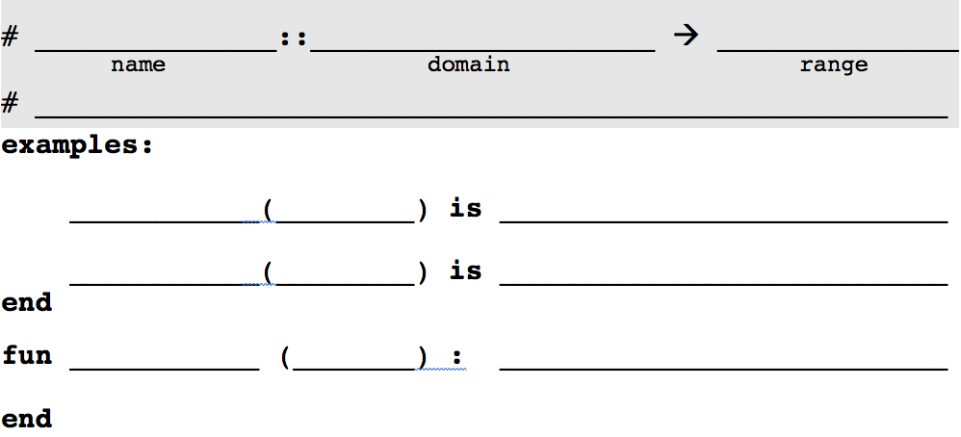
Defining Functions
Define a function called is-fixed, which looks up whether or not an animal is fixed
is-fixed
animal
is-fixed
is-fixed
(animal :: Row)
Boolean
Consumes an animal, and produce true if the animal is fixed
animalA
animalA[“fixed”]
is-fixed
animalB
animalB[“fixed”]
animal[“fixed”]
Complete the next word problem on your own!

Slide 35
Defining Functions
Define is-cat, which consumes a Row of the animals table and produces true if it's a cat.
is-cat
is-cat
animal
is-cat
(animal :: Row)
Boolean
Consumes an animal, and produce true if the animal is a cat
animalA
animalA[“species”] == “cat”
is-cat
animalB
animalB[“species”] == “cat”
animal[“species”] == “cat”
Complete the next word problem on your own!

Slide 36


The Design Recipe in Your Classroom
“Battling”, “Peer Review”, “Challenging”, etc..
  Have students justify each step based on the last
  “Where’d you get that”?
Tri-fold paper
Contract & Purpose
Examples
Definition

Slide 37
Why not just “go nuts”?
What the Design Recipe Buys You
Scaffold problem-solving
Multiple representations
Make thinking explicit
Pedagogical tool (battling, questioning, presenting)
Equity

Slide 38
The filter method
# <Table>.filter :: (test :: (Row→Value)) → Table
animals-table.filter(is-fixed)
animals-table.filter(is-cat)
bar-chart(animals-table.filter(is-fixed), “name”, “age”)
Functions can be argumenst!
Try using the gender function you defined.
Try using is-young.

Slide 39
Unit 3

Slide 40
Review
Open your saved file, or a ready-made one
What functions are defined here?
Turn to page 15, and use the Design Recipe to solve both problems.
Once you’re done, type them into the Definitions Area.

Slide 41
The build-column method
# <Table>.build-column :: (col :: String, builder :: (Row→Value))→Table
animals-table.build-column("label", nametag)
Use this method to add a column called “born”, which contains the birth-year of each animal

Slide 42
Methods, Man
Methods can be chained together:
animals-table.build-column(“year”, birth-year).filter(is-fixed).order-by("species", true)
animals-table
.build-column(“year”, birth-year)
.filter(is-fixed)
.order-by("species", true)
Order matters!

Slide 43
Let’s make some tables!
I want a table of only the cats at the shelter. How do I do it?
cats = animals-table.filter(is-cat)
I want a table of only fixed animals. How do I do it?
fixed = animals-table.filter(is-fixed)
I want a table of animals, with their birth-year attached. How do I do it?
labels = animals-table.build-column(”born”, birth-year)

Slide 44
Let’s make some charts!
I want to get a bar-chart of animal’s ages, sorted alphabetically by name, for all the young cats at the shelter. How would I do that?
bar-chart(cats.filter(is-young).order-by(“name”, true),
"name", "age")
I want to get a bar-chart of animal’s ages, sorted alphabetically by name, for all the young fixed animals at the shelter. How would I do that?
bar-chart(fixed.filter(is-young).order-by(“name”, true),
"name", "age")
I want to get a bar-chart of animal’s ages, sorted alphabetically by name, for all the young animals at the shelter. How would I do that?
bar-chart(animals-table.filter(is-young).order-by(“name”, true),
"name", "age")
bar-chart(labels.filter(is-young).order-by(“name”, true),
“name”, "age")
There has to be a better way!

Slide 45
Introducing Table Plans
Problem 1: Duplicate Code
That’s a lotta typing!
If we find a bug, we have to fix it everywhere
Longer programs are harder to debug
Problem 2: Order-of-Operations
t.order-by(“birth”, true).build-column(“birth”, birth-year)
What’s wrong with this picture?
Order matters!

Slide 46
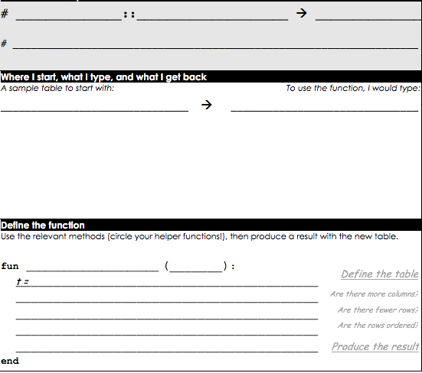
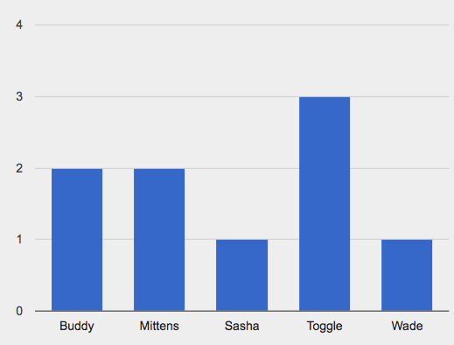
Table Plans
sorted-age-bar
sorted-age-bar
(animals :: Table)
Image
animals
Consume a table of animals, and produce a bar chart of their ages, sorted alphabetically, for all young animals
example-table
(example-table)
sorted-age-bar
name | … | age
Sasha |  | 1
Toggle |  | 3
Buddy |  | 2
Wade |  | 1
Mittens |  | 2
Design Recipe!
animals
.filter(is-young)
.order-by(“name”, true)
bar-chart(t, “name”, “age”)

Slide 47
Let’s make some charts!
Before Table Plans
bar-chart(cats.filter(is-young).order-by(“name”, true),
"name", "age")
bar-chart(fixed.filter(is-young).order-by(“name”, true),
"name", "age")
bar-chart(animals-table.filter(is-young).order-by(“name”, true),
"name", "age")
After Table Plans
sorted-age-bar(cats)
sorted-age-bar(fixed)
sorted-age-bar(animals-table)

Slide 48
Unit 4

Slide 49
Making Good Sample Tables
Up to now, every Table Plan you’ve seen has included pre-written Sample tables. Why?
Now it’s time for you to start choose these tables yourself! A good sample table has several qualities:
  Includes all relevant columns
  Includes rows that will be filtered (both true and false)
  Includes enough rows to show random ordering
The Austerity Problem
Complete Page 22 & 23

Slide 50
Project: Choose Your Dataset!
Choose a dataset that interests you
  We’ll be adding more
  You can find your own (data.gov, google, and other sources)
  You can collect your own using Google forms!
Click “Save a Copy”. Use .row-n to define at least two sample rows. Be sure to use reasonable variable names!
Complete Page 24 & 25

Slide 51
Use the Design Recipe
You as you did for the Animals dataset, define some functions to let you filter and build-columns for your dataset!
Complete Pages 26 & 27

Slide 52
Quantity Charts in Your Dataset
Make at least one Pie Chart and one Bar Chart for columns in your dataset
What do you Notice? What do you Wonder?
Write your findings on Page 28

Slide 53
Unit 5

Slide 54
What do you think?
According to the Animal Shelter Bureau, the average pet waits 5.8 weeks to be adopted.
Does that mean most pets wait more than a month homes to find? Why or why not?
What kind of question is this?
Open the Animals w/Functions File
Summarizing columns (GPA, Credit Score…)

Slide 55
Mean
The Mean is the Sum, divided by the Length of the list.
What is the mean of 5, 2, 3, 1, 4?
Pyret has a mean function for tables!
# mean :: (t :: Table, col :: String) → Number
  mean(animals-table, “weeks”)
  Write your answer on Page 31

Slide 56
Median
The Median is the “middle” value of a sorted list of numbers
What is the mean of 5, 2, 3, 1, 4?
If there is no “middle”, take the mean of the “middle two”
What is the mean of 5, 2, 3, 1, 4, 6?
# median :: (t :: Table, col :: String) → Number
  median(animals-table, “weeks”)
  Write your answer on Page 31

Slide 57
Modes
The Modes are the “most repeated” value in a list of numbers
What are the modes of 5, 2, 3, 3, 1, 4?
There can be more multiple modes: 5, 2, 3, 3, 1, 4, 6, 5
There can be no modes: 5, 2, 3, 1, 4, 6?
# modes:: (t :: Table, col :: String) → List<Number>
  modes(animals-table, “weeks”)
  Write your answer on Page 31

Slide 58
Which measure is “best”?
Imagine that a math teacher is tracking their students’ grades. Here are the students’ grades on the first test.
grade-list = [list: 68, 64, 62, 100, 100, 68, 67]
Which measure gives the best indication of how the class did?
  mean: 75.57
  median: 68
  mode: 69
Outliers

Slide 59
What do you think?
According to the US Census Bureau, the average American household earned more than $45,000 in 2003 - more than 3x the poverty line that year. They conclude that very few Americans live in poverty.
What do you think?
What kind of question is this?
Notes:
Compute question

Slide 60
Variation Matters
Plotting values on a number line
The median splits the values into “upper” and “lower” halves
The medians of the halves defines four quartiles
Interquartile Range
Range
Min
Q1
Median
Q3
Max

Slide 61
Variation Matters
Plots like these are called box-plots.
# box-plot :: (t :: Table, col :: String) → Image
  box-plot(animals-table, “weeks”)
Five-Number Summary
  Min, Max, Median (Q2), Q1 and Q3
  Write this on Page 31
Sketch your box plot - horizontally - on Page 31

Slide 62
Fake News
Terms like “average” (or mean), “most common” (mode), or “median” show up in the news.
But they don’t mean the same thing, and they can easily be abused to trick the reader into drawing a faulty conclusion.
Complete Page 32.

Slide 63
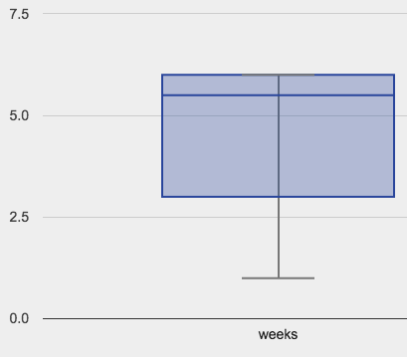
fixed-weeks-box
fixed-weeks-box
fixed-weeks-box
(animals :: Table)
Image
animals
Consume a table of animals, and produce a box plot of the
weeks taken to be adopted, for only fixed animals
example-table
(example-table)
fixed-weeks-box
name | fixed | weeks
Sunflower | true | 6
Sheba | true | 6
Buddy | false | 3
Felix | true | 5
Mittens | true | 1
Design Recipe!
animals
.filter(is-fixed)
box-plot(t, “weeks”)

Slide 64
Your dataset
Explore Center and Variation for your data on Page 34
How else can we visualize variation…?

Slide 65
Unit 6

Slide 66
Visualizing Frequency
Complete Page 37
What are these two charts measuring?
These charts visualize the frequency with which certain values appear in our dataset!
# freq-bar-chart :: (t :: Table, values :: Str) → Image
# histogram :: (t:: Table, values:: Str, bin-width:: Num)→Img
Notes:
By filling in the last bar, you have created a bar chart. However, there’s something special about chart. What is different about this bar chart from the ones we have created before?
Previous bar charts used a column from the table as the labels, and another column as the values.
In this bar chart, we are using the categories of a column as the labels, and the frequency of each category as the value.
Here, we are looking at the Eye Color column, which contains categorical data. In this special kind of bar chart, we are computing the frequency of each category, and that frequency relates to the length of each bar. Since there are 3 people with brown eyes, the bar for Brown extends to 3 marks long.

Slide 67
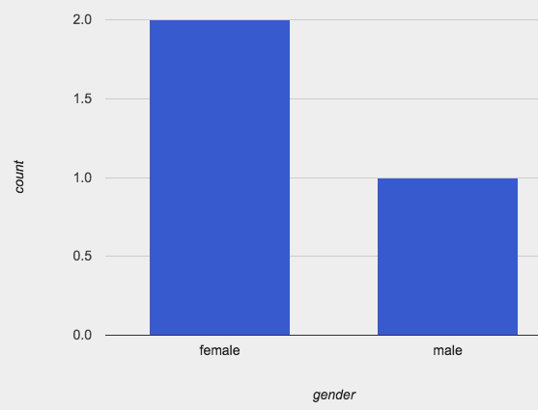
freq-bar-gender
freq-bar-gender
freq-bar-gender
(animals :: Table)
Image
animals
Consume a table of animals, and produce a frequency bar chart
for the gender, for only animals who are cats
example-table
(example-table)
freq-bar-gender
species | gender
Cat | Female
Dog | Female
Tarantula | Male
Cat | Male
Cat | Female
Design Recipe!
animals
.filter(is-cat)
freq-bar-chart(t, “gender”)

Slide 68
Bins and Spread
  What does the last argument to histogram mean?
What if there were only 2 bins? 40? 400?
Complete Page 39
Explore variation in your dataset, and write up your findings on Page 40

Slide 69
Which Chart is Best?
  You’ve seen
    Bar Charts
    Pie Charts
    Frequency Bar Charts
    Histograms
  How do you know which one to use?
  Complete page 41
Notes:
Unfortunately, we still don't know if 7 comes up often enough for this to be a game worth playing! We've used our measures of center to figure out the most frequent number, but just @italic{how frequent is it}? We need some way of asking if 7 appears more than all the other numbers combined.

Slide 70
Unit 7

Slide 71
Do Now
“Young animals get
adopted faster”
Do you agree?
What kind of question is this?
- Write your hypothesis on Page 45
Notes:
At last: an Analysis question!!!

Slide 72
Scatter plots
Complete Page 46.
Scatter plots visualize relationships between two columns
# scatter-plot :: (t :: Table, labels :: Str, xs :: Str, ys :: Str) → Img
Make a labeled-scatter-plot for age v. weeks, using names as the labels
Complete Page 47

Slide 73
Searching for Correlations
Is there a trend?
Are there outliers?
Hover over each dot.
Correlations
  Direction
  Strength
Adoption(weeks)
Age (years)

Slide 74

Correlation <> Causation
Search for correlations – not causes! – in your dataset

Slide 75
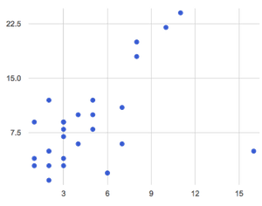
Predictors
Age (yrs) v. Adoptions (wks)
Suppose there is a trend
Can you draw it?
We can make predictions!
Page 48…

Slide 76
Your Dataset
Generate some scatterplots from your data
What patterns emerge?
  Are they strong or week?
  Positive or Negative?
Write up your findings on Page 49.

Slide 77
Unit 8

Slide 78
Searching for Correlations
How do we measure the “fit” of a predictor (strength of correlation)?
How do we draw the predictor with the “best fit”?
Complete Page 53
Playing with predictors (http://bit.ly/ExploreLR)
Age (yrs) v. Adoptions (wks)

Slide 79
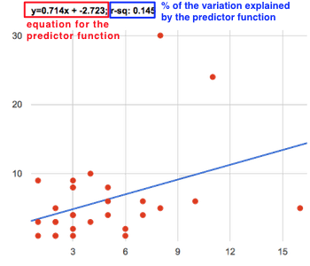
Linear Regression
# lr-plot :: ( t:: Table, labels :: Str, xs :: Str, ys :: Str)→Img

Slide 80
Linear Regression
r²
slope
y-intercept

Slide 81
Practice Making Scatterplots
The age vs. weeks waiting for adoption, but just for the dogs in the shelter.
The weight vs. weeks waiting for adoption, but just for the cats in the shelter.
The age vs. weight waiting for adoption, but just for animals that have been fixed.
Write up your findings on Page 54

Slide 82
Your Dataset
Write up your findings on Page 55

Slide 83
Unit 9

Slide 84
Threats to Validity
“95% of cat-owners surveyed said that cats are better than dogs!”
Selection bias
Sample size
Sample error
Confounding variables
Practice on Pages 59 and 60

Slide 85
Fake News!
People misrepresent data all the time
Turn to Page 61
Being able to speak accurately about data is an essential part of being a Data Scientist
Your Research Paper

Slide 86

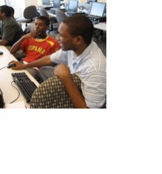
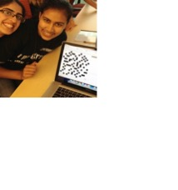
Algebra
Bootstrap:Algebra applies algebraic
concepts and rigorous programming
principles to creating a simple
videogame. Students use order of
operations, function composition, the
distance formula, coordinates and inequalities in the plane to detect collisions, handle keystrokes, and determine how they move and interact – with each challenge framed as a standard word-problem. The module is aligned to National & State Standards for Mathematics, the CSTA standards and K12CS frameworks, and has been shown to improve students’ performance on standards algebraic tasks*.
DataScience
Which artist do you listen to most? Do
schools in richer areas of your town do
better than those in poorer ones? What’s
the healthiest cuisine? Our Data Science
module teaches students to view
programs as questions we ask of data. Students form their own questions about the world around them, and learn to analyze data critically and carefully to find answers. Business, science, and history teachers can utilize this module to help students make inferences from data. Math teachers can use this module to introduce statistics in an accessible way. It also works great as a module for AP CS Principles’ unit on data!
Physics
This module is developed in partnership
with the American Association of Physics
Teachers & American Modeling Teachers
Association. It helps students understand
dynamics concepts by using
programming to build models of the
physical world. The module is targeted at ninth grade, a year in which every student is expected to take science. The module is aligned to the Physics First movement, allowing teachers to present computational modeling as a basic tool to students preparing to study science more broadly.
Reactive
Bootstrap:Reactive goes deeper into
programming, building events and data
structures on top of the foundation laid by
our intro courses and allowing students to
build far more sophisticated programs.
Students learn how the event loop that drives their Bootstrap:Algebra game works, and use it to create animations using simple datatypes. They then learn about data structures, and design a structure for a sophisticated game of their own design. Bootstrap:Reactive is aligned to the CSTA standards and K12CS frameworks.
Notes:
This is just one part of a multi-facet pathway that we at Bootstrap have created. Bootstrap:Physics allows your physics teacher to integrate computing into a standard HS Physics class, and Bootstrap:Reactive allows your students to go deeper into CS by building on – rather than throwing away – what they’ve learned. But there’s also a new trend in CS, which is taking over universities and the corporate world: Data Science. Here are just a few screenshots of major institutions that are pushing for Data Science. And now…Bootstrap is offering an introductory Data Science module for middle or high school, which requires no computing background!

Slide 87


Connect with Us!
/ BootstrapWorld
@BootstrapWorld
Questions:
bit.ly/BootstrapHelp
Grab a photo!

Slide 88

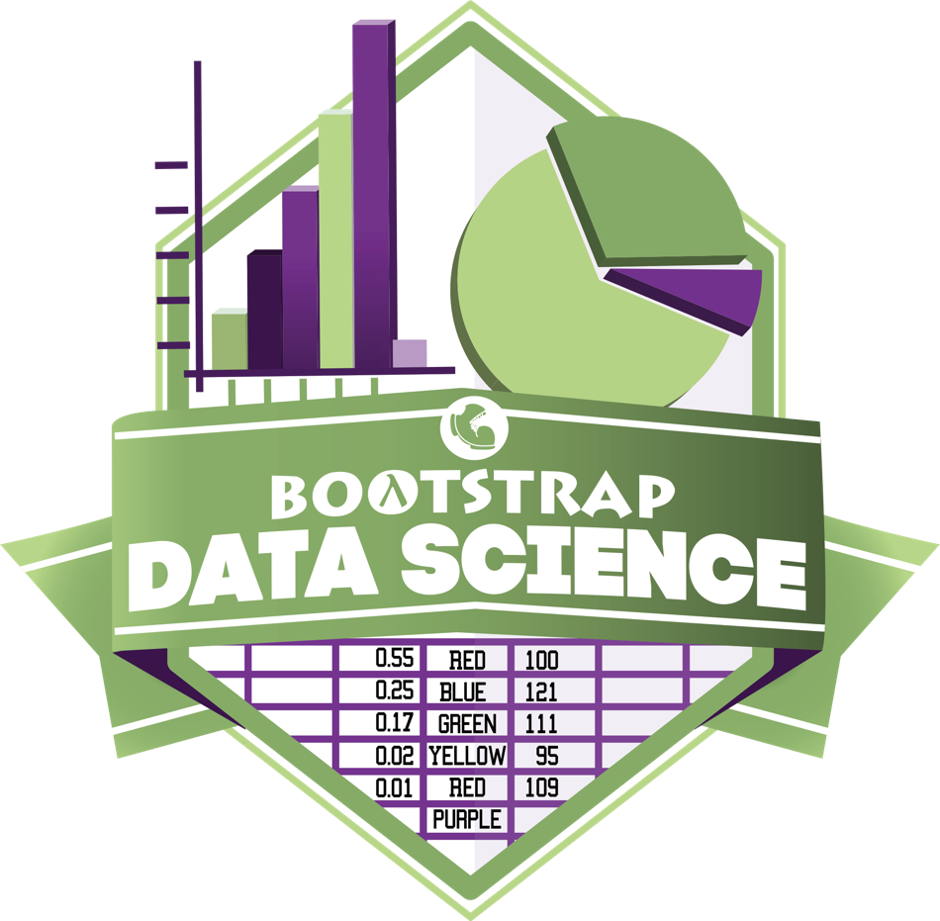
Notes:
Use this slide as background for the Group Photo

Slide 89
We’d like your feedback!

