Slide 1
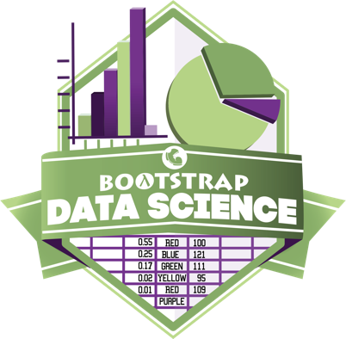
Have you finished the survey? bit.ly/BootstrapPrePD
Notes:
Introduce Trainers, and have Participants introduce themselves

Slide 2

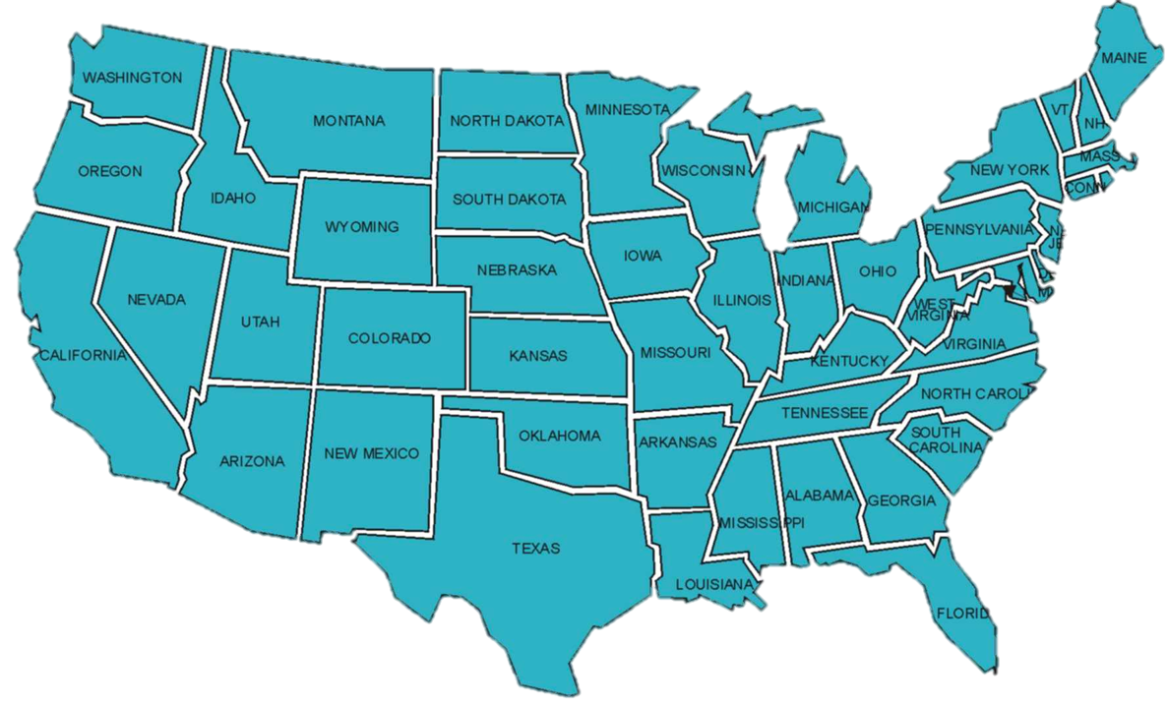
25 Thousand Students Annually
43% Girls and Young Women
46% African-American or Latino

Slide 3
Design Principles
Data Science is the New Hotness™
Principle 1: It should be authentic
  Use real, messy data
  Separate analysis from data
  Dynamic tables - not interconnected spreadsheets
Principle 2: It should be accessible
  R?
  Looping through 2D Arrays?
  Python + PANDAS?
http://bit.ly/WhyNotExcel19
Notes:
Equity implications of these points

Slide 4
The Austerity Problem

Slide 5
The Austerity Problem
Austerity was based on recommendations from economists
Those economists created a giant Excel spreadsheet to analyze historical data
“Backed by millions of data points” sounds a lot more convincing than “backed by hundreds of data points”.
There was just one problem…
Notes:
Equity implications of these points

Slide 6
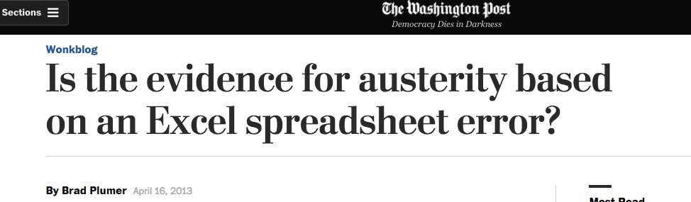
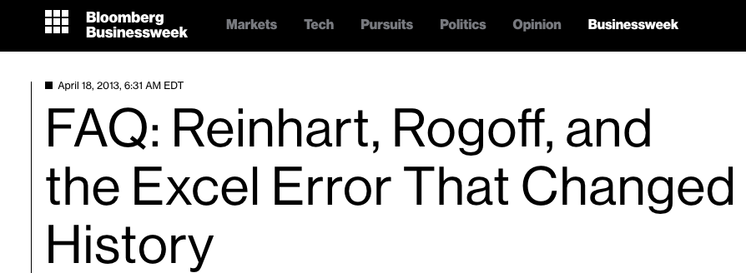
The Austerity Problem
Notes:
Equity implications of these points

Slide 7
The Austerity Problem
Data Science is not about writing for-loops, queries or Excel formulas…
…any more than programming is about “writing code”
Data Science is about analysis, and making sense of data. If all we do is teach kids Excel, R, etc…we fail.
Principle 3: Address the Austerity Problem
Notes:
If it’s more about programming than it is about thinking and writing, we fail

Slide 8
Goals for this Workshop
Understand what “Data Science” is, why it matters
Get comfortable with programming in Pyret
Work through the entire curriculum
Discuss pedagogy

Slide 9
Bootstrap Materials
Software: In the cloud, or on your machine.
Lesson Plans: Detailed[*] curricula, student handouts, integrated workbooks, and supplemental activities.
Language: Algebraic semantics, integrated tables, integrated graphing and plotting

Slide 10
Where Does Data Science Fit?
Math & Statistics Classes
Business Classes
CS/AP CS Principles Classes
Social Studies / Civics Classes
Data Science Classes

Slide 11
Setting up your classroom
Physical Materials (workbooks, pens, etc)
One computer for each pair of students
Gmail Account (per-class? per-pair?)
Log into https://code.pyret.org/
Go to www.BootstrapWorld.org/
Let’s check out the materials…

Slide 12
Unit 1

Slide 13
Do Now
Choose a question.
Quick! What’s your hypothesis?
How would you find an answer to that question?
What do you Notice?
What do you Wonder?

Slide 14
The Animals Dataset
Open the Animals Dataset in a new tab, or turn to Page 2
Complete the top of Page 3…
  What do you Notice?
  What do you Wonder?
What columns do you see? What sheet are we in?
This is just a sample of shelter animals.

Slide 15
Categorical v. Quantitative
Categorical Data
  Answers “which one?”
Quantitative Data
  Answers “how much?”
  The rules of arithmetic make sense
What kind of data is…
  Hair color
  Age
  ZIP Code
  Date
Complete the bottom of Page 3

Slide 16
Intro to Pyret
Open the Animals Starter File
Save a copy, and click “Run”
About the editor
include gdrive-sheets
include tables
include image
# load the file
shelter-sheet = load-spreadsheet("19m1bUCQo3fCzmSEmWMjTfnmsNIMqiByLytHE0JYtnQM")
# load the 'pets' sheet as a table called animals
animals-table = load-table: name, species, age, fixed, legs
source: shelter-sheet.sheet-by-name("pets", true)
end

Slide 17
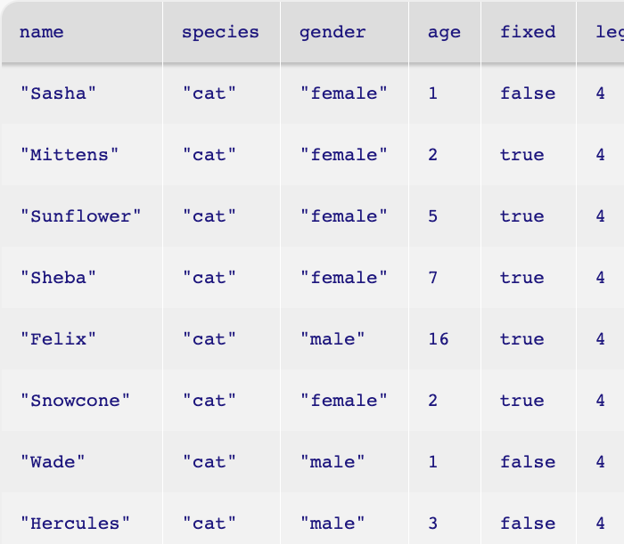
Tables
Variable Columns
Variable Columns
Variable Columns
Identifier Column
Variable Columns
Header Row
Variable Columns
Variable Columns
Variable Columns
Data Rows
Data Rows
How many data rows can a table have?

Slide 18
Datatypes in Pyret
Number
Boolean
String
String
String

Slide 19
Values and Operators
Complete Page 4 (Questions 5-8 require writing)
Numbers and Strings evaluate to themselves
Anything in matching quotes is a string
Operators need spaces around them
More than one operator? Use parens!
Error messages are helpful!

Slide 20
Error Messages
How we react is key: are we scared or excited?
“The computer is giving you a clue…”
“What do you think it’s trying to tell us…?”

Slide 21
Values and Operators (cont.)
Complete Page 5
The rules for parens and spaces still apply!
and & or
Operators still need spaces around them.
More than one operator? Still use parens!
Error messages are still helpful!

Slide 22
Functions in Pyret
Math: f(24, 2)
Pyret: f(24, 2)
When using a function, always write its name, then all its arguments (separated by commas).
num-sqr(16)
triangle(50, “solid”, “red”)
Make different triangles, and square different Numbers.
What kind of mistakes could we make?

Slide 23
“What’s the Rule?”
Name
of the function
Input
always one number!
Output
always one number!
num-sqr(1) 1
num-sqr(2) 4
num-sqr(3) 9
num-sqr (n :: Number) Number
::
→
Name
of the function
Domain
Names & types of Inputs
Range
Type of the Output

Slide 24
“What’s the Rule?”
Name
of the function
Input
a Number and two Strings!
Output
always one Image!
triangle(50, ”solid”, ”red”) triangle(20, ”solid”, ”blue”) triangle(50, ”outline”, ”red”)
::
triangle (size:: Num, style:: String, color:: String) Image
→
Name
of the function
Domain
Names & types of Inputs
Range
Type of the Output

Slide 25
Back of your Book: Contracts!
Reading contracts
# triangle :: (side :: Num, mode :: String, color :: String) → Image
# text:: (str :: String, size :: Number, color :: String) → Image
# circle :: (radius :: Num, style :: String, color :: String) → Image
# star :: (radius :: Num, style :: String, color :: String) → Image
# string-repeat :: (s :: String, n :: Number) → String
# string-contains :: (text :: Str, search-for :: Str) → Boolean
is a
“triangle
function
which consumes
(1) side is a number
(2) mode is a string
and (3) color is a string
…and produces an Image”

Slide 26
Can you make these images?
Data Science!
Data Science!

Slide 27
Images from Tables!
# pie-chart :: (t :: Table, col :: String) → Image
pie-chart(animals-table, “gender")
What is the name of this function?
How many inputs are in its Domain?
What will it evaluate to?
# bar-chart :: (t :: Table, col :: String) → Image
bar-chart(animals-table, ”species")
What kinds of columns can we use for labels and data?

Slide 28
Functions over Tables
# count :: (t :: Table, col :: String) → Table
count(animals-table, “species”)
What is the name of this function?
How many inputs are in its Domain?
What will it evaluate to?
What if the only table we had was a summary table, like this one?
# pie-chart-raw :: (t :: Table, label::String, size :: String) → Image
# bar-chart-raw :: (t :: Table, label::String, size :: String) → Image
Challenge: Use count and one of the -raw functions together!

Slide 29
What other displays are there?
How many columns are needed to make a histogram?
Are histograms made from quantitative or categorical columns?
What do you think a histogram tells us about the data?
How many columns are needed to make a box-plot?
Are box-plots made from quantitative or categorical columns?
What do you think a box-plot tells us about the data?
Can you answer these questions for other plots?

Slide 30
What’s on your mind?
Take a minute to jot down notes, questions, or ideas you have on Page 6

Slide 31
Unit 2

Slide 32
Guiding Question
“How many of each species at the shelter are under 2 years old?”
What was your algorithm?

Slide 33
Question Types
Lookup questions - Answered simply by looking up a particular value in the table. Examples: “is Sunflower fixed?”
Compute questions - Answered by computing an answer across an entire row or column. Examples: "what is the heaviest animal?" or "What is the average age of animals at the shelter?".
Relate questions - Answered by looking for patterns and trends between columns. Examples: "Do cats tend to be adopted faster than dogs?" or "Are older animals heavier than young ones?".

Slide 34
Question Types
Pedagogy
Go back to your Wonders from Page 3. What type of questions are these?
Connecting to AP CSP Data

Slide 35
Getting Started
First, open Animals Starter File – Unit 2
There’s one new line of code here. What is it?

Slide 36
Row and Column Lookups
To lookup up a Row from a Table…
# <Table>.row-n :: (index :: Number) → Row
Index starts at zero, not one!
What index would you use to get the 20th row? The 100th?
To lookup up a Column from a Row…
animals-table.row-n(3)[“species”]
Access values of a row using the column name
Complete Page 8

Slide 37
Methods, Man
Methods are like functions, but:
  They must be referenced from data
  That data forms the “secret input”

Slide 38
The order-by method
# <Table>.order-by :: (col :: String, asc :: Boolean)→ Table
animals-table.order-by("species", true)
Order this table by age, in descending order
Order alphabetically by name
Order by # weeks to adoption

Slide 39
Defining Values
Math: x = 4
Pyret: x = 4
my-name = “Maya”
sum = 2 + 2
img = triangle(10, “solid”, “red”)
Challenge:
food – A String, your fav cuisine
year – A Number, the current year
likes-cats – A Boolean, true if you like cats

Slide 40
Defining Values
Define some values for different rows!
animalA = animals-table.row-n(3)
animalB = …?
Pick four animals, and define animalA, animalB, animalC and animalD
Complete Page 9

Slide 41
Filtering a Table
Turn to Page 2, and scan every row. Put a check next to animals that are fixed.
What was your algorithm?
  “for each row, look up the fixed column”
  animals-table.row-n(0)[“fixed”]
  animals-table.row-n(1)[“fixed”]
  animals-table.row-n(2)[“fixed”]
Try animals-table.filter(is-fixed)
There has to be a better way!

Slide 42
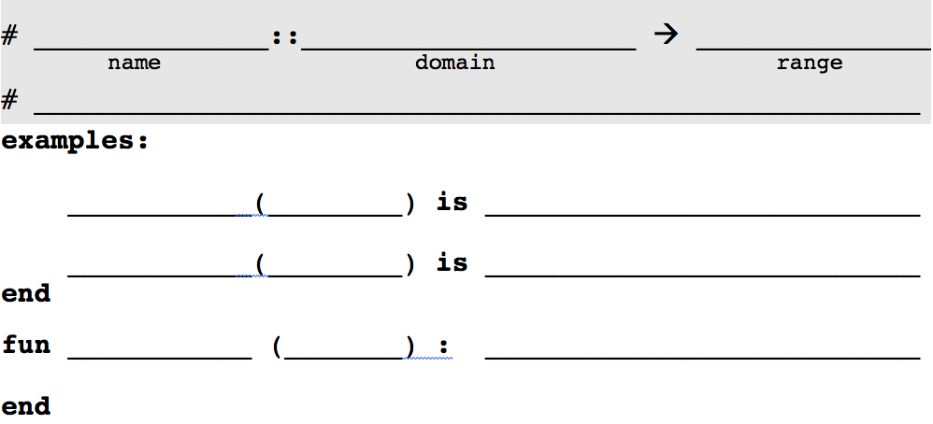

Defining Lookup Functions (pg. 10)
Define a function called is-fixed, which looks up whether or not an animal is fixed
is-fixed
r
is-fixed
is-fixed
(r :: Row)
Boolean
Consumes an animal, and look up whether the animal is fixed
animalA
false
is-fixed
animalB
true
r[“fixed”]
Complete the next word problem with your partner!

Slide 43
Defining Compute Functions (pg. 11)
Define is-cat, which consumes a Row of the animals table and computes whether it is a cat.
is-cat
is-cat
r
is-cat
(r :: Row)
Boolean
Consumes an animal, and produce true if the animal is a cat
animalA
true
is-cat
animalB
false
r[“species”] == “cat”
Complete the next word problem with your partner!

Slide 44


The Design Recipe in Your Classroom
“Battling”, “Peer Review”, “Challenging”, etc..
  Have students justify each step based on the last
  “Where’d you get that”?
Tri-fold paper
Contract & Purpose
Examples
Definition

Slide 45
Why not just “go nuts”?
What the Design Recipe Buys You
Scaffold problem-solving
Multiple representations
Make thinking explicit
Pedagogical tool (battling, questioning, presenting)
Equity

Slide 46
More about Methods
#<Table>.filter :: (test :: (Row → Boolean)) → Table
animals-table.filter(is-fixed)
bar-chart(animals-table.filter(is-fixed), “species”)
Functions can consume other functions!
Try using is-young.
Try using gender.
  filter needs Boolean-producing functions!

Slide 47
Methods, Man
#<T>.build-column :: (col:: String, b :: (Row→Value))→ Table
animals-table.build-column(“young”, is-young)
Challenge:
  Make a pie-chart showing how many animals
  in the dataset are young v. “not-young”

Slide 48
What’s the pattern?
“Make a pie-chart of dogs, showing how many are fixed”
“Make a bar-chart of young animals, showing species”
Can you come up with other examples?
“Make a <display> of <subset>, showing <data>”
1) If needed, write a filter function
2) If needed, write a builder function
3) Use methods to make your table
4) Make the display from that table

Slide 49
Get those reps!
Make a pie-chart of cats, showing how many are fixed or unfixed.
Make a bar-chart of fixed animals, showing distribution of species.
Make a bar chart of young animals, showing how many are cats or “not-cats”
(You can use Blank Design Recipes on Page 60)

Slide 50
What’s on your mind?
Take a minute to jot down notes, questions, or ideas you have on Page 12

Slide 51
Unit 3

Slide 52
Guiding Question
“Which 10 animals best represent the animals at the shelter?”

Slide 53
Review
Challenge: write is-dog, and make a bar-chart for all the dogs in the dataset showing how many are fixed vs. unfixed.

Slide 54
Making Subsets
“How do Americans feel about X?”
Ask only churchgoers?
Ask only Californians?
“How do women feel about Y?”
Ask only the women?
Ask only women over 50?

Slide 55
Making Subsets
Sampling can be complicated.
Depending on the question, you may want a logical subset of the population.
Given some row r, how would check to see if it’s a kitten?
  fun is-kitten(r):
  (r[“age”] < 2) and (r[“species”] == “cat”)
  end
Complete Page 14

Slide 56
Making Subsets
Sometimes you want a random subset.
  Check the contracts page!
How big should the subset be in order to be representative?
Make two random subsets: tiny and small
  tiny-sample = random-rows(animals-table, 3)
  small-sample = random-rows(animals-table, 8)

Slide 57
Start with Subsets
When exploring a new dataset, start with logical subsets. Don’t bias your analysis!
What subsets make sense for the animals dataset?
  dogs = animals-table.filter(is-dog)
  cats = animals-table.filter(is-cat)
  fixed = animals-table.filter(is-fixed)
  young = animals-table.filter(is-young)

Slide 58
Which sample is best?
Suppose we want to see the distribution of species
  pie-chart(animals-table, “species”)
Which subset is most representative?
  pie-chart(tiny-sample, “species”)
  pie-chart(small-sample, “species”)
  pie-chart(cats, “species”)
  pie-chart(fixed, “species”)
  …and so on

Slide 59
Project: Choose Your Dataset!
On the Teacher Resources Page, scroll to “Project Files”
Choose a dataset that interests you
  We’ll be adding more
  You can find your own (data.gov, google, and other sources)
  You can collect your own using Google forms!
Click on “README”
Save a copy of the Starter File, and click “Run”

Slide 60
Exploring Your Dataset
Complete Page 15
Use .row-n to define at least two sample rows. Be sure to use reasonable variable names!
Use random-rows to define “tiny” and “small” random samples

Slide 61
Exploring Your Dataset
What subsets make sense?
Complete Page 16
You’ll need some functions! Use Pages 17 and 18 to build those functions, filter your dataset, and define at least two subsets.
Pick one categorical column and make a chart. Which of your subsets is most representative?

Slide 62
What’s on your mind?
Take a minute to jot down notes, questions, or ideas you have on Page 19

Slide 63
Unit 4

Slide 64
Guiding Question
“How long does it take for animals at the shelter
to be adopted?”

Slide 65
Review
Challenge:
  Complete Page 22
  Use the .build-column method to make a table showing the weight of every animal, in kilograms

Slide 66
“What’s a typical adoption time?”
Look at the raw data. What do you think?
Would a bar or pie chart help us?
How would you answer?
A simple number isn’t good enough – we need to describe the shape of the data

Slide 67
Not all bars are created equal…
Complete Page 23
What is similar about these displays?
What is different?
Bar charts count values of categorical data
Histograms count ranges of quantitative data
Bar charts can “make sense” in any order
Histograms must be ordered

Slide 68
Histograms
histogram :: (t:: Table, vals:: Str, bin-size:: Num)→Img
histogram(animals-table, ”weeks", 5)
Most animals adopted in ≤10 weeks
A couple of animals took a very long time
More than half (17/31!) took just 5 weeks

Slide 69
Histograms
Histograms give us insight into the shape of a dataset.
By learning to read a histogram, you’ll be able to interpret the shape of your own.
Practice reading histograms on Page 24

Slide 70
Histograms
Symmetric shapes are balanced around the middle.
  Ex: Heights of 12-year-olds
Skewed Left, or low outlier shapes have most values clustered on the right, trailing off to the left.
  Ex: Number of teeth in adults (some have none, none have 2x !)
Skewed Right, or high outlier shapes have most values clustered on the left, trailing off to the right.
  Ex: Earnings (some of 10x, none have negative!)
Complete Page 25

Slide 71
Bin Size
  What does the last argument to histogram mean?
Make a histogram of the pounds column in the animals table, using 20 pounds bins:
  histogram(animals-table, “pounds”, 20)
Try 1-pounds bins. 100-pound bins. What size is best?
Rule of Thumb: always have between 5 and 10 bins
Practice making histograms from the animals dataset, and describe them on Page 26.

Slide 72
Your Research
Make some histograms from your dataset. What columns are interesting?
What shapes stand out?
Write your findings on Page 27

Slide 73
What’s on your mind?
Take a minute to jot down notes, questions, or ideas you have on Page 28

Slide 74
Unit 5

Slide 75
Guiding Question
“What is a typical weight for animals at the shelter?”

Slide 76
Summarizing Data
What kind of question is this?
Open the Animals w/Functions File
Examples summaries: GPA, SAT, Credit Score…

Slide 77
Mean
The Mean is the Sum, divided by the Length of the list.
What is the mean of 5, 2, 3, 1, 4?
Pyret has a mean function for tables!
# mean :: (t :: Table, col :: String) → Number
  mean(animals-table, “pounds”)
  Write your answer on Page 30

Slide 78
Median
The Median is the “middle” value of a sorted list of numbers
What is the median of 5, 2, 3, 1, 4?
If there is no “middle”, take the mean of the “middle two”
What is the median of 5, 2, 3, 1, 4, 6?
# median :: (t :: Table, col :: String) → Number
  median(animals-table, “pounds”)
  Write your answer on Page 30

Slide 79
Modes
The Modes are the “most repeated” value in a list of numbers
What are the modes of 5, 2, 3, 3, 1, 4?
There can be multiple modes 5, 2, 3, 3, 1, 4, 6, 5
There can be no modes at all! 5, 2, 3, 1, 4, 6?
# modes:: (t :: Table, col :: String) → List<Value>
  modes(animals-table, “pounds”)
  Write your answer on Page 30

Slide 80
Which measure is “best”?
Imagine that a math teacher is tracking their students’ grades. Here are the students’ grades on the first test.
grade-list = [list: 68, 63, 62, 100, 99, 68, 67]
Which measure gives the best indication of how the class did?
  mean: 75.57
  median: 68
  modes: [list: 68]
Outliers

Slide 81
What do you think?
According to the US Census Bureau, the average American household earned more than $45,000 in 2003 - more than 3x the poverty line that year. They conclude that very few Americans live in poverty.
What do you think?
What kind of question is this?
Notes:
Compute question

Slide 82
Variation Matters
Plotting values on a number line
The median splits the values into “upper” and “lower” halves
The medians of the halves defines four quartiles
Interquartile Range
Range
Min
Q1
Median
Q3
Max

Slide 83
Variation Matters
Plots like these are called box-plots.
# box-plot :: (t :: Table, col :: String) → Image
  box-plot(animals-table, “weeks”)
Five-Number Summary
  Min, Max, Median (Q2), Q1 and Q3
  Write this on Page 33
Sketch your box plot - horizontally - on Page 30

Slide 84
Fake News
Terms like “average” (or mean), “most common” (mode), or “middle” (median) show up in the news.
But they don’t mean the same thing, and can easily be abused to trick the reader into drawing a faulty conclusion.
Complete Page 31, and refute the misleading claims at the bottom!
Connecting box-plots to histograms: complete Page 32

Slide 85
Your Research
Explore Center and Variation for your data on Page 33

Slide 86
What’s on your mind?
Take a minute to jot down notes, questions, or ideas you have on Page 34

Slide 87
Unit 6

Slide 88
Guiding Question
“How do we trust someone else’s data analysis code?”

Slide 89
Methods, Man
Methods can be chained together on one line, or split:
animals-table.build-column(“year”, birth-year).filter(is-fixed).order-by("species", true)
animals-table
.build-column(“year”, birth-year)
.filter(is-fixed)
.order-by("species", true)
Complete Page 36
Complete Page 37
Order matters!

Slide 90
Trust, but verify…
Data Scientists are good people who like to help each other out.
But how do you know if you can trust someone else’s code? (Especially if you can’t see it…)
# fixed-cats :: (animals :: Table) → Table
# consumes a table of animals, produces a one containing only
# cats that have been fixed, sorted from youngest-to-oldest

Slide 91
Trust, but verify…
Complete Pages 38 and 39
Open the “Trust, but Verify” Starter file
Save a copy, and click “Run”
verify1 and verify2 are your verification tables
Build the verification tables you wrote down, and figure out which functions are right!

Slide 92
Trust Matters
Verification tables are how we check our work.
A mistake in a program can cost billions, or harm millions of people. (Austerity problem)
Machine learning uses data to “train” machines to…
  Create chat bots
  Drive cars
  Identify criminals

Slide 93
What’s on your mind?
Take a minute to jot down notes, questions, or ideas you have on Page 40

Slide 94
Unit 7

Slide 95
Guiding Question
“Do young animals get adopted faster?

Slide 96
Scatter plots
Complete Page 43.
Scatter plots visualize relationships between two columns
# scatter-plot :: (t :: Table, labels :: Str, xs :: Str, ys :: Str) → Img
Make a scatter-plot for age v. weeks, using names as the labels

Slide 97
Searching for Correlations
Is there a trend?
Are there outliers?
Hover over each dot.
Correlations
  Direction
  Strength
Adoption(weeks)
Age (years)

Slide 98

Correlation <> Causation
Search for correlations – not causes! – in your dataset

Slide 99
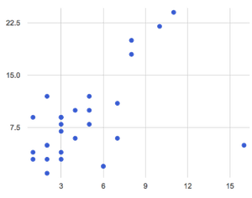
Predictors
Age (yrs) v. Adoptions (wks)
Suppose there is a trend
Can you draw it?
We can make predictions!
Complete Page 44

Slide 100
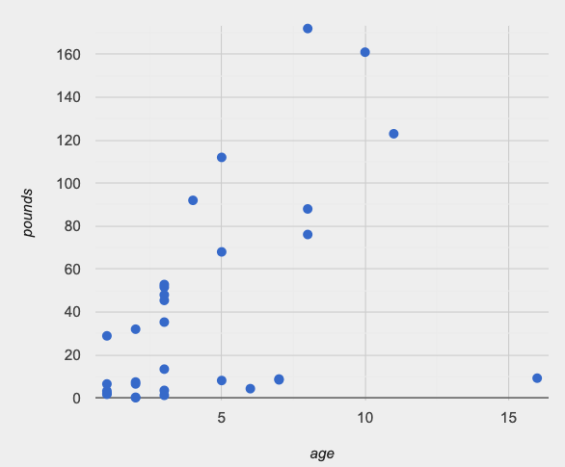
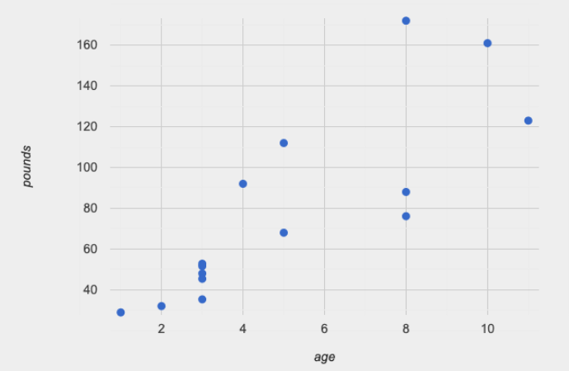
Subsets and Correlations
Which Correlation is Stronger?
Age v. Pounds, all animals
Age v. Pounds, only dogs

Slide 101
Your Dataset
Generate some scatterplots from your data
What patterns emerge?
  Are they strong or week?
  Positive or Negative?
Write up your findings on Page 45

Slide 102
What’s on your mind?
Take a minute to jot down notes, questions, or ideas you have on Page 46

Slide 103
Unit 8

Slide 104
Guiding Question
“How do you know if one correlation is stronger
than another?”

Slide 105
Searching for Correlations
How do we measure the “fit” of a predictor (strength of correlation)?
Playing with predictors
  Move point P
  What happens to the line?
  What does the line’s slope mean?
  What does “r = …” mean?
How do we draw the predictor with the “best fit”?
Complete Page 48
Age (yrs) v. Adoptions (wks)

Slide 106
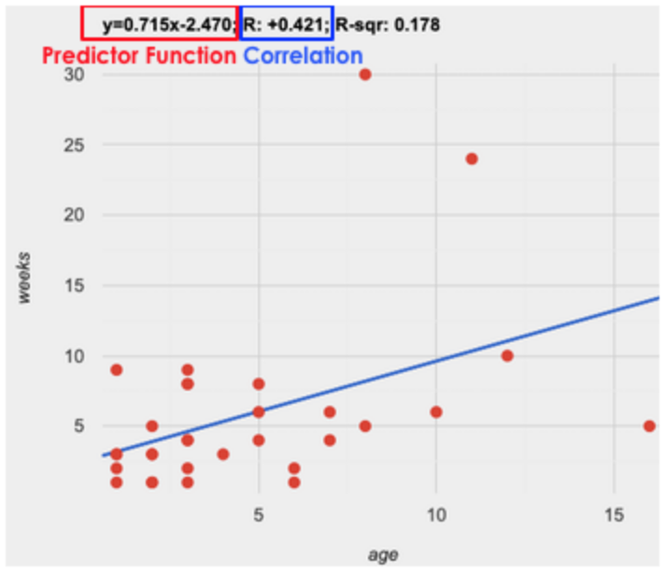
Linear Regression
# lr-plot :: ( t:: Table, labels :: Str, xs :: Str, ys :: Str)→Img

Slide 107
Linear Regression
r
r²
slope
y-intercept
http://bit.ly/ExploreLR19

Slide 108
Do you speak Linear Regression?
In LR, x is sometimes referred to as the explanatory variable, and y is referred to as the response or “outcome” variable.
How well can you read the result of a linear regression analysis?
Turn to Page 49, and match the the findings to the predictor function and r-value

Slide 109
The Animals Dataset
The age vs. weeks waiting for adoption, but just for the dogs in the shelter.
The weight vs. weeks waiting for adoption, but just for the cats in the shelter.
The age vs. weight waiting for adoption, but just for animals that have been fixed.
Write up your findings on Page 50

Slide 110
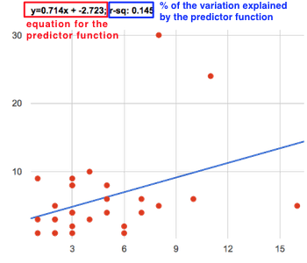
Your Dataset
Write up your findings on Page 51

Slide 111
What’s on your mind?
Take a minute to jot down notes, questions, or ideas you have on Page 52

Slide 112
Unit 9

Slide 113
Guiding Question
95% of cat-owners surveyed said that cats are better than dogs.
“What’s wrong with this?”

Slide 114
Threats to Validity
“95% of cat-owners surveyed said that cats are better than dogs!”
Selection bias
Sample size
Sample error
Confounding variables
Practice on Pages 54 and 55

Slide 115
Fake News!
People misrepresent data all the time!
Complete Page 56.
Now it’s your turn. ;) Complete Page 57.
Being able to speak accurately about data is an essential part of being a Data Scientist.
Your Research Paper

Slide 116
Implementation Options
Small
Unit 1
  Cat/Quant
  Datatypes
  Contracts
  Make images
  Pie/Bar charts
Unit 4-5,7-8 “lite”
  Histograms
  Box-plots
  Scatterplots
  Linear Regression
  Presentation
Medium
Unit 1
Unit 2
  Define values
  Define functions
  Methods
Unit 3
  Making subsets
  Choose your own data
Unit 4-5, 7-8 “lite”
Paper or Presentation
Large
Unit 1-3
Unit 4
  Measures of Center
  Measures of Variation
Unit 5
Unit 6
  Method Chaining
  Verification Tables
Unit 7
Unit 8
Unit 9
  Threats to Validity
  Fake News
Paper or Presentation

Slide 117

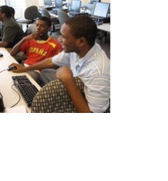
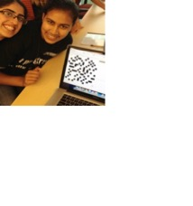
Algebra
Bootstrap:Algebra applies algebraic
concepts and rigorous programming
principles to creating a simple
videogame. Students use order of
operations, function composition, the
distance formula, coordinates and inequalities in the plane to detect collisions, handle keystrokes, and determine how they move and interact – with each challenge framed as a standard word-problem. The module is aligned to National & State Standards for Mathematics, the CSTA standards and K12CS frameworks, and has been shown to improve students’ performance on standards algebraic tasks*.
DataScience
Which artist do you listen to most? Do
schools in richer areas of your town do
better than those in poorer ones? What’s
the healthiest cuisine? Our Data Science
module teaches students to view
programs as questions we ask of data. Students form their own questions about the world around them, and learn to analyze data critically and carefully to find answers. Business, science, and history teachers can utilize this module to help students make inferences from data. Math teachers can use this module to introduce statistics in an accessible way. It also works great as a module for AP CS Principles’ unit on data!
Physics
This module is developed in partnership
with the American Association of Physics
Teachers & American Modeling Teachers
Association. It helps students understand
dynamics concepts by using
programming to build models of the
physical world. The module is targeted at ninth grade, a year in which every student is expected to take science. The module is aligned to the Physics First movement, allowing teachers to present computational modeling as a basic tool to students preparing to study science more broadly.
Reactive
Bootstrap:Reactive goes deeper into
programming, building events and data
structures on top of the foundation laid by
our intro courses and allowing students to
build far more sophisticated programs.
Students learn how the event loop that drives their Bootstrap:Algebra game works, and use it to create animations using simple datatypes. They then learn about data structures, and design a structure for a sophisticated game of their own design. Bootstrap:Reactive is aligned to the CSTA standards and K12CS frameworks.
Notes:
This is just one part of a multi-facet pathway that we at Bootstrap have created. Bootstrap:Physics allows your physics teacher to integrate computing into a standard HS Physics class, and Bootstrap:Reactive allows your students to go deeper into CS by building on – rather than throwing away – what they’ve learned. But there’s also a new trend in CS, which is taking over universities and the corporate world: Data Science. Here are just a few screenshots of major institutions that are pushing for Data Science. And now…Bootstrap is offering an introductory Data Science module for middle or high school, which requires no computing background!

Slide 118


Connect with Us!
/ BootstrapWorld
@BootstrapWorld
Questions:
http://discourse.BootstrapWorld.org
Grab a photo!

Slide 119

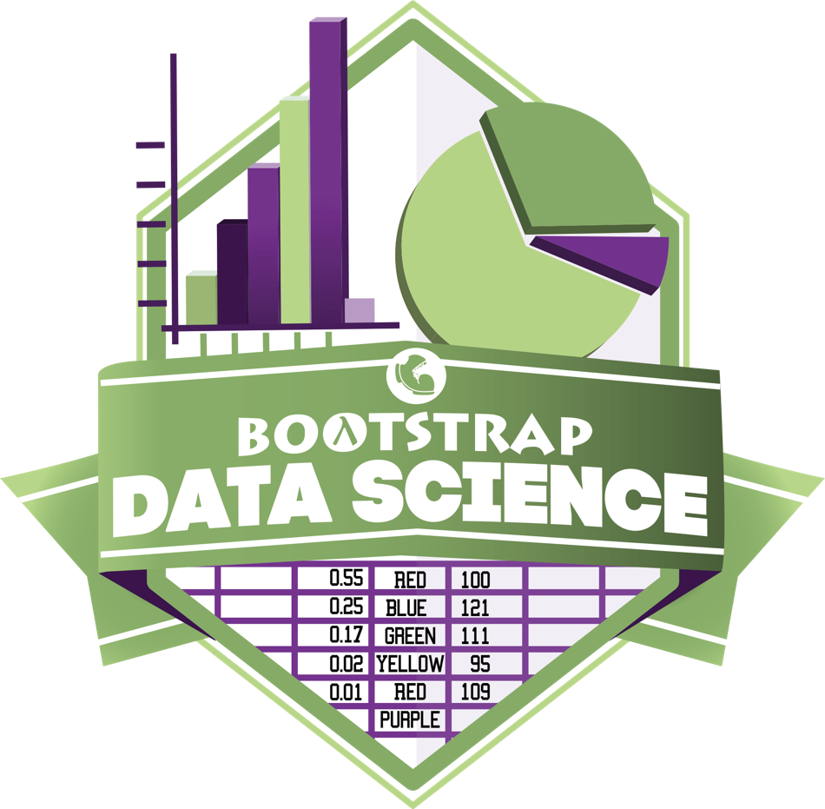
Notes:
Use this slide as background for the Group Photo

Slide 120
We’d like your feedback!

