Slide 1

BETA
DataScience
Notes:
Introduce Trainers, and have Participants introduce themselves

Slide 2
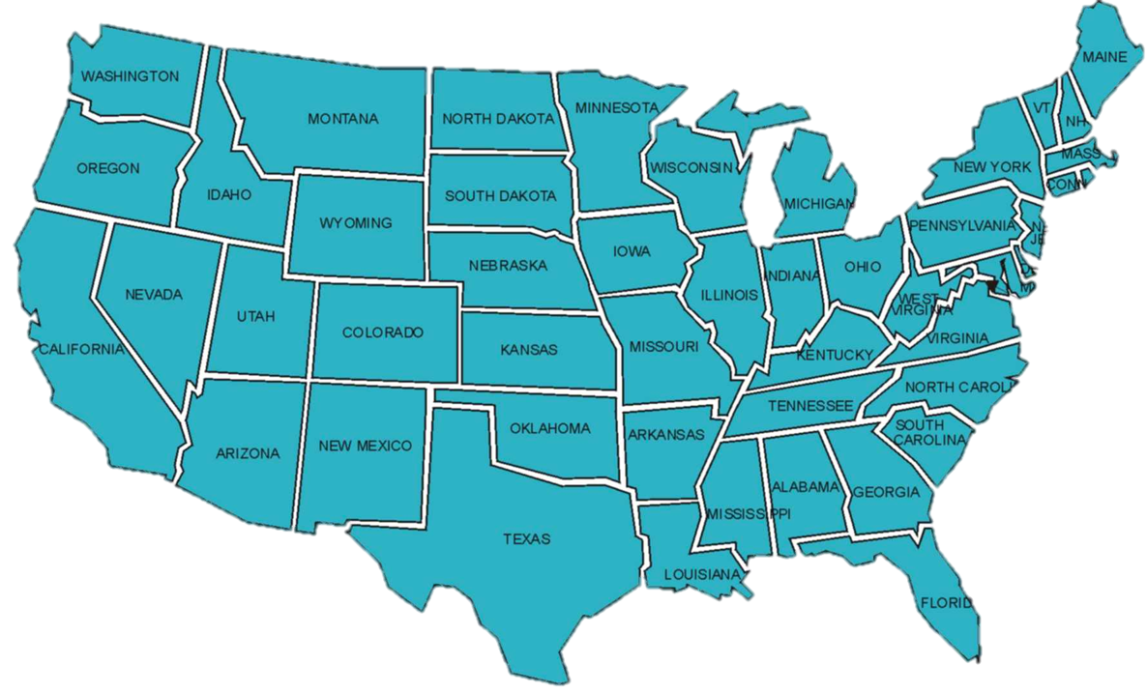
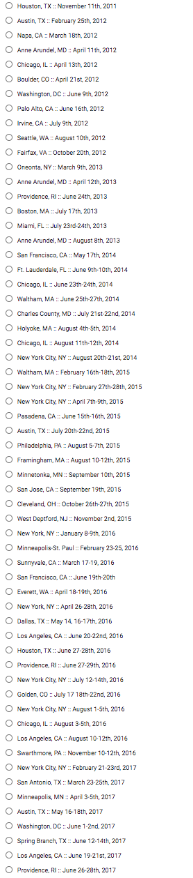
20 Thousand Students Annually
43% Girls and Young Women
46% African-American or Latino
2011

Slide 3
2017

Slide 4
What does “Beta” mean?
It’s not finished!
There are going to be mistakes
We don’t have all the answers
You will set the direction for the course

Slide 5
Goals for this Workshop
Understand what “Data Science” is, why it matters
Get comfortable with programming in Pyret
Work through the entire curriculum
Discuss pedagogy
Get your feedback

Slide 6
What is Data Science?
Notes:
Equity implications of these points

Slide 7
Challenges for K12
Professional DS tools aren’t student-friendly
Non-DS languages are cumbersome
  Importing data is messy
  Batteries not included (plotting, stats)
  Loops and arrays make for a high floor!
Mixing off-the-shelf tools means teachers must spend time putting the pieces together.
Notes:
Equity implications of these points

Slide 8

Bootstrap’s Solution
Build a DS tool made for learning!
Easy importing from Google Sheets
Make tables as easy as numbers
If tables are values, queries are expressions
  You can teach a real DS course – with #NoLoops and #NoArrays!
But getting the tool right is only half of the equation…
www.pyret.org
Notes:
Equity implications of these points

Slide 9
The Austerity Problem

Slide 10
The Austerity Problem
Austerity measures were chosen – despite the misery they caused – because of recommendations from economists.
Those recommendations were based on an analysis of debt-to-growth trends: a giant excel spreadsheet, and lots of analysis of that data.
“Backed by millions of data points” sounds a lot more convincing than “backed by hundreds of data points”.
There was just one problem…
Notes:
Equity implications of these points

Slide 11
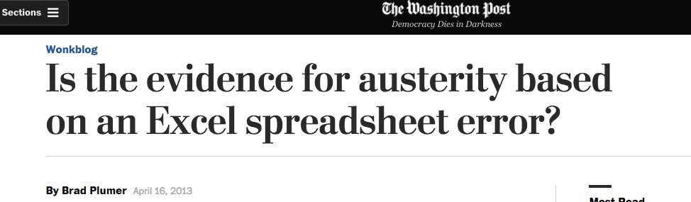
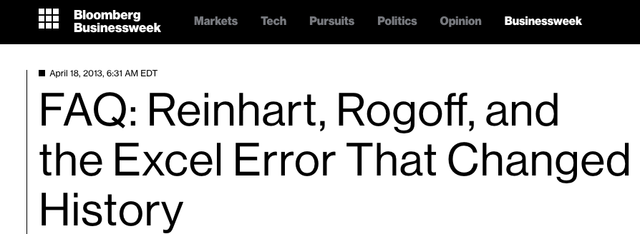
The Austerity Problem
Notes:
Equity implications of these points

Slide 12
The Austerity Problem
Data Science is not about writing for-loops, queries or Excel formulas…
…any more than programming is about “writing code”
Data Science is about analysis, and making sense of data. If all we do is teach kids Excel, R, etc…we fail.
Data Science must be about more than the tool!
Notes:
Equity implications of these points

Slide 13
Agenda
Theory
Overview
Practice
Pedagogy

Slide 14
Bootstrap Materials
Software: In the cloud, or on your machine.
Lesson Plans: Detailed[*] curricula, student handouts, integrated workbooks, and supplemental activities.
Standards: All lessons are aligned to National and State Standards.
Language: Algebraic semantics, integrated tables, integrated graphing and plotting

Slide 15
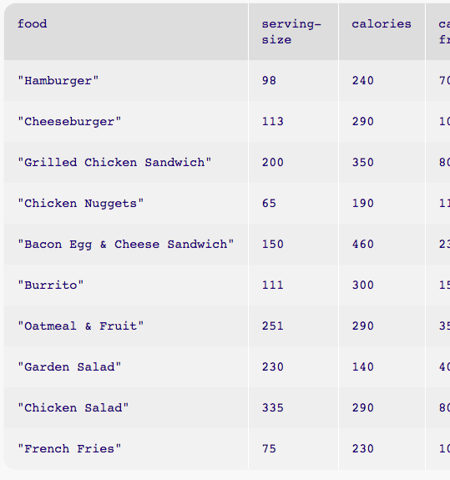
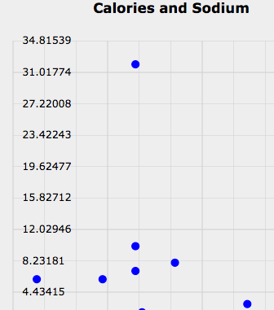
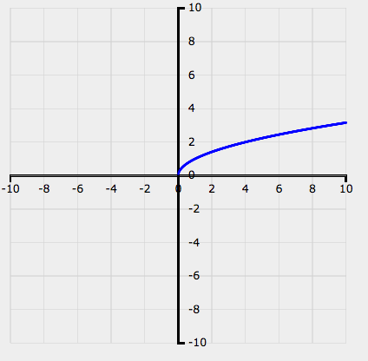
10,000 Foot View
What Questions Matter to You?
Introduction to Pyret, plotting and tables

Slide 16
10,000 Foot View
What Questions Matter to You?
Introduction to Pyret, plotting and tables
Measures of Center
Bar and Pie Charts

Slide 17
10,000 Foot View
What Questions Matter to You?
Introduction to Pyret, plotting and tables
Measures of Center
Bar and Pie Charts
Histograms
Notes:
How do we know the kids are actually getting this?
We do something that most colleges don’t do: code reviews.

Slide 18
10,000 Foot View
What Questions Matter to You?
Introduction to Pyret, plotting and tables
Measures of Center
Bar and Pie Charts
Histograms
Line of Best Fit

Slide 19
10,000 Foot View
What Questions Matter to You?
Introduction to Pyret, plotting and tables
Measures of Center
Bar and Pie Charts
Histograms
Line of Best Fit
Selecting and Sorting Tables
Filtering rows with Boolean Expressions
Computing new columns
?

Slide 20
Where Does DataScience Fit?
Data Science Classes
Math & Statistics Classes
Business Classes
Civics Classes
AP CS Principles Classes

Slide 21
Agenda
Introduction
Theory
Practice
Pedagogy

Slide 22
Setting up your classroom
Physical Materials (workbooks, pens, etc)
One computer for each pair of students
Gmail Account (per-class? per-pair?)
Log into http://code.pyret.org/ (IE9+, FF, Chrome)
Go to www.BootstrapWorld.org/materials

Slide 23
Unit 1

Slide 24
Do Now
Find a topic that interests you (max 4 students to a topic!)
Choose a question, or create your own
Discuss your answer to the question (2min)
What measurements/data came up? (2min)
Complete Page 1 in your workbook

Slide 25
Driver / Navigator
Pair programming needs structure!
The “Driver” has their eyes on the computer
The “Navigator” has their eyes on the workbook
Switch roles regularly

Slide 26
Numbers and Strings in Pyret
Start a new Pyret Program
Making Numbers
Making Strings
Operations
Turn to Page 2…
Notes:
Start a new Pyret Program
Making Numbers (show off rationals)
Making Strings (errors w/unclosed strings)
Operations (errors w/spaces)

Slide 27
Error Messages
How we react is key: are we scared or excited?
“The computer is giving you a clue…”
“What do you think it’s trying to tell us…?”

Slide 28
Definitions in Pyret
Suppose you want to throw a pizza party for a class of 16 students. We need to buy one of each of these per student:
  1 Slice of Pizza : $2.50
  1 Plastic Plate : $0.20
  1 Soda : $0.98
What code will compute the total cost for the party?
Defining variables: party-people
Turn to page 3…
Notes:
Start a new Pyret Program
Making Numbers (show off rationals)
Making Strings (errors w/unclosed strings)
Operations (errors w/spaces)

Slide 29
Functions in Pyret
Let’s explore a new function, num-min. Type each of these lines of code into the interactions area and hit enter.
  num-min(0, 1)
  num-min(-5, 2)
  num-min(8, 6)
How many arguments does num-min have?
What type of values does this function take in?
What type of value does this function output?
How does this output relate to the arguments?
Try num-sqrt
Notes:
Start a new Pyret Program
Making Numbers (show off rationals)
Making Strings (errors w/unclosed strings)
Operations (errors w/spaces)

Slide 30
Page 46: Contracts
<name> : <domain> → <range>
# MrCoffee : Beans Water → Coffee
# num-sqrt : Number → Number
# num-sqr : Number → Number
“Comment”

Slide 31
Plotting in Pyret
Add include plot-list at the top of Definitions
Two new functions (and datatypes!):
  # function-plot: (Number -> Number) -> Series
  # plot : Series -> Plot
Use them to plot num-sqrt:
# define the series and graph for the function f(x)=√x
sqrt-series = function-plot(num-sqrt)
sqrt-graph = plot(sqrt-series)

Slide 32
Plotting in Pyret
You can zoom by drawing a rectangle!
Save your work

Slide 33
Unit 2

Slide 34
Do Now
“What is the relationship between calories and sugar?”
- Write your hypothesis on Page 4

Slide 35
Tabular Data
Not all data is atomic.
We live in a world of structured data!
  Restaurant menus
  Flight itineraries
  Musical playlists
Let’s look at an example
Vocabulary: Rows, Columns and Entries
Header Row
Turn to Page 5…
First | Last | Eye-Color | Height
"John" | "Doe" | "Green" | 52.0
"Jane" | "Smith" | "Brown" | 49.1
"Javon" | "Jackson" | "Brown" | 57.7
"Angela" | "Enriquez" | "Hazel" | 52.5
"Jack" | "Thompson" | "Blue" | 53.0
"Dominique" | "Rodriguez" | "Hazel" | 51.1
"Sammy" | "Carter" | "Blue" | 56.2
Notes:
All the data in a column has one type

Slide 36
Tables in Pyret
Open the Unit 2 Starter File
Save a Copy
Click Run
What definitions do you see?
Loading spreadsheets and tables

Slide 37
Quantitative v. Categorical
First | Last | Eye-Color | Height
"John" | "Doe" | "Green" | 52.0
"Jane" | "Smith" | "Brown" | 49.1
"Javon" | "Jackson" | "Brown" | 57.7
"Angela" | "Enriquez" | "Hazel" | 52.5
"Jack" | "Thompson" | "Blue" | 53.0
"Dominique" | "Rodriguez" | "Hazel" | 51.1
"Sammy" | "Carter" | "Blue" | 56.2
Quantitative data answers “How much?”
Categorical data answers “Which one?”
Turn to Page 6…

Slide 38
Extracting Lists From Tables
sodium-list = extract sodium from nutrition end
What is the type of sodium-list?
Define state-list, which contains the state column from presidents
Define calories-list, which contains the calories column from nutrition
Define sugar-list, which contains the sugar column from nutrition
List<Number>

Slide 39
Scatterplots
# scatter-plot : List<Number> List<Number> → Series
sugar-v-calories = scatter-plot(calories-list, sugar-list)
plot1 = plot(sugar-v-calories)
plot2 = plot(sugar-v-calories).title("Calories and Sodium")
plot3 = plot(sugar-v-calories)
.title("Calories and Sodium")
.x-max(600)
plot4 = plot(sugar-v-calories)
.title("Calories and Sodium")
.x-max(600)
.y-max(400)

Slide 40
Back to our Question…
“What is the relationship between calories and sugar?”
- Write your answer on Page 4

Slide 41
Project: Choose Your Dataset!
Choose a dataset that interests you
  We’ll be adding more
  You can find your own (data.gov, google, and other sources)
  You can collect your own using Google forms!
What question do you have about this dataset?
Open and Save a Copy of the Starter File and Final Report for your dataset
Complete Questions 1-3 in your Project Report

Slide 42
Unit 3

Slide 43
Do Now
“According to the US Census Bureau, the average American household earned more than $45,000 in 2003 - more than 3x the poverty line that year. Can we conclude that only a small percentage of Americans were in poverty that year?”
- Write your hypothesis on Page 7

Slide 44
New Dataset: Countries
Open the Unit 3 Starter File
Save a Copy and click Run
Review:
  What tables are being loaded here?
  What are the columns of countries?
  Are they categorical or quantitative?
  What do they tell us about each country?

Slide 45
Defining Lists
a = [list: 1, 1 , 4]
What is the Name of this list?
What is its Type?
Define lists of your own
  A list of all the days of the week
  A list of the first 10 even numbers
  A list of your favorite colors
List<Number>

Slide 46
Mean
The Mean is the sum of the elements of a list, divided by the length of the list.
Turn to Page 8…
Pyret has a mean function! What do you think its contract is?
    # mean : List<Number> → Number
    mean([list: 1, 2, 3, 4])
How do you take the mean of a? Test your answers from Page 8

Slide 47
Median
The Median is the “middle” value of a list of numbers.
What is the median of [list: 2, 3, 1]? Why?
What is the median of [list: 2, 3]? Why?
Turn to Page 8…
Pyret has a median function! What do you think its contract is?
    # median : List<Number> → Number
    median([list: 2, 3, 1])
How do you take the median of a? Test your answers from Pg 8

Slide 48
Mode
The Mode is the element that appears most often in a list.
What is the mode of [list: 1, 2, 2, 3, 4]? Why?
What is the mode of [list: 1, 1, 2, 3, 4, 4]? Why?
Turn to Page 8…
We have 2 mode functions! What do you think their contracts are?
    # mode: List<Number> → Number
    # modes: List<Number> → List<Number>
How do you take the mode of a? Test your answers from Page 8

Slide 49
Measuring Center w/Tables
How would we find the mean of the calories column in our nutrition table?
calorie-list = extract calories from nutrition end
mean(calorie-list)
mean(extract calories from nutrition end)
Which style do you like better? Why?
Turn to Page 9…
A
B

Slide 50
Which measure is “best”?
Imagine that a math teacher is tracking their students’ grades. Here are the students’ grades on the first test.
grade-list =[list: 68, 64, 62, 100, 100, 68, 67]
Which measure gives the best indication of how the class did?
  mean: 75.57
  median: 68
  mode: 69
Outliers

Slide 51
Which measure is “best”?
Suppose we want to look at how much sodium is in our menu. Would taking the mean or median be more accurate? Why or why not?
Suppose we want to know how long the average person on Earth lives. Would taking the mean of median-life-expectancy give us the answer? Why or why not?

Slide 52
Back to our question…
“According to the US Census Bureau, the average American household earned more than $45,000 in 2003 - more than 3x the poverty line that year. Can we conclude that only a small percentage of Americans were in poverty that year?”
- Write your findings on Page 7

Slide 53
Project: Centers of Your Dataset
Open your Final Project files (code and report)
Answer Question 4

Slide 54
Unit 4

Slide 55
Bar and Pie Charts
Open the Unit 4 Starter File
Let’s go through the code together…
What new functions do you see here?
What are their contracts?
# bar-chart : List<String> List<Number> -> Series
# pie-chart : List<String> List<Number> -> Series
Practice reading your charts on Page 11

Slide 56
Frequency Bar Charts
Turn to Page 12…
What’s different about this bar chart?
# freq-bar-chart : List<String> -> Series
Create a frequency chart chart for the party column in the presidents dataset.
Create a frequency chart chart for the continent column in the countries dataset.
For more practice reading charts, complete Pages 13-16
Notes:
By filling in the last bar, you have created a bar chart. However, there’s something special about chart. What is different about this bar chart from the ones we have created before?
Previous bar charts used a column from the table as the labels, and another column as the values.
In this bar chart, we are using the categories of a column as the labels, and the frequency of each category as the value.
Here, we are looking at the Eye Color column, which contains categorical data. In this special kind of bar chart, we are computing the frequency of each category, and that frequency relates to the length of each bar. Since there are 3 people with brown eyes, the bar for Brown extends to 3 marks long.

Slide 57
Project: Visualizing Your Dataset
Open your Final Project files (code and report)
Use the new visualization functions you’ve just learned to work with your dataset.
Answer Questions 5 and 6

Slide 58
Unit 5

Slide 59
Do Now
“A stranger invites you to play a game. You start by guessing a number between 2 and 12. The stranger rolls two dice, and add the numbers together. If that sum is the number you guessed, you win the jackpot, but if your number is wrong, then you lose your money. What are your odds of winning this game? Are they good enough that it’s worth playing?
Write your hypothesis on Page 17

Slide 60
Plotting Probability
What are all the possible numbers we could guess? Are they all “equally likely”, or is there a Lucky Number?
Open the Unit 5 Starter File, Save a Copy, and click Run.
What do the following expressions evaluate to?
  roll-dice(1)
  roll-dice(2)
  roll-dice(100)
What is the contract for roll-dice?
  # roll-dice: Number → List<Number>
  Will roll-dice(10) always return the same thing?

Slide 61
Plotting Probability
  Use roll-dice(10000) to define a list of 10,000 sample rolls.
What are the mean, median and mode of this list?
7 is certainly the best number, but is it “lucky”?
Will it come up at least 50% of the time, or are we still more likely to with that number?
We need something like a frequency-bar chart…
dice-histogram-series = histogram(roll-dice(10000), 11)
dice-histogram-plot = plot(dice-histogram-series)
Notes:
Unfortunately, we still don't know if 7 comes up often enough for this to be a game worth playing! We've used our measures of center to figure out the most frequent number, but just @italic{how frequent is it}? We need some way of asking if 7 appears more than all the other numbers combined.

Slide 62
Bins and Spread
  What does the second argument to histogram mean?
What if there were only 2 bins? 40?
Why is 11 ideal?
  It accurately covers all possible rolls (it’s “big enough”)
  There are no relevant values left out (it’s “small enough”)
Turn to Page 18…
Create a histogram for the calories column in nutrition
Create a histogram for the gdp column in countries
Notes:
Unfortunately, we still don't know if 7 comes up often enough for this to be a game worth playing! We've used our measures of center to figure out the most frequent number, but just @italic{how frequent is it}? We need some way of asking if 7 appears more than all the other numbers combined.

Slide 63
Back to Our Question…
“A stranger invites you to play a game. You start by guessing a number between 2 and 12. The stranger rolls two dice, and add the numbers together. If that sum is the number you guessed, you win the jackpot, but if your number is wrong, then you lose your money. What are your odds of winning this game? Are they good enough that it’s worth playing?
Write your findings on Page 17

Slide 64
More Practice with Histograms
Turn to Page 19…
You want to rent a shuttle bus to take people from the airport to an event. You know what time everyone’s fight lands, and they all arrive between 8am and 8pm. What would be a good bin-size to determine how many busses you’ll need?
Open your Final Project files (code and report)
Answer Question 7
Notes:
Unfortunately, we still don't know if 7 comes up often enough for this to be a game worth playing! We've used our measures of center to figure out the most frequent number, but just @italic{how frequent is it}? We need some way of asking if 7 appears more than all the other numbers combined.

Slide 65
Unit 6

Slide 66
Do Now
“Are expensive restaurants
generally better than cheaper ones?”
- Write your hypothesis on Page 20

Slide 67
New Dataset: restaurants
name | price | rating
"Family Diner" | 13.21 | 4.5
"Geoff’s Sandwiches" | 10.23 | 4.1
"Best Burger" | 6.52 | 2.9
"Riverside Grille" | 19.56 | 4.9
"Jackie’s BBQ" | 5.57 | 2.3
"La Taqueria" | 9.72 | 4
"Bebop Bar" | 7.2 | 3.3
"Spike’s" | 6.98 | 3.8
"Fred’s Shake Shack" | 5.25 | 3.5
What’s the best-reviewed restaurant? Most expensive?

Slide 68
A return to plotting
Open the Unit 6 Starter File, Save a Copy, and click Run
Define ratings-list and prices-list, by extracting those two columns from the table.
What’s the mean rating of all the restaurants?
Use a histogram to visualize the prices in this table
Create a scatterplot of the prices and ratings
Based on this plot, do you see a pattern – a relationship – between price and rating?
Notes:
By filling in the last bar, you have created a bar chart. However, there’s something special about chart. What is different about this bar chart from the ones we have created before?
Previous bar charts used a column from the table as the labels, and another column as the values.
In this bar chart, we are using the categories of a column as the labels, and the frequency of each category as the value.
Here, we are looking at the Eye Color column, which contains categorical data. In this special kind of bar chart, we are computing the frequency of each category, and that frequency relates to the length of each bar. Since there are 3 people with brown eyes, the bar for Brown extends to 3 marks long.

Slide 69
A return to scatterplots
Is there a trend?
Are there outliers?
Hover over each dot.
Which dot is “Spike’s”?
Complete Page 21…

Slide 70
A return to scatterplots
For practice, make a scatterplot showing the gdp v. median-life-expectancy from countries
Is it positive or negative?
Are there outliers?

Slide 71
Seeing Correlations
Positive v. Negative Correlation
Using the relationship to make a prediction
What rating would we expect a $16 restaurant to have?
Correlations aren’t perfect predictors!
Brainstorm 3 correlations you can think of

Slide 72
Measuring Correlation Strength
Line of Best Fit
Predictor Function
Good v. Bad Predictors
Turn to Page 22…

Slide 73
Linear Regression* and r²
“ish”
#linear-regression:List<Num> List<Num> → (Num→Num)
rating-predictor =
linear-regression(prices-list, ratings-list)
linear-regression is a function that produces a function
The function is the “best fit” for all the points in the dataset
Type rating-predictor(0) into the Interactions Area
How could we get the slope and y-intercept of this function?

Slide 74
Correlation <> Causation
Just because two measures seem to co-relate does not mean that one causes the other!

Slide 75
Combining Plots
rating-predictor is just a function (just like num-sqrt).
Review: Plot this function using function-plot
We’d like to combine the scatterplot and the predictor plot
# plots : List<Series> → Plot
How do we grade this predictor?
# r-squared : List<Num> List<Num> (Num->Num) -> Num

Slide 76
Reflecting
Turn to Page 23…
Return to Page 20, and write down your findings.
Open your Final Project Files (code and report)
Answer Question 8: What kind of correlations would you like to search for in your dataset?

Slide 77
Unit 7

Slide 78
Introduction to Table Queries
Open the Unit 7 Starter File, Save a Copy, and Click Run
Race to explore the new dataset: movies
  What was the domestic gross for "Big Hero 6"?
  What was the overseas gross for "Up"?
  What was the total gross for "Zootopia"?
  What year did "Maleficent come out?"
Type movies-selected into the Interactions Area

Slide 79
The select query
keyword
keywords
select title, year from movies end
table operator
desired columns
dataset
Take notes on Page 45

Slide 80
The select query
In the Definitions Area, complete “Countries and Continents” and “Fat Content”
Complete Page 25 and 26 in your workbook

Slide 81
More Table Queries
Race to answer the following questions:
  Which three foods have the most sodium?
  Which 3 movies had the highest domestic gross ticket sales?
  What are the 3 countries with the smallest population?
Type presidents-ordered into the Interactions Area

Slide 82
The order query
colon
keyword
order movies: title ascending end
table operator
dataset
name/order pairs
Take notes on Page 45
Open the Syntax Error file, and debug these queries

Slide 83
The order query
In the Definitions Area, complete “Salt Order” and “Population”
Complete Page 27

Slide 84
Combining Queries
What if we want to select and order?
Type studio-and-gross into the Interactions Area
What table is this query using?
Are the rows in this table in any particular order?

Slide 85
Introducing Table Plans
We might want to order by one column, then remove it later.
The order of our queries matters – a lot!
Turn to Page 28…

Slide 86
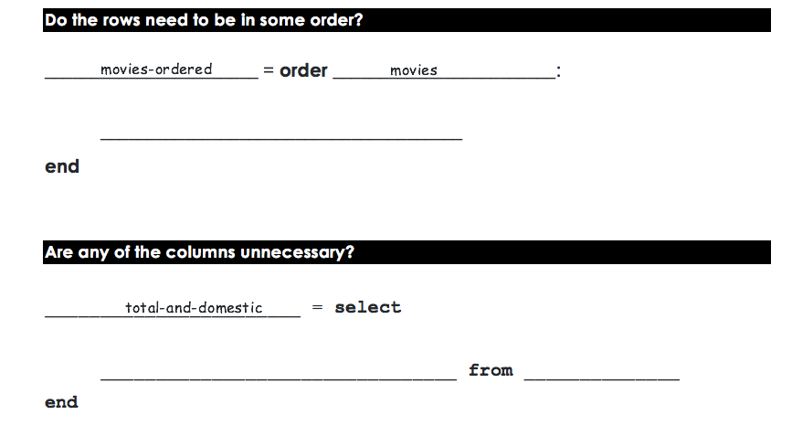
Total-and-Domestic
Movie Title | Studio | Total | Domestic | Overseas | Year
Interstellar | Par. | 675.1 | 188 | 487.1 | 2014
The Sixth Sense | BV | 672.8 | 293.5 | 379.3 | 1999
Man of Steel | WB | 668 | 291 | 377 | 2013
Kung Fu Panda 2 | P/DW | 665.7 | 165.2 | 500.4 | 2011
Ice Age: The Meltdown | Fox | 660.9 | 195.3 | 465.6 | 2006
Movie Title | Total | Domestic
Ice Age: The Meltdown | 660.9 | 188
Kung Fu Panda 2 | 665.7 | 293.5
Man of Steel | 668 | 291
The Sixth Sense | 672.8 | 165.2
Interstellar | 675.1 | 195.3
movies-ordered
“Start” and “End” tables
Examples of our whole dataset, and the desired result
total ascending
Complete the Table Plan on Page 29
title, total, domestic

Slide 87
Final Project
Open your Final Project Files (code and report)
Look at your answer to question 8. Was the correlation what you expected?
Would you have found a stronger correlation (or a different one!) if some of the rows were removed?
Answer question 9

Slide 88
Unit 8

Slide 89
Do Now
“How much of Asia’s GDP does China generate?”
- Write your hypothesis on Page 30

Slide 90
Two missing pieces
How do we write a check? (i.e. – “is this country in Asia?”)
How do we use that check in a query? (i.e. - produce a table containing only countries in Asia)

Slide 91
1. Writing Checks
What will each of the following expressions evaluate to?
5 + 3 4 * 2 3 > 2 8 < (1 + 1)
What is the Type of the value produced from the last two?
true and false belong to a new Type, called a Boolean

Slide 92
1. Writing Checks
What will each of the following expressions evaluate to?
  18 > 18
  18 >= 18
  -5 <= 20
  -4 == -4
  3 <> 2
  (-8 + 8) == 0
  (12 - 4) == (-4 + 12)
What is the difference between = and == ?
Turn to Page 31…
How might (continent == “Asia”) be useful to us?

Slide 93
Two missing pieces
✅
How do we write a check? (i.e. – “is this country in Asia?”)
How do we use that check in a query? (i.e. - produce a table containing only countries in Asia)

Slide 94
2. Using check inside queries
Open the Unit 8 Starter File, Save a Copy, and click Run
Type restaurants into the Interactions Area
Type restaurants-sieved into the Interactions Area
What is different about these two tables?

Slide 95
The sieve query
table operator
dataset
keyword
column arguments
colon
sieve restaurants using rating :
rating >= 4
end
query body
keyword
Take notes on Page 45
Open the Syntax Error file, and debug these queries

Slide 96
Two missing pieces
✅
How do we write a check? (i.e. – “is this country in Asia?”)
How do we use that check in a query? (i.e. - produce a table containing only countries in Asia)
In the Definitions Area, complete low-calorie, ca-presidents and asian-countries.
✅

Slide 97
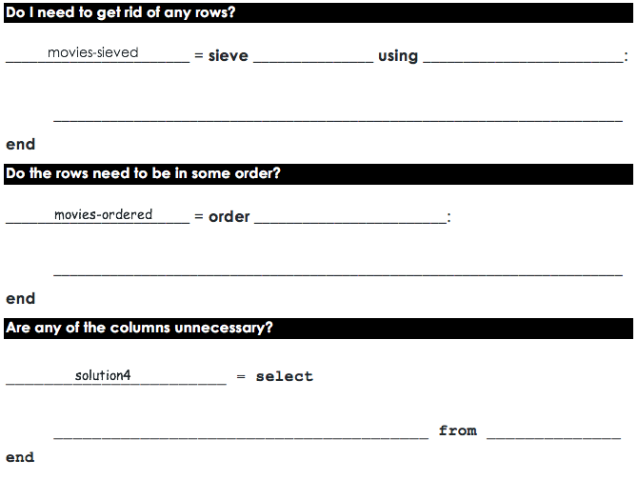
Page 32: Recent Title & Year
Movie Title | Studio | Total | Domestic | Overseas | Year
Interstellar | Par. | 675.1 | 188 | 487.1 | 2014
The Sixth Sense | BV | 672.8 | 293.5 | 379.3 | 1999
Man of Steel | WB | 668 | 291 | 377 | 2013
Kung Fu Panda 2 | P/DW | 665.7 | 165.2 | 500.4 | 2011
Ice Age: The Meltdown | Fox | 660.9 | 195.3 | 465.6 | 2006
Title | Year
Interstellar | 2014
Man of Steel | 2013
Kung Fu Panda 2 | 2011
movies-sieved
movies
year
year > 2011
movies-ordered
total descending
title, year

Slide 98
Page 33: Title and Overseas
Movie Title | Studio | Total | Domestic | Overseas | Year
Interstellar | Par. | 675.1 | 188 | 487.1 | 2014
The Sixth Sense | BV | 672.8 | 293.5 | 379.3 | 1999
Man of Steel | WB | 668 | 291 | 377 | 2013
Kung Fu Panda 2 | P/DW | 665.7 | 165.2 | 500.4 | 2011
Ice Age: The Meltdown | Fox | 660.9 | 195.3 | 465.6 | 2006
Title | Overseas
Ice Age: The Meltdown | 465.6
The Sixth Sense | 379.2
movies-sieved
movies
year
year < 2010
movies-ordered
total asending
title, overseas

Slide 99
Choosing Start/End Tables
Up to now, every Table Plan you’ve seen has included pre-written Start and End tables. Why?
Now it’s time for you to start choose these tables yourself! A good start table has several qualities:
  Includes all relevant columns
  Includes rows that will be sieved (both true and false)
  Includes enough rows to show random ordering
  Is properly representative of the entire dataset
The Austerity Problem
Turn to Page 34

Slide 100
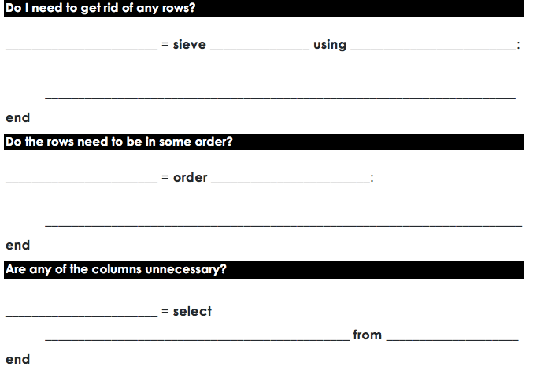
Page 35: Asian GDPs
countries-sieved
countries-sieved
countries
countries-sieved
continent
continent == “asia”
countries-ordered
gdp ascending
countries-selected
country, gdp
Open the Syntax Error file, and debug these queries!

Slide 101
Back to the Do Now
“How much of Asia’s GDP does China generate?”
- Write your findings on Page 30

Slide 102
Unit 9

Slide 103
Do Now
“Is GDP-per-capita positively correlated with life-expectancy?”
- Write your hypothesis on Page 36
Notes:
Discuss – get volunteers.

Slide 104
Easy, right? Well…
Our countries table has total GDP
But all things being equal, larger countries will always have more total GDP.
We need per-capita GDP. How can we calculate this?
We need a way to extend tables, with new columns!
Turn to Page 37…
per-capita-gdp = gdp × population

Slide 105
extend queries
Open the Unit 9 Starter File, Save a Copy, and click Run
What does basketball evaluate to?
What does basketball-extended evaluate to?

Slide 106
The extend query
table operator
dataset
keyword
column arguments
colon
extend basketball using game1,game2,game3 :
total: game1 + game2 + game3
end
query body
keyword
Take notes on Page 45
Open the Syntax Error file, and debug these queries

Slide 107
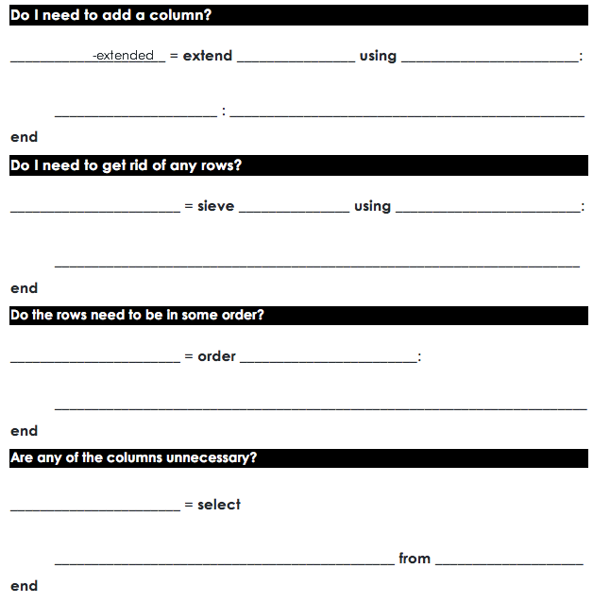
Page 38: body building
nutrition-extended
nutrition
protein, serving-size
protein-per-gram : sodium / serving-size
nutrition-ordered
nutrition-extended
protien-per-gram ascending
nutrition-selected
food, calories, protein-per-gram
nutrition-ordered

Slide 108
Page 39: term length
presidents-extended
presidents
year-started, year-ended
term-length year-ended – year-started

Slide 109
Page 40: gdp v. population
countries-extended
countries
gdp, population
per-capita-gdp gdp / population
countries-sieved
countries-extended
continent
continent == “africa”

Slide 110
Final Project
Open your Final Project Files (code and report)
Finish the remaining question(s)!
Don’t forget to copy/paste any new charts or graphs you create.

Slide 111



Algebra
Bootstrap:Algebra applies algebraic
concepts and rigorous programming
principles to creating a simple
videogame. Students use order of
operations, function composition, the
distance formula, coordinates and inequalities in the plane to detect collisions, handle keystrokes, and determine how they move and interact – with each challenge framed as a standard word-problem. The module is aligned to National & State Standards for Mathematics, the CSTA standards and K12CS frameworks, and has been shown to improve students’ performance on standards algebraic tasks*.
DataScience
Which artist do you listen to most? Do
schools in richer areas of your town do
better than those in poorer ones? What’s
the healthiest cuisine? Our Data Science
module teaches students to view
programs as questions we ask of data. Students form their own questions about the world around them, and learn to analyze data critically and carefully to find answers. Business, science, and history teachers can utilize this module to help students make inferences from data. Math teachers can use this module to introduce statistics in an accessible way. It also works great as a module for AP CS Principles’ unit on data!
Physics
This module is developed in partnership
with the American Association of Physics
Teachers & American Modeling Teachers
Association. It helps students understand
dynamics concepts by using
programming to build models of the
physical world. The module is targeted at ninth grade, a year in which every student is expected to take science. The module is aligned to the Physics First movement, allowing teachers to present computational modeling as a basic tool to students preparing to study science more broadly.
Reactive
Bootstrap:Reactive goes deeper into
programming, building events and data
structures on top of the foundation laid by
our intro courses and allowing students to
build far more sophisticated programs.
Students learn how the event loop that drives their Bootstrap:Algebra game works, and use it to create animations using simple datatypes. They then learn about data structures, and design a structure for a sophisticated game of their own design. Bootstrap:Reactive is aligned to the CSTA standards and K12CS frameworks.
Notes:
This is just one part of a multi-facet pathway that we at Bootstrap have created. Bootstrap:Physics allows your physics teacher to integrate computing into a standard HS Physics class, and Bootstrap:Reactive allows your students to go deeper into CS by building on – rather than throwing away – what they’ve learned. But there’s also a new trend in CS, which is taking over universities and the corporate world: Data Science. Here are just a few screenshots of major institutions that are pushing for Data Science. And now…Bootstrap is offering an introductory Data Science module for middle or high school, which requires no computing background!

Slide 112


Connect with Us!
/ BootstrapWorld
@BootstrapWorld
Questions:
bit.ly/BootstrapHelp
Grab a photo!

Slide 113
We’d like your feedback!

